Slide 1
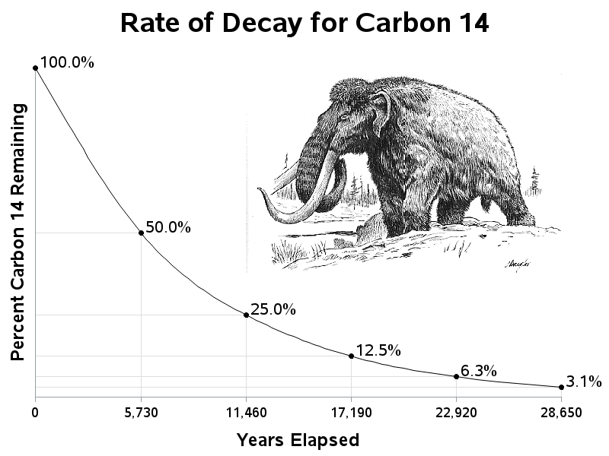
Warm Up: 5/9/16
1. What is the ½ life for carbon 14?
2. If you have 25% of the carbon remaining, how many years have gone by?

Slide 2
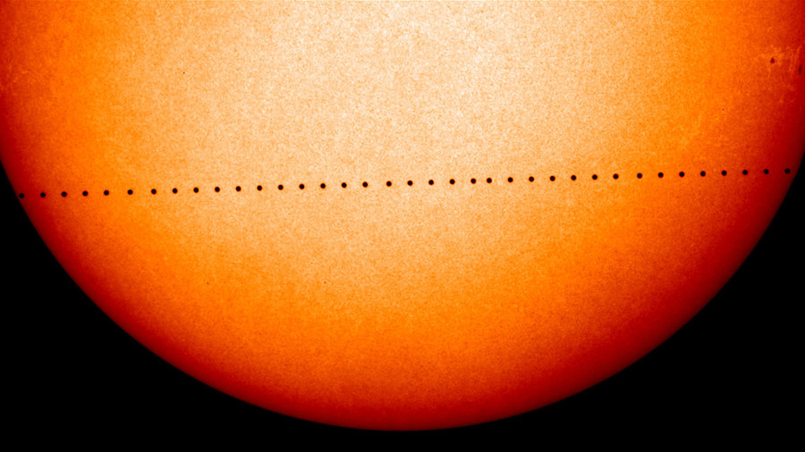
This is happening today! What is it? When will it happen again?

Slide 3
Reminders
Reading Quiz tomorrow (cricket article I handed out)
Test is on Thursday
Study guide passed out tomorrow in class

Slide 4
Whale Hunt
Scientists theorize that today’s modern whales once had land-dwelling ancestors. Whales are mammals that have lungs to breathe air and mammary glands to feed their young. In addition, many whale species still have remnants of tiny hind-legs inside of their bodies, underneath their blubber. These are known as vestigial structures. Fossil evidence of their ancestors has been accumulated through many years of discovery. In this activity, you’ll learn about those discoveries and piece together the information to demonstrate the transition of whale anatomy through time.
Hint: The order is the order that it was found in, not through time!

Slide 5
Great Transformations: 4:12 till min 17
http://www.youtube.com/watch?v=HhhgPCPD4zc
As the documentary progresses, write down each piece of information that scientists have for whale evolution.

Slide 6
Reading Quiz

Slide 7
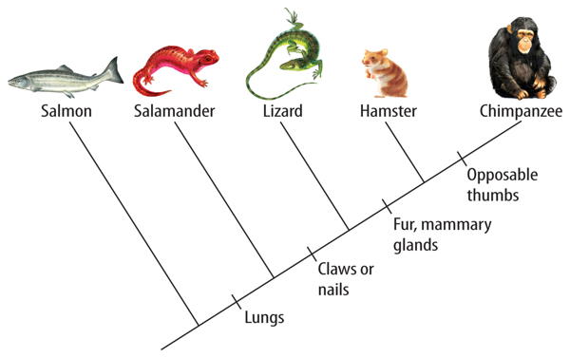
5/10/16 Warm Up:
What characteristic separates hamsters and chimpanzees?
What characteristic do salamanders, lizards, hamsters and chimpanzees share?

Slide 8
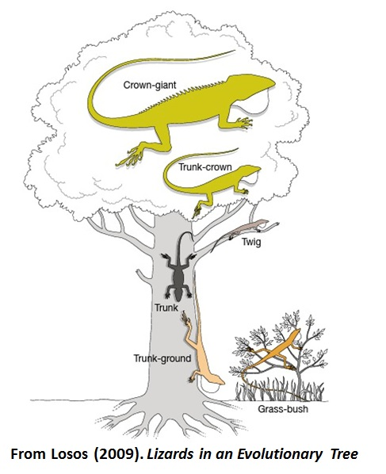
Evolution in Action
Anole Lizards in the Caribbean
On different islands there are different anoles living in different environments:
Grassland vs. Twigs vs. Canopy
Do the lizards on twigs all share a common ancestor?

Slide 9
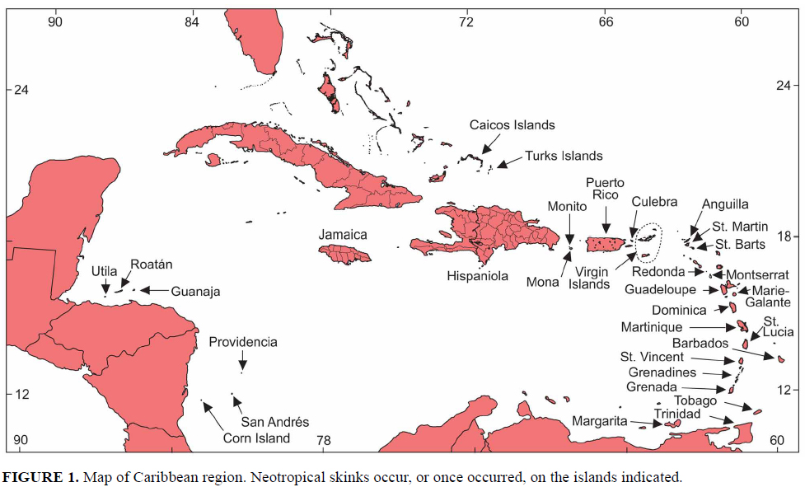

Slide 10
Evolution in Action
Do the lizards on twigs all share a common ancestor?
Nope!
DNA data shows that lizards on the same island are more closely related then lizards on different islands are more closely related then lizards from different islands in the same habitat type.

Slide 11
Convergent Evolution
Convergent evolution is the process whereby unrelated organisms independently evolve similar traits. Natural selection favors certain traits based on the part of the ecosystem they are found in.

Slide 12
Divergent Evolution
Divergent Evolution descendants of a single ancestor diversify into species that each fit different parts of the ecosystem.
-Common ancestor on each island, lizards then diverged on the island into new species.

Slide 13
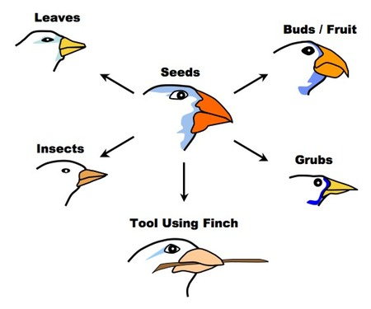
Adaptive Radiation
Adaptive radiation is a process in which organisms diversify rapidly into a multitude of new forms

Slide 14
Anole Lizard Film
http://www.hhmi.org/biointeractive/origin-species-lizards-evolutionary-tree

Slide 15
Evidence for Evolution
Fossils
Comparative Anatomy
Molecular Evidence

Slide 16
Evidence for Evolution
Fossils
Comparative Anatomy
Molecular Evidence

Slide 17
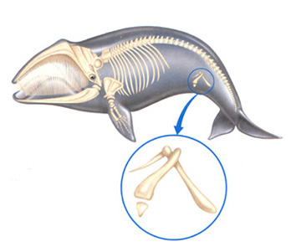
Comparative Anatomy:
Vestigial Structures: remnants of features that served a function in the organism ancestors
In Humans:
-Tailbone
-Appendix
In other Animals:
-eye sockets in eyeless fish
-small wings on flightless birds
-remnant limb bones in snakes

Slide 18
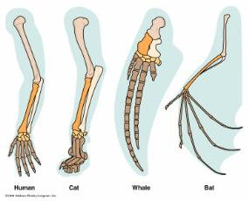
Comparative Anatomy:
Homologous Structures: variations on a structural theme that was present in their common ancestor.

Slide 19
Comparative Anatomy:
Homologous Structures: variations on a structural theme that was present in their common ancestor.
Convergent or divergent evolution?

Slide 20
Comparative Anatomy:
Analogous Structure:
Closely related functions but do not derive from the same ancestral structure

Slide 21
Comparative Anatomy:
Analogous Structure:
Closely related functions but do not derive from the same ancestral structure
Convergent or divergent evolution?

Slide 22
Coloring Sheet to Start Review and Study Guide

