Slide 1
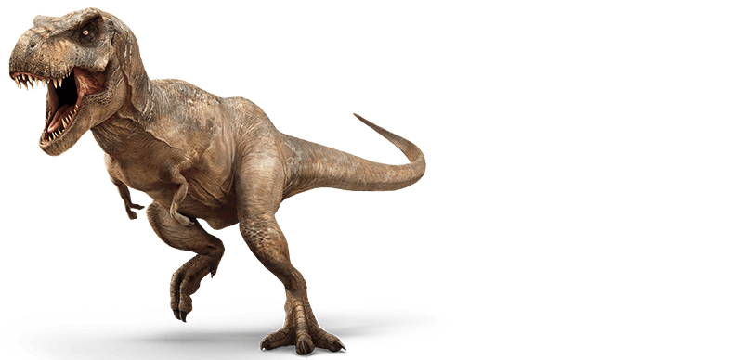
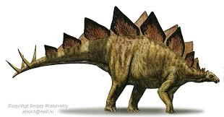
5/4/16 Warm Up:
What is geologic time?
What is the importance of fossils in evolution?
Did tyrannosaurus rex live closer in time to a stegosaurus or to a Katy Perry concert?

Slide 2
Reading Quiz Next Tuesday
Hand Out, already posted on website

Slide 3
Cladograms/ Phylogenetic Trees

Slide 4
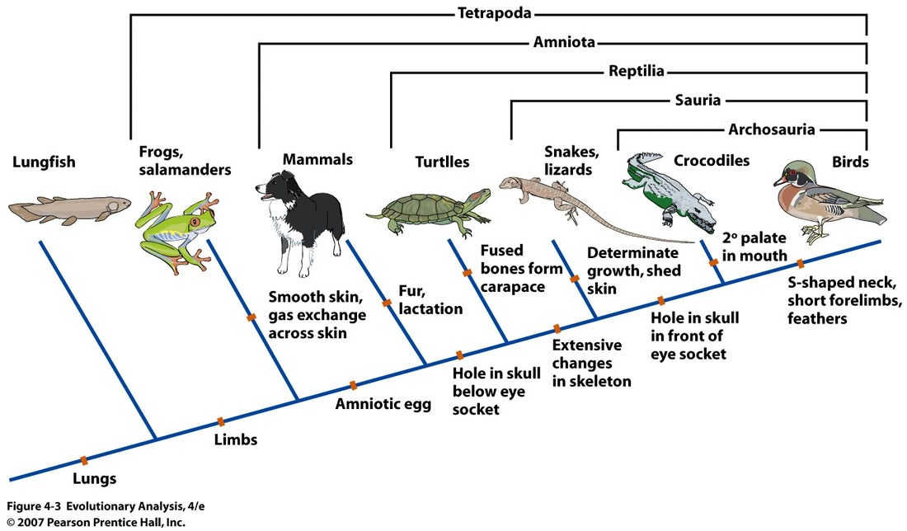
Cladograms

Slide 5
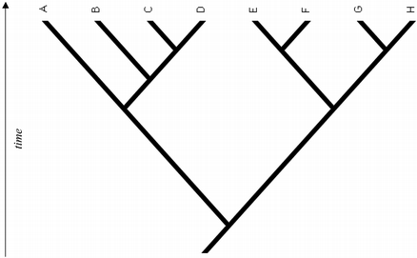
4
6
2
15
20
25
40

Slide 6
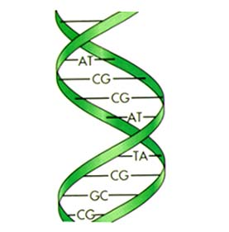
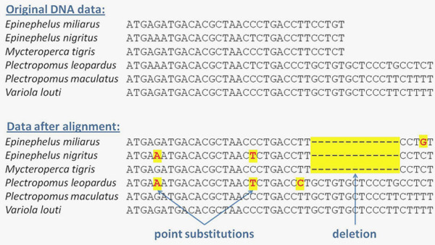
DNA Comparisons

Slide 7
Species name |  | DNA differences between the two species compared
C.d. | U | 8
C.t. | P | 46
P | D | 32
P | C.d. | 21

Slide 8
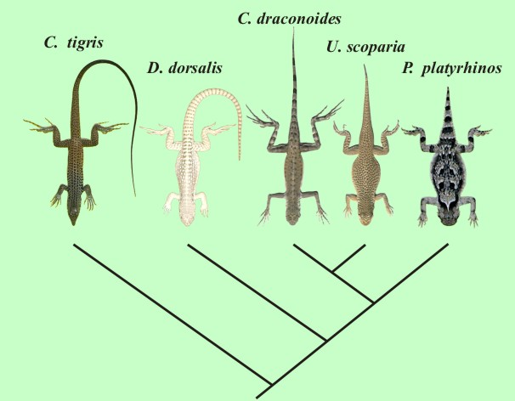
Example of Arizona Desert Lizards
Cd
Ct
U
D
P
8
21
32
46

Slide 9
Species name |  | DNA differences between the two species compared
Heirra (H) | Gome (G) | 4
Gome (G) | Tenera (T) | 19
Palm (P) | Tenera (T) | 8
Stelini (S) | Tenera (T) | 23
Atlantica (A) | Stelini (S) | 36

Slide 10
Genetic Phylogenetic Tree
Stelini
Gome
Tenera
Atlantica
Hierra
Palm
4
8
19
23
36

Slide 11
Horse Fossils in Packet
Top part is relative dating
Phylogenetic Tree Handout, staple to Packet
Do not do #4 “what traits do the above four organisms share?

Slide 12
Notes: Dating Methods

Slide 13
Notes: Dating Methods
1. Relative Dating: Estimated age
Using the order of the layers to estimate the age of any fossils in the rock.
2. Radioactive (Absolute) Dating: Exact age
Using the steady decay of elements to get the exact age of fossils or rock.

Slide 14
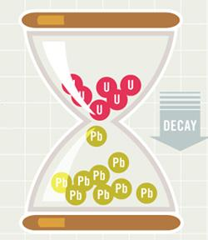
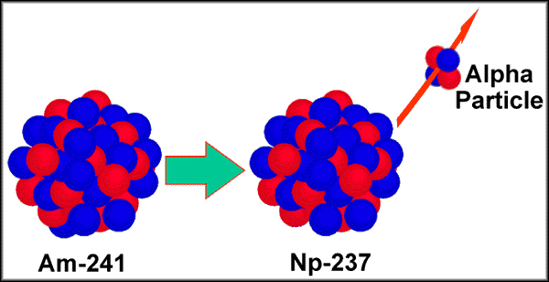
How does Radioactive Dating work?
1. Rocks contain unstable elements that release parts of their nucleus at a steady rate (like an hourglass loses sand at a steady rate).
2. When elements lose part of their nucleus, they turn into different elements. (Example: Uranium turns to Lead)
3. Scientists measure the amount of the parent element left in a rock to determine the age.

Slide 15
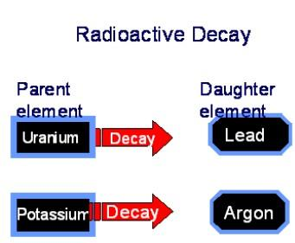
Half-life
Half-life: the amount of time it takes for half of the element to decay into a different element.
Example: It takes 704 million years for HALF of Uranium to decay into Lead!!!!
If a rock contains 50% uranium and 50% lead, how old is the rock?

Slide 16
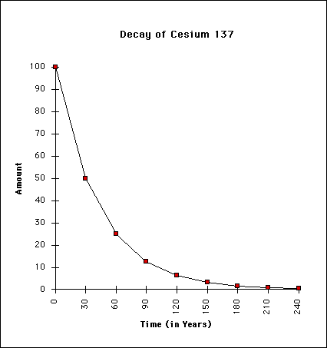
Practice with radioactive Cesium
1. How many half-lives are represented in the graph?
2. What is the half-life of this element?
3. A rock has 10% Cesium-137. How old is the rock?

Slide 17
Dating Advice from Science!!!
Do not eat the M&M’s they have been handled by
LOTS – O – Students! (gross)
Make sure that if you have no M&Ms with the “m” pointing up, record the same number twice in the box!

