Slide 1
Reading Quiz! Get your Reading Outline Out

Slide 2
Warm Up 5/3/16 1. Define a gene pool. 2. What is speciation?

Slide 3
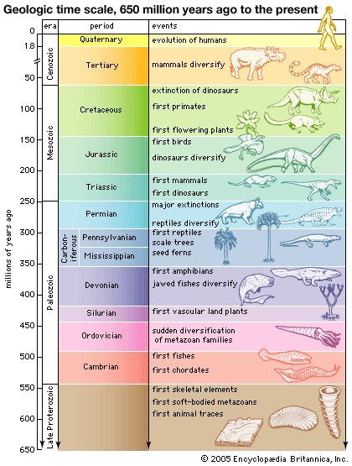
Life's History
Geologic Time Scale - a system of chronological measurement that relates stratigraphy to time, describes the timing and relationships between events that have occurred throughout Earth's history.

Slide 4
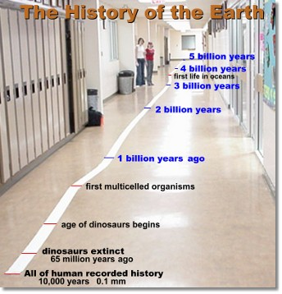

Slide 5
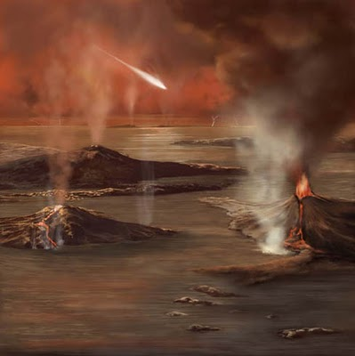
Precambrian: 88% of geologic time, Bacteria and soft body organisms

Slide 6
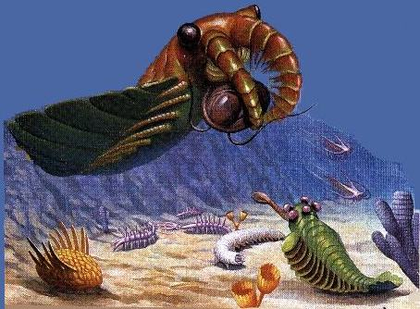
Cambrian Life: First Fishes and Chordates

Slide 7
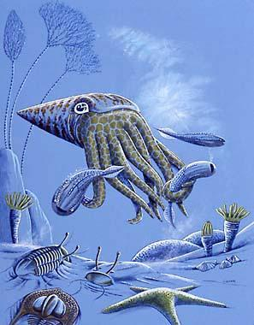
Ordovician Life: Lots of mollusks no life on land yet!

Slide 8
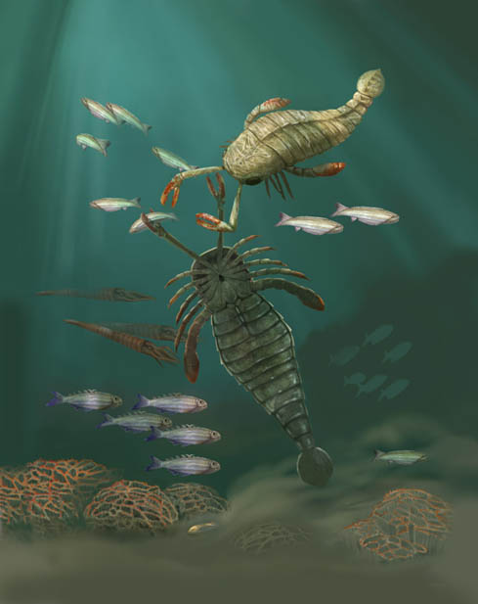
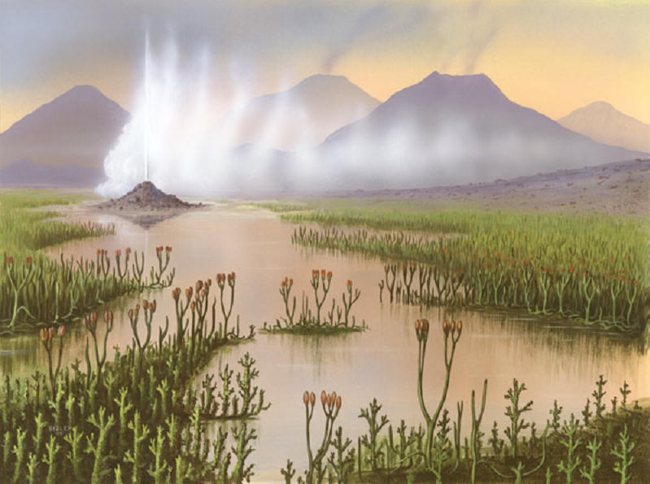
Silurian Life: First moss like plants…

Slide 9
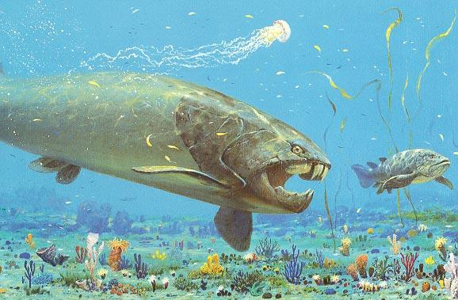
Devonian Life: Age of the fishes (with jaws)! First amphibians!

Slide 10
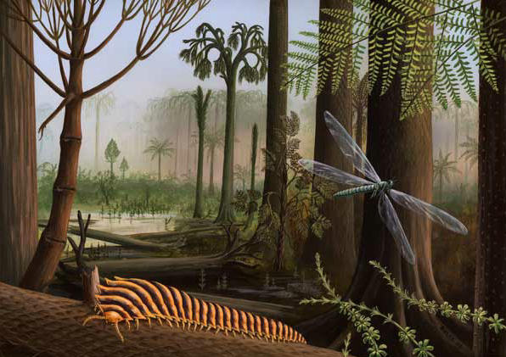
Carboniferous Life: Forest life!

Slide 11
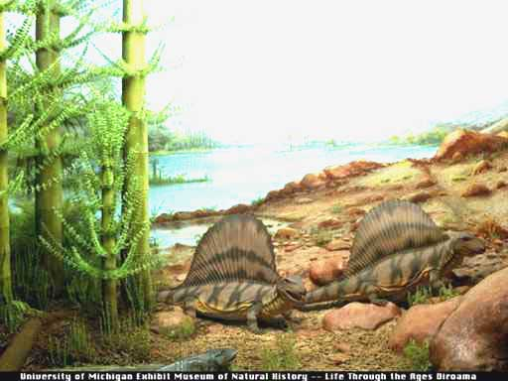
Permian Life: Amniotes

Slide 12
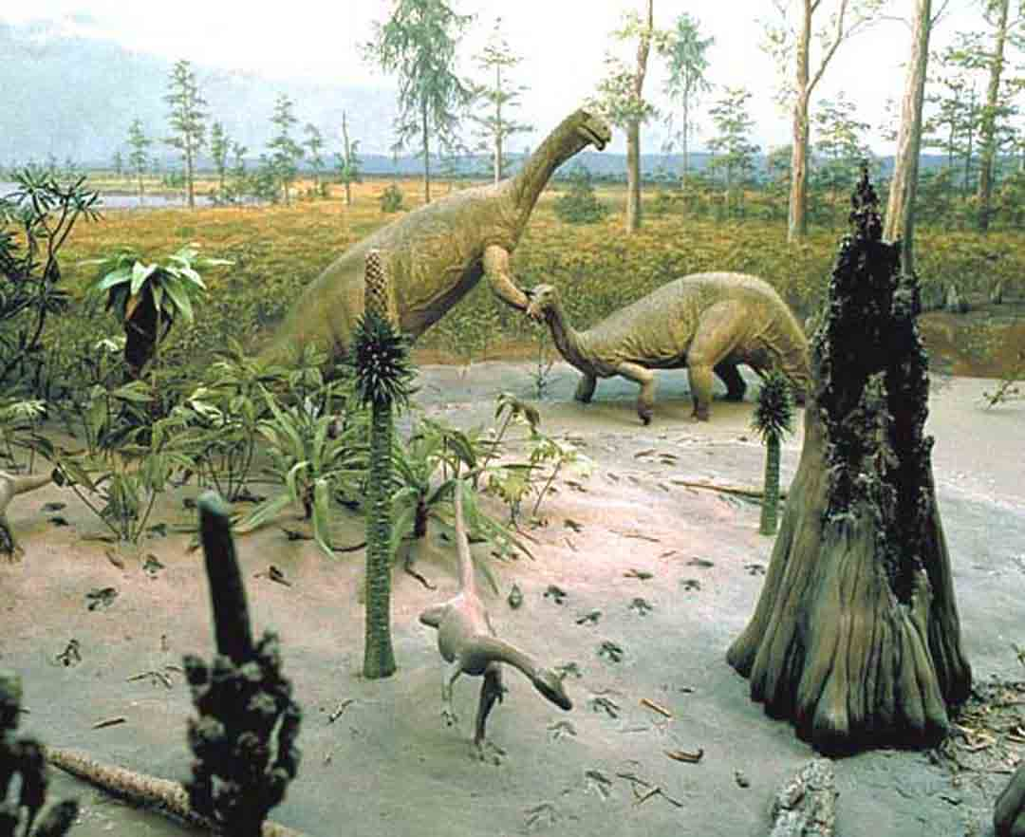
Triassic Life: Dinosaurs!

Slide 13
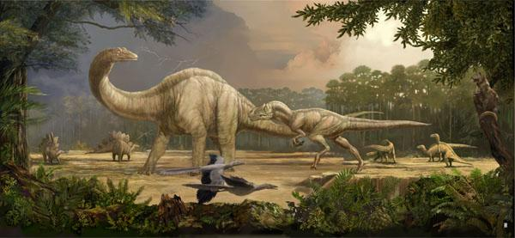
Jurassic Life: More Dinosaurs

Slide 14
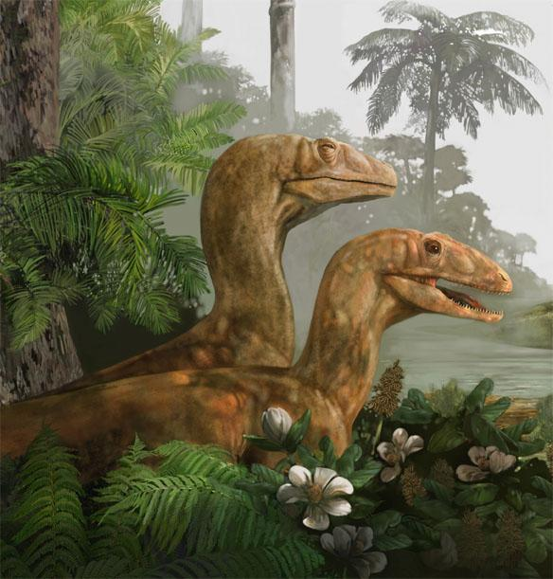
Cretaceous Life: More dinosaurs

Slide 15
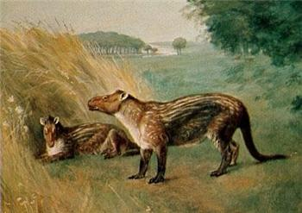
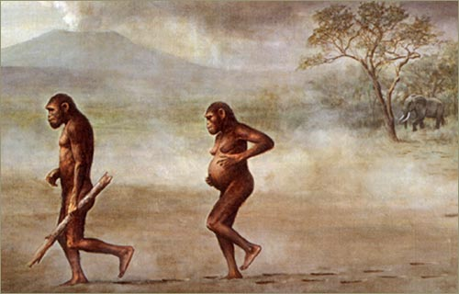
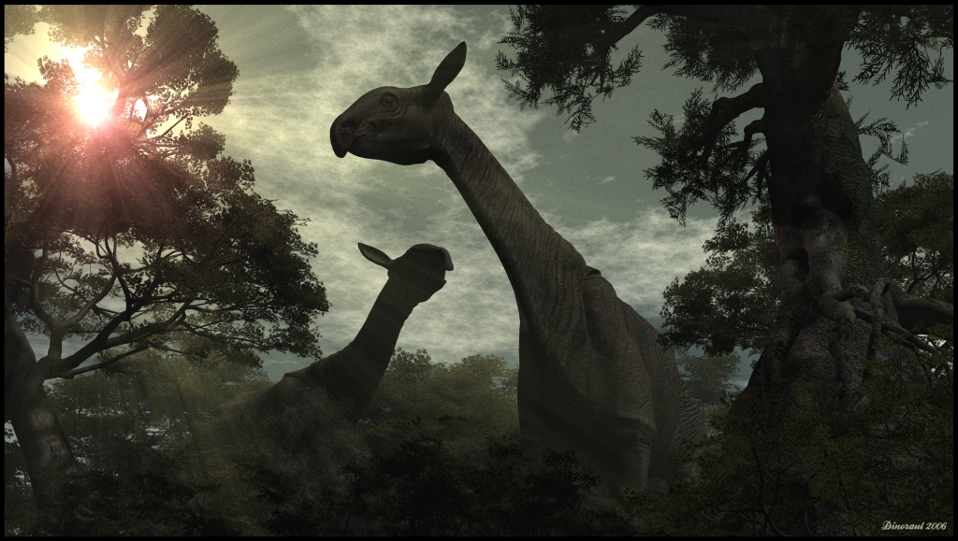
Tertiary

Slide 16
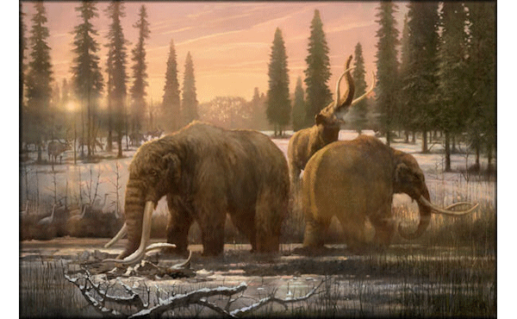
Quaternary

Slide 17
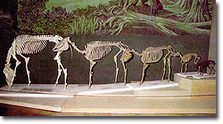
Fossils
Fossils - The remains of organisms that lived long ago.
Significance of Fossils - Evidence that natural selection has been occurring for a long time.
Small genetic changes can eventually add up to big genetic changes.

Slide 18
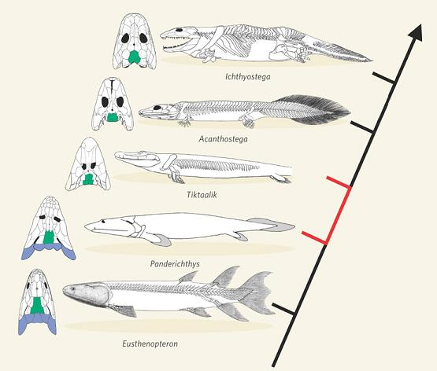
Transitional Fossils
Transitional Fossils: fossils that show an evolutionary transition between species through time.

Slide 19
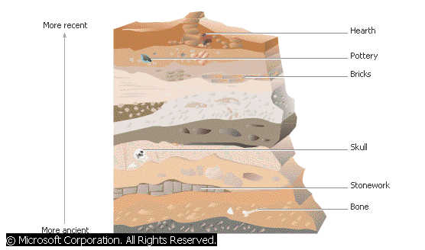
Relative Dating of Fossils
Law of Superposition - Sediments and rocks pile on top of each other over time.
Younger - top.
Older - bottom.
Relative Dating - Using the order of the layers to estimate the age of any fossils in the rock.

Slide 20
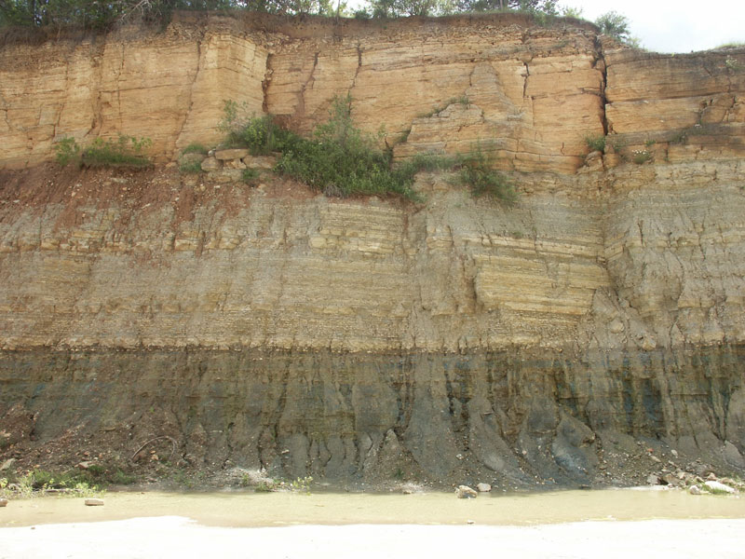

Slide 21
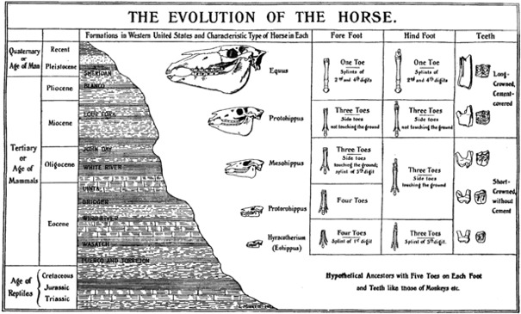
Relative Dating

Slide 22
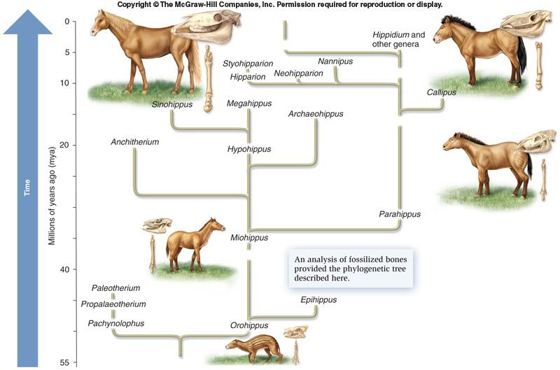
Horse Phylogeny

Slide 23
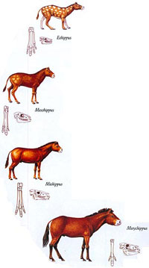
Speciation occurred over millions of years!
56 million years ago (mya)

Slide 24
Trilobite Fossils Through Time Read through and answer the prelab questions

Slide 25
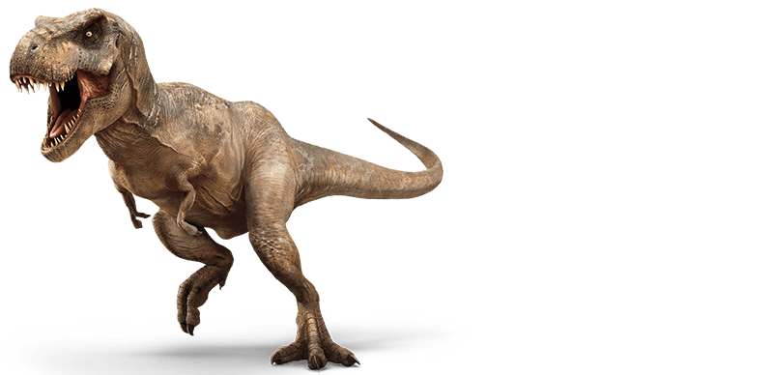
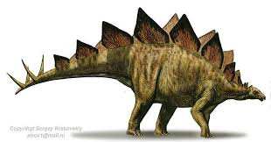
5/4/16 Warm Up:
What is geologic time?
What is the importance of fossils in evolution?
Did tyrannosaurus rex live closer in time to a stegosaurus or to a Katy Perry concert?

Slide 26
Reading Quiz Next Tuesday
Hand Out, already posted on website

Slide 27
Cladograms/ Phylogenetic Trees

Slide 28
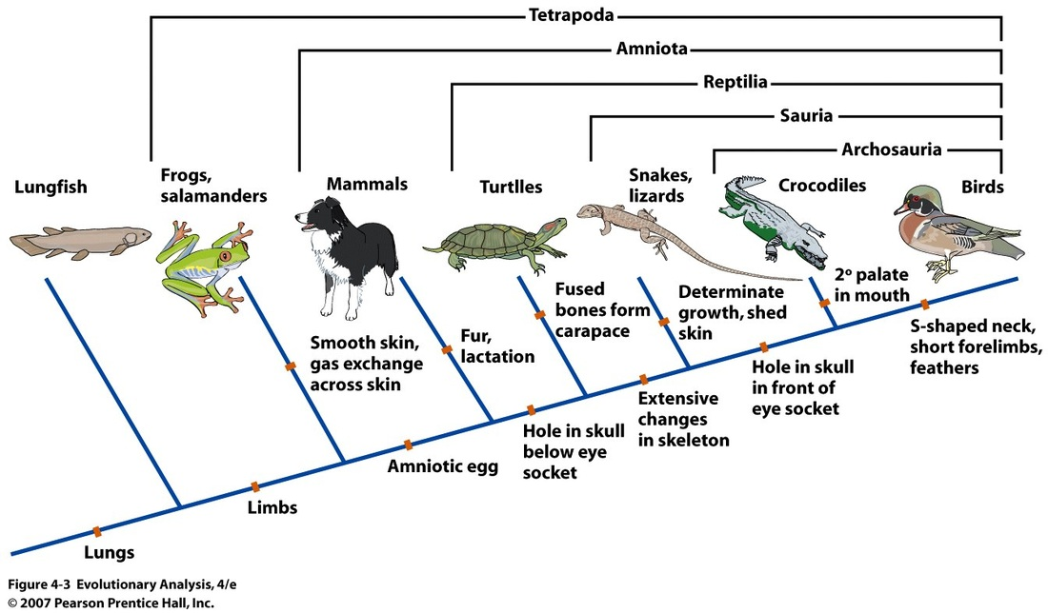
Cladograms

Slide 29
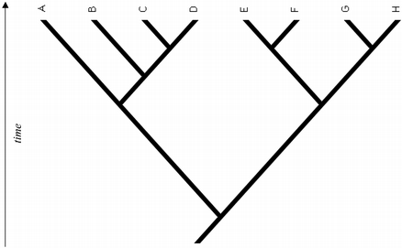
4
6
2
15
20
25
40

Slide 30
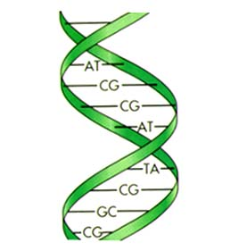
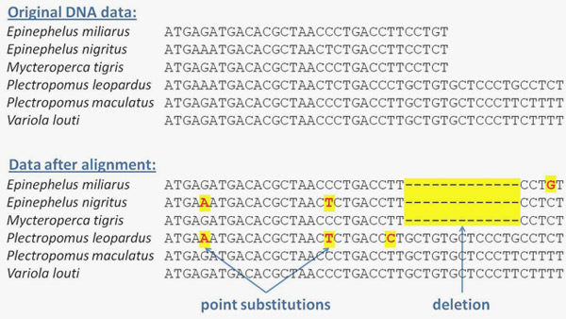
DNA Comparisons

Slide 31
Species name |  | DNA differences between the two species compared
C.d. | U | 8
C.t. | P | 46
P | D | 32
P | C.d. | 21

Slide 32
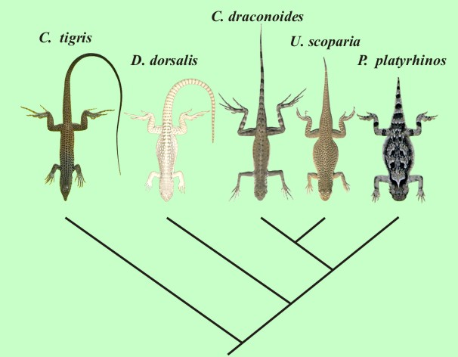
Example of Arizona Desert Lizards
Cd
Ct
U
D
P
8
21
32
46

Slide 33
Species name |  | DNA differences between the two species compared
Heirra (H) | Gome (G) | 4
Gome (G) | Tenera (T) | 19
Palm (P) | Tenera (T) | 8
Stelini (S) | Tenera (T) | 23
Atlantica (A) | Stelini (S) | 36

Slide 34
Genetic Phylogenetic Tree
Stelini
Gome
Tenera
Atlantica
Hierra
Palm
4
8
19
23
36

Slide 35
Horse Fossils in Packet
Top part is relative dating
Phylogenetic Tree Handout, staple to Packet
Do not do #4 “what traits do the above four organisms share?

Slide 36
Notes: Dating Methods

Slide 37
Notes: Dating Methods
1. Relative Dating: Estimated age
Using the order of the layers to estimate the age of any fossils in the rock.
2. Radioactive (Absolute) Dating: Exact age
Using the steady decay of elements to get the exact age of fossils or rock.

Slide 38
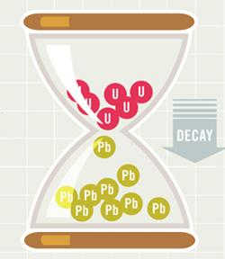
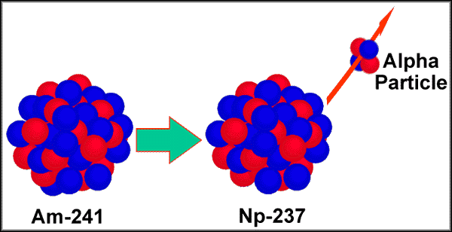
How does Radioactive Dating work?
1. Rocks contain unstable elements that release parts of their nucleus at a steady rate (like an hourglass loses sand at a steady rate).
2. When elements lose part of their nucleus, they turn into different elements. (Example: Uranium turns to Lead)
3. Scientists measure the amount of the parent element left in a rock to determine the age.

Slide 39
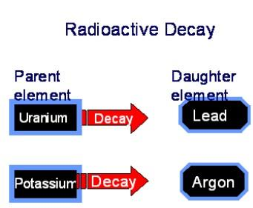
Half-life
Half-life: the amount of time it takes for half of the element to decay into a different element.
Example: It takes 704 million years for HALF of Uranium to decay into Lead!!!!
If a rock contains 50% uranium and 50% lead, how old is the rock?

Slide 40
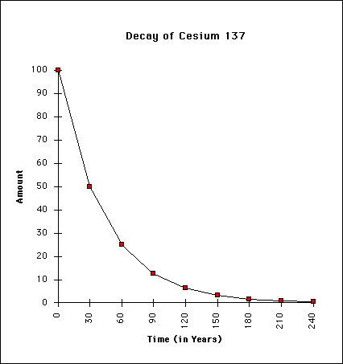
Practice with radioactive Cesium
1. How many half-lives are represented in the graph?
2. What is the half-life of this element?
3. A rock has 10% Cesium-137. How old is the rock?

Slide 41
Dating Advice from Science!!!
Do not eat the M&M’s they have been handled by
LOTS – O – Students! (gross)
Make sure that if you have no M&Ms with the “m” pointing up, record the same number twice in the box!

