Slide 1
Reading Quiz

Slide 2
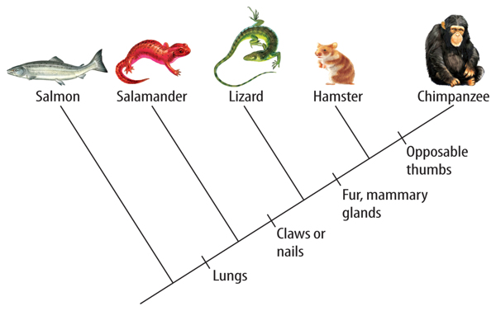
5/10/16 Warm Up:
What characteristic separates hamsters and chimpanzees?
What characteristic do salamanders, lizards, hamsters and chimpanzees share?

Slide 3
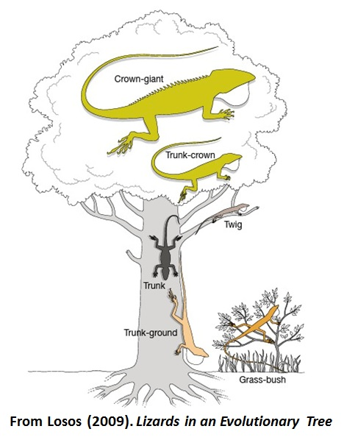
Evolution in Action
Anole Lizards in the Caribbean
On different islands there are different anoles living in different environments:
Grassland vs. Twigs vs. Canopy
Do the lizards on twigs all share a common ancestor?

Slide 4
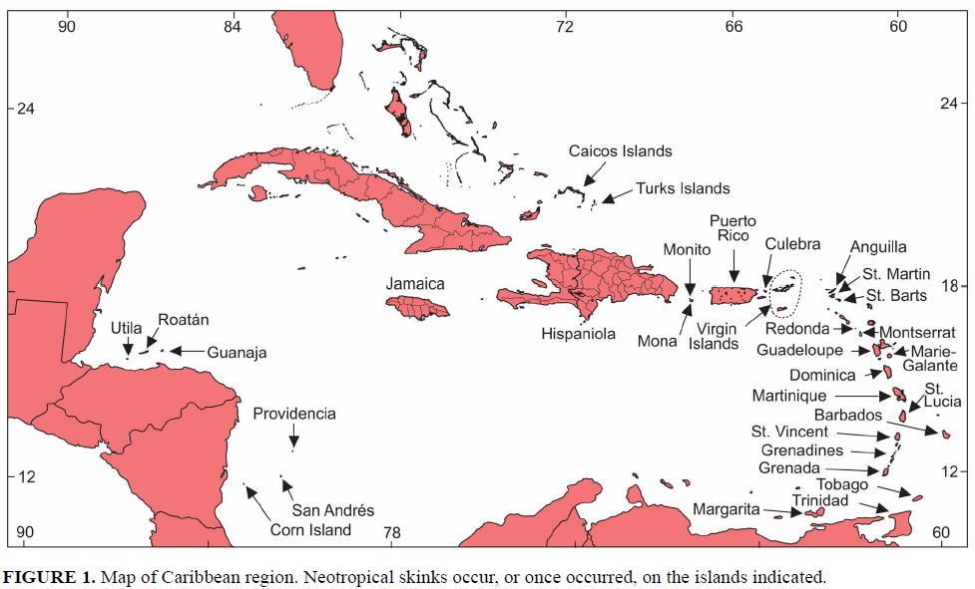

Slide 5
Evolution in Action
Do the lizards on twigs all share a common ancestor?
Nope!
DNA data shows that lizards on the same island are more closely related then lizards on different islands are more closely related then lizards from different islands in the same habitat type.

Slide 6
Convergent Evolution
Convergent evolution is the process whereby unrelated organisms independently evolve similar traits. Natural selection favors certain traits based on the part of the ecosystem they are found in.

Slide 7
Divergent Evolution
Divergent Evolution descendants of a single ancestor diversify into species that each fit different parts of the ecosystem.
-Common ancestor on each island, lizards then diverged on the island into new species.

Slide 8
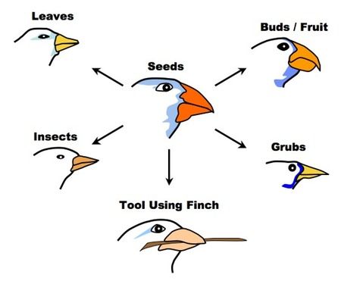
Adaptive Radiation
Adaptive radiation is a process in which organisms diversify rapidly into a multitude of new forms

Slide 9
Anole Lizard Film
http://www.hhmi.org/biointeractive/origin-species-lizards-evolutionary-tree

Slide 10
Evidence for Evolution
Fossils
Comparative Anatomy
Molecular Evidence

Slide 11
Evidence for Evolution
Fossils
Comparative Anatomy
Molecular Evidence

Slide 12
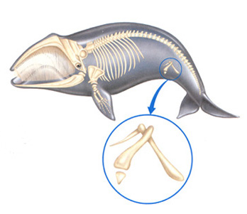
Comparative Anatomy:
Vestigial Structures: remnants of features that served a function in the organism ancestors
In Humans:
-Tailbone
-Appendix
In other Animals:
-eye sockets in eyeless fish
-small wings on flightless birds
-remnant limb bones in snakes

Slide 13
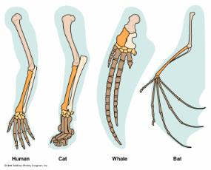
Comparative Anatomy:
Homologous Structures: variations on a structural theme that was present in their common ancestor.

Slide 14
Comparative Anatomy:
Homologous Structures: variations on a structural theme that was present in their common ancestor.
Convergent or divergent evolution?

Slide 15
Comparative Anatomy:
Analogous Structure:
Closely related functions but do not derive from the same ancestral structure

Slide 16
Comparative Anatomy:
Analogous Structure:
Closely related functions but do not derive from the same ancestral structure
Convergent or divergent evolution?

Slide 17
Coloring Sheet to Start Review and Study Guide

