Slide 1
4/5/16 Warm Up:
1. A cross between a blue blahblah bird & a white blahblah bird produces offspring that are silver. The color of blahblah birds is determined by just two alleles (use the letter A). a) What are the genotypes of the parent blahblah birds in the original cross? b) What is/are the genotype(s) of the silver offspring? c) What would be the phenotypic ratios of offspring produced by two silver blahblah birds?
Phyla project is due on June 2nd
If you have not yet taken the Cell Division Test or turned in your Cartoon you need to do so soon! Absolute final day is Thursday April 7th.

Slide 2
Step 1: Work on Incomplete and Codominance coloring (do not do sex linked yet, we have not covered that) For Blood Types use the following: O = Blue A = Green B = Yellow AB = Red When done: Work on Section I, II, V Problems

Slide 3
Sex-linked Traits

Slide 4
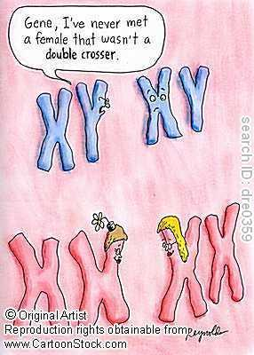
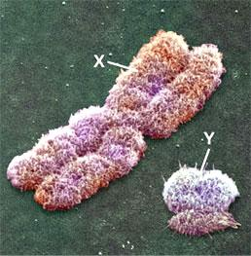
Sex Chromosomes
Two chromosomes - X and Y
• XX = Female
• XY = Male
The X chromosome has more traits because it is MUCH bigger than the Y

Slide 5
Inheritance of Sex
No matter what, there is always a 50/50 chance of male vs. female offspring.
Mom
X X
X
Y
XX XX
XY XY
Dad

Slide 6
Examples of Sex-linked Traits
Hemophilia (recessive X-linked) - Inability to form blood clots
Colorblindness (recessive X-linked) - Inability to tell red from green
Male Baldness (recessive X-linked) - Hair loss in adult males.

Slide 7
Steps for Sex-linked Punnetts
Put XX for mom, and XY for Dad
Put the allele letter on each X chromosome.
Complete Punnett.
STEP 1 STEP 2 STEP 3
X X
X
Y

Slide 8
Steps for Sex-linked Punnetts
Put XX for mom, and XY for Dad
Put the allele letter on each X chromosome.
Complete Punnett.
STEP 1 STEP 2 STEP 3
X X XB Xb XB Xb
X
Y
XB
Y
XB
Y

Slide 9
Steps for Sex-linked Punnetts
Put XX for mom, and XY for Dad
Put the allele letter on each X chromosome.
Complete Punnett.
STEP 1 STEP 2 STEP 3
X X XB Xb XB Xb
X
Y
XB
Y
XB
Y
XBXB XBXb
XBY XbY

Slide 10
Sex-linked example problem
A women who is a carrier for color blindness marries and man who is colorblind:
What is the chance they have a colorblind son?
What is the chance they have a colorblind daughter?
What is the chance their child will be a carrier?
Who does the son get colorblindness from - Mom or Dad?

Slide 11
Practice Problems
Coloring: Need a Red Colored Pencil
Practice Problems:
Then:
Section I
Section II
Section III
Section V

