Slide 1
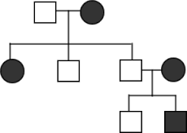
Warm Up 4/4/16
Copy the pedigree into your notebook.
Properly number the Pedigree.
The trait is dominant. Write out the genotype for each individual (use the letter “A”)

Slide 2
Step 1: Finish Pedigree Problems When done: Work on Section 1: Complete Dominance Problems You have 20 minutes

Slide 3
Complete Dominance
Involves dominant and recessive alleles
Dominant allele always expressed over the recessive allele

Slide 4
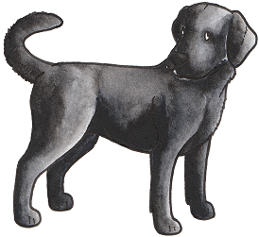
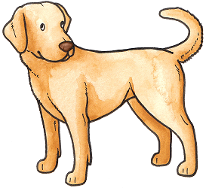
Complete Dominance
Involves dominant and recessive alleles
Dominant allele always expressed over the recessive allele
=
BB
bb

Slide 5
Complete Dominance
Involves dominant and recessive alleles
Dominant allele always expressed over the recessive allele
=
BB
bb
Bb

Slide 6
Answer the following questions in your notes section:
Black fur (B) in dogs is dominant over white fur (b).
Draw a Punnett square of the cross between: Bb x bb.
What is the probability that an offspring will be white?
What is the probability that an offspring will be black?
Bb
bb

Slide 7
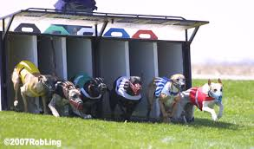
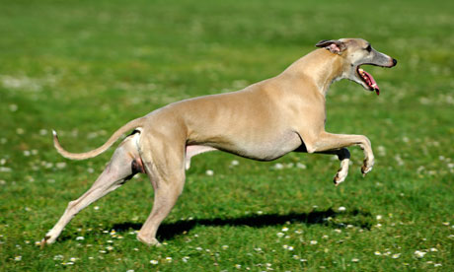
Moving on to Whippets:
http://www.animalplanet.com/tv-shows/animal-planet-presents/videos/most-outrageous-wendy-the-whippet.htm

Slide 8
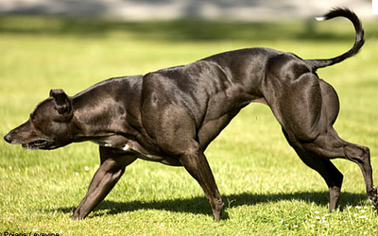
What is going on here?
Normal Whippet
‘bully’ Whippet

Slide 9
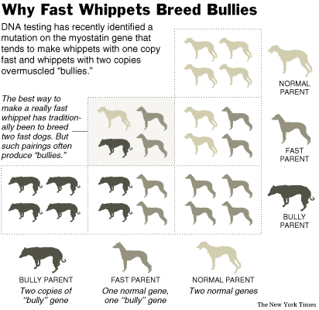
What are the genotypes of offspring?
Why does a bully parent and a normal parent produce a fast whippet? Why is it not a bully or normal whippet?

Slide 10
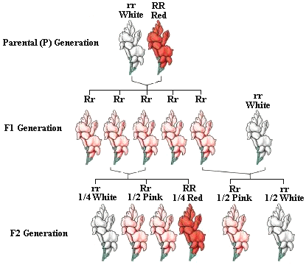
Incomplete Dominance, another example

Slide 11
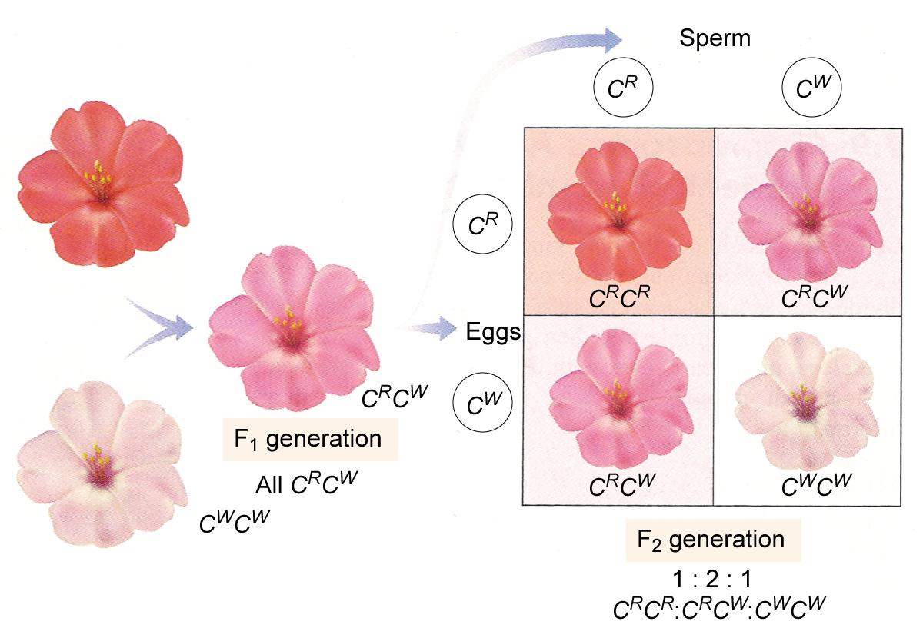
Incomplete Dominance
A condition in which a trait of an individual is intermediate between the phenotype of the two parents.

Slide 12
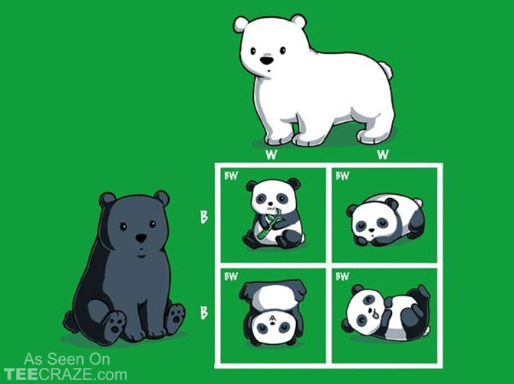
Co-Dominance
A condition in which both alleles for a gene are fully expressed.

Slide 13
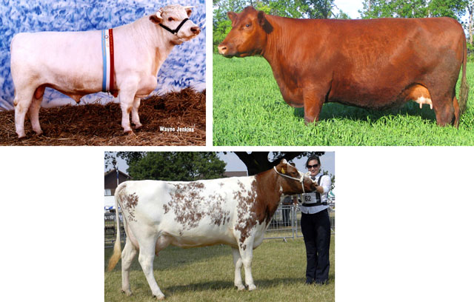
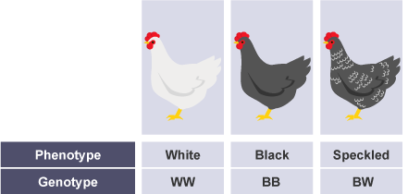
Co Dominance Examples:

Slide 14
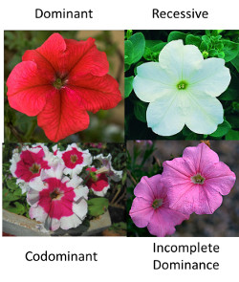

Slide 15
Blood Types
Blood types in humans are an example of codominance
A is dominant over O
B is dominant over O
A and B are Codominant

Slide 16
Amoeba Sisters
https://www.youtube.com/watch?v=9O5JQqlngFY

Slide 17
Blood Types
A couple has four kids, each with a different blood type:
Blood type O
Blood type A
Blood type B
Blood type AB…
How is this possible? What are the genotypes of the parents?

Slide 18
