Slide 1
Warm UP 4/28
According to the table below which lion is the most fit and why?
Name | George | Dwayne | Spot | Tyrone
Age at death | 13 years | 16 years | 12 years | 10 years
# cubs fathered | 19 | 25 | 20 | 20
# cubs surviving to reproductive adulthood | 15 | 14 | 14 | 19
Size | 10 feet | 8.5 feet | 9 feet | 9 feet

Slide 2
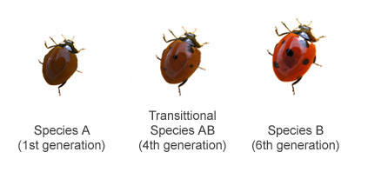
Speciation
As time progresses and organisms change, their genetics may become so different that they can no longer reproduce together. Thus, they become two different species.
Speciation - Changing from one species to another

Slide 3
Wait…what is a species?
Species: a group of organisms that are closely related and can mate to produce fertile offspring.

Slide 4
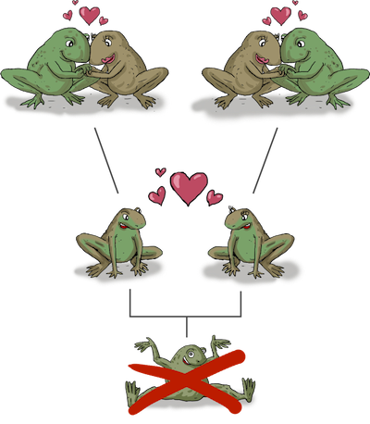

Slide 5
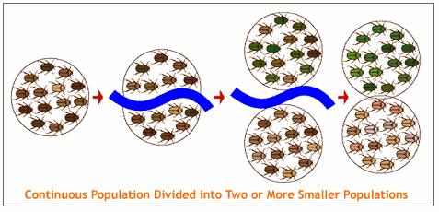
How does speciation occur?
Geographic Isolation – Physical separation of members of a population. Landmarks such as new rivers, lakes, islands, etc, form a barrier between two populations and they become reproductively isolated (separated).

Slide 6
Result: The two populations encounter different types of natural selection. Thus, one population can change drastically from the other in its new environment.

Slide 7
Allopatric Speciation
Allopatric: division of a population into two new populations by a physical barrier
Mountain formation
Islands
River

Slide 8
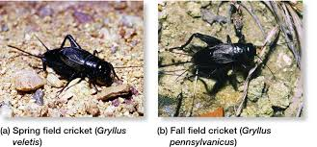
Reproductive Isolation: Barriers to successful breeding between population groups in the same area.

Slide 9
Sympatric Speciation
Sympatric: division of a population into two new populations at the same location

Slide 10
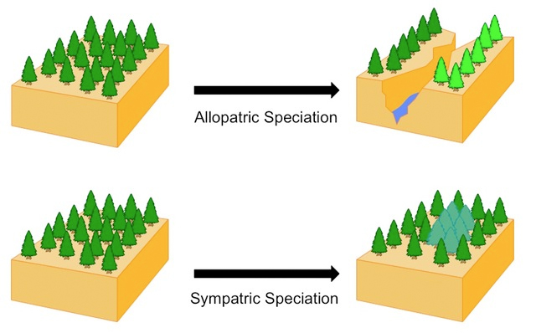

Slide 11
Rates of Speciation
Gradualism: Speciation occurs in regular, gradual rate
Punctuated Equilibrium: During most of the life time of a species there is no change—there is not a strong selective pressure, things are in “equilibrium”
Occasionally a dramatic environmental change “punctuates” this “equilibrium” and rapid speciation occurs

Slide 12
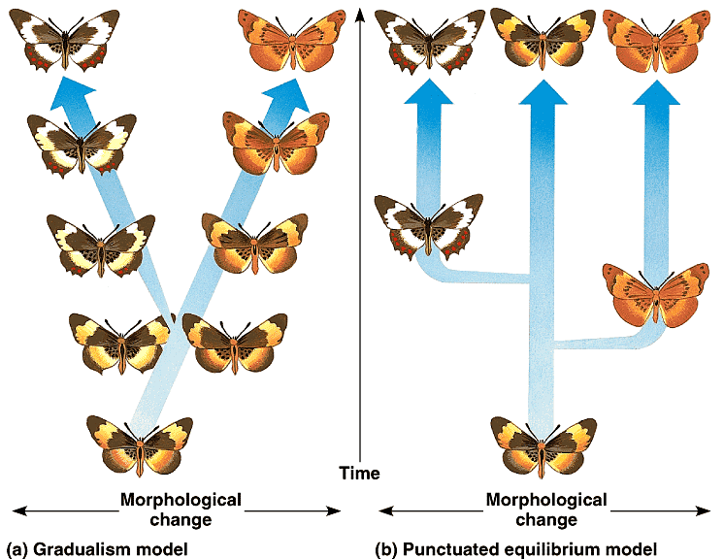

Slide 13
Speciation requires:
1. Time
Generations of genetic change
2. Different or Changing Environments
Adaptations to new environments are driven by selection
3. Reproductive Isolation
Two species become so genetically different, they cannot reproduce fertile offspring.

Slide 14
Speciation Jig Saw
Groups of up to 4 individuals
Silent Reading time for 7 minutes
Then ‘present’ the scenario to the group

Slide 15
Organisms | Type of separation? | Length of separation? | Do you think speciation occurred? | If no, given more time, could speciation occur? | Allopatric or Sympatric Speciation?
Spotted Owls
Fruit Flies
Three Spine Stickleback
Finches
Apple Maggots
What is speciation?
What evidence do we have to suggest that speciation has occurred in the past?

Slide 16
Think about the following: You do not need to write anything.
Did speciation occur?
If given more time, is it possible that speciation can occur?

Slide 17
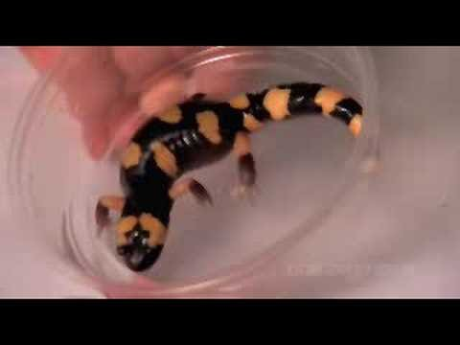

Slide 18
Think about the following: You do not need to write anything.
Did speciation occur?
If given more time, is it possible that speciation can occur?

