Slide 1
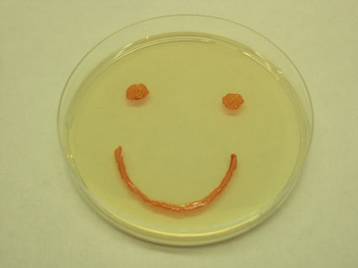
Antibiotic Resistant Bacteria: Natural Selection at Work

Slide 2
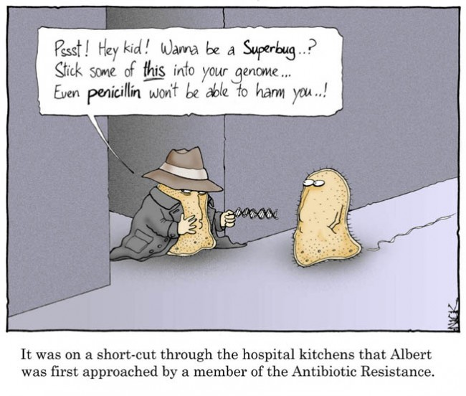
Antibiotic Resistance

Slide 3
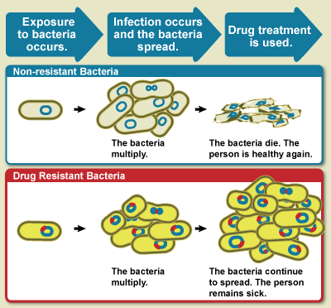
Antibacterial resistance is the ability of bacteria to grow in the presence of a chemical (drug) that would normally kill them or limit their growth.

Slide 4
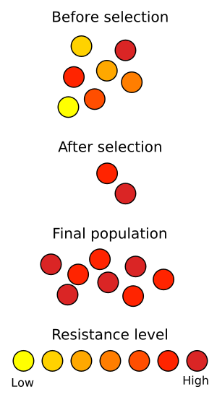
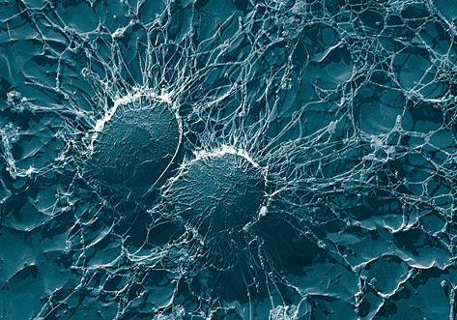
How does antibiotic resistance happen?
Staphylococcus
Natural Selection!
The antibiotic acts as an environmental pressure.
It weeds out those bacteria with low resistance and only those with high resistance survive to reproduce.
Notes:
Presenter notes: A final and perhaps especially convincing piece of evidence for evolution is the familiar way that bacteria may become resistant to antibiotics. Bacteria have a fast life cycle and can produce a new generation every 4 hours. As natural selection acts on each generation this means bacteria can rapidly respond to environmental pressures. In effect the antibiotics act to weed out those bacteria with low resistance in each generation. Only bacteria with high resistance survive and pass their alleles to the next generation. Consequently, in just a short time, natural selection increases the resistance level of the bacteria population. This is an example of evolution in action amongst the simplest organisms on our planet – and then having an impact on the most complex organisms!

Slide 6
Take antibiotics exactly as the doctor prescribes. Do not skip doses. Complete the prescribed course of treatment, even when you start feeling better.
Only take antibiotics prescribed for you; do not share or use leftover antibiotics. Antibiotics treat specific types of infections. Taking the wrong medicine may delay correct treatment and allow bacteria to multiply.
Do not save antibiotics for the next illness. Discard any leftover medication once the prescribed course of treatment is completed.
Do not ask for antibiotics when your doctor thinks you do not need them. Remember antibiotics have side effects.
Prevent infections by practicing good hand hygiene and getting recommended vaccines.

Slide 7
Ted Ed on Antibiotic Resistance
http://ed.ted.com/lessons/how-antibiotics-become-resistant-over-time-kevin-wu

Slide 8
In your science notebooks answer the following questions while watching the video (to 26:50)
https://www.youtube.com/watch?v=0zsWdW7eJ1M
What is the one “predator” that humans have left to fear?
How much faster than humans can bacteria reproduce?
Name 3 microorganisms that claimed huge populations of human life.
What chemicals are used by microorganisms to kill each other that humans have utilized? Give an example.
What is the new epidemic in the Russian prison systems?
What conditions lead to an active state of the above mentioned disease?
How can the disease spread through the prison?
How has Sasha’s strain of the disease evolved?
How have Russian prisons created ideal conditions for drug-resistant strains?
How is a drug-resistant infection treated?
How has the disease spread to outside the prison walls?
How can scientists track epidemic strains of bacteria?
Describe two causes of drug resistance.

Slide 9
Answer Question 14 in your science notebook: (Answer not found in Video )
14. What characteristics would you look for when designing a treatment to reduce drug-resistance?

