Slide 1
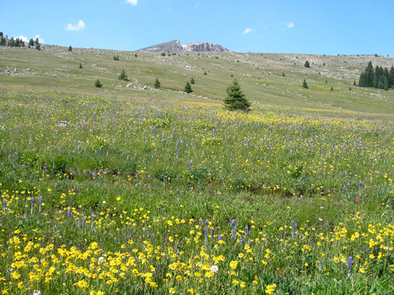
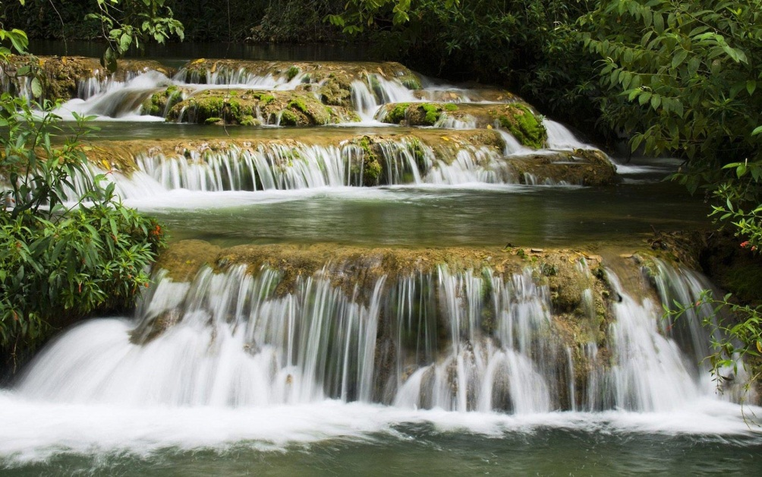
Warm Up 4/20
What adaptations would be useful in these environments?
Turn in your beast and get out packet for a stamp
Prairie
River

Slide 2
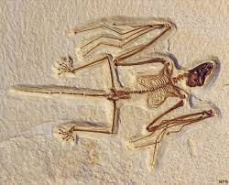
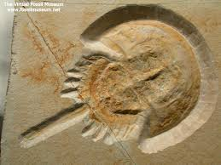
History of Evolutionary Thought Change through time….
It started with geology…
Cuvier (1769-1832) compiled evidence that the Earth was very different in the past.

Slide 3
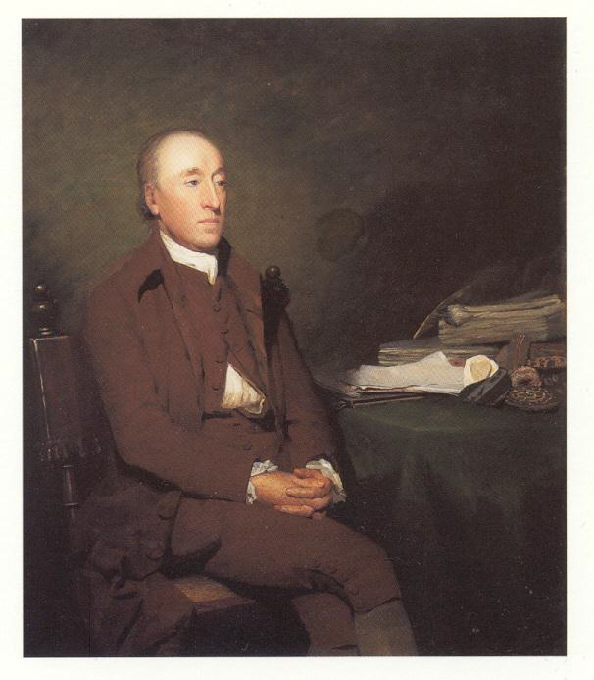
James Hutton (1726-1797)
Gradualism:
Earth’s geological features are created by a slow and continuous process

Slide 4
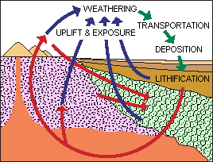
Charles Lyell (1797-1875)
Uniformitarianism: the same natural laws and processes that operate at present also operated in the past.

Slide 5
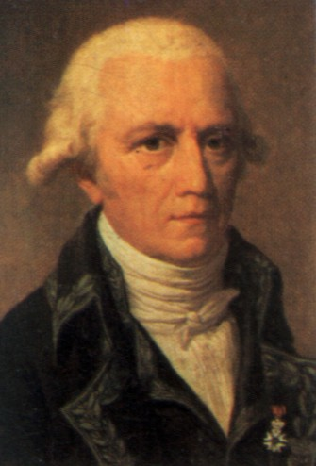
Lamarck (1744-1829)
Thoughts:
Inheritance of Acquired Characteristics
acquired changes were passed to offspring
Law of Use and Disuse
If a body part were used, it got stronger
If body part NOT used, it deteriorated
Example: Body Builder

Slide 6
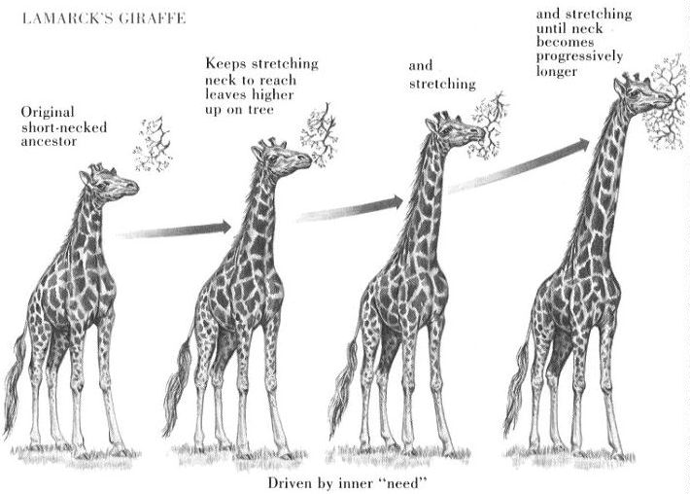

Slide 7
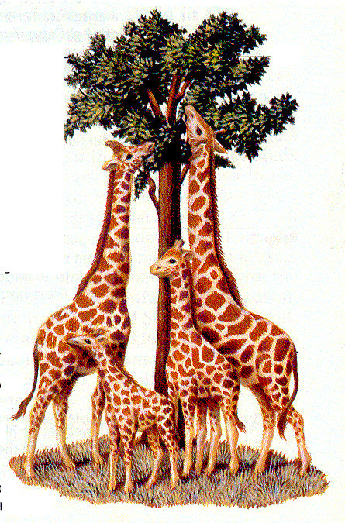
Lamarck’s View
More examples:
Pierced ears
Blacksmiths & Their Sons (muscular arms)
Giraffe’s Necks Longer (from stretching)

Slide 8
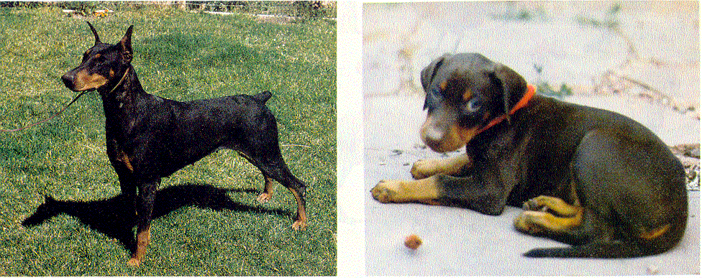
Lamarck’s View
More examples
Traits Acquired During Ones Lifetime Would Be Passed To Offspring
Clipped ears and tails of dogs could be passed to offspring!

Slide 9
Lamarck’s Mistakes
Was he correct??
NO!
Lamarck did NOT know how traits were inherited (Traits are passed through genes)
Genes Are NOT Changed By Activities In Life
Change Through Mutation Occurs Before An Organism Is Born

Slide 10
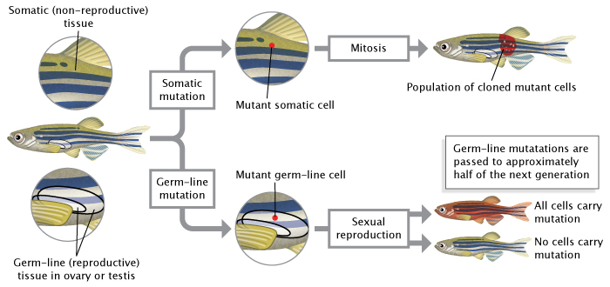

Slide 11
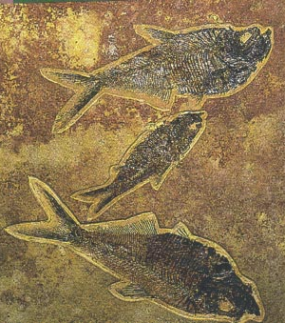
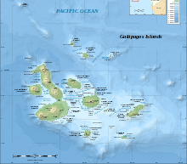
Darwin - 1809-1882
Galapagos Tour on the Beagle
Lots of Variety on the islands
Descent with modification for all species

Slide 12
Darwin:
Proposed the theory Natural Selection
Natural Selection: the process by which individuals that are better adapted to their environment are more successful (they survive and reproduce) than less well adapted individuals do.

Slide 13
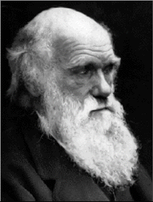
So in Darwin’s View what happened to the giraffe’s?
Natural Selection
The giraffes with short necks have less food to eat
The food resources changed to leaves only on the upper branches
Short necks could not reach upper branches and did not survive
Long neck giraffes survived because they were able to reach the food

Slide 14
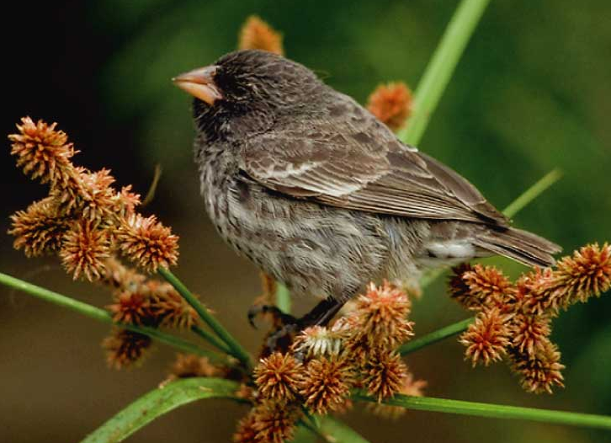
Evolution is change in a population of organisms allele frequency over time…

Slide 15
Fitness
Measure of an individual’s hereditary contribution to the next generation.
Individuals who win the competition and survive to reproduce are more ‘fit’

Slide 16
1. Who is the most fit (biological definition!)?
A. Matt is able to run 10 miles in 55 minutes and bench 140 pounds. He is married with 1 child.
B. Bob cannot make it one time around the track and can bench 25 pounds. He is married and has 3 children.
2. Who is the most fit (biological definition!)?
A. Martha is able to play two soccer games back to back and has given birth to 4 children. However, one child died in tragic car crash.
B. Molly can play only one soccer game. She has given birth to 4 children all of which are still alive and live with her.

Slide 17
Beak Lab
You will each have a type of beak.
You will feed for a set amount of time (I will time you) from your plate
You will then record how much of that food type you were able to consume.
Food sources will then change but your beak type will remain the same!
When done we will record class data.

