Slide 1
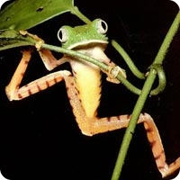
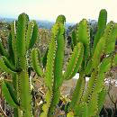
Warm up 4/19/16
What adaptations do each of these organisms have to help them survive in their environment?

Slide 2
Differences Among Organisms
Adaptation – a genetic characteristic that helps an organism survive and reproduce in its environment
Physical – how the animal is formed or shaped
Ex: long neck or striped fur, body temperature
Behavioral – how the animal acts or what it does to find food, protect itself, or reproduce
Ex: hibernating

Slide 3
Building Beasts – An Evolutionary Activity
This activity demonstrates an important part of evolution…adaptation.
To survive in an environment, an organism needs to adapt, to develop traits that fit in to where it lives.

Slide 4
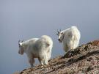
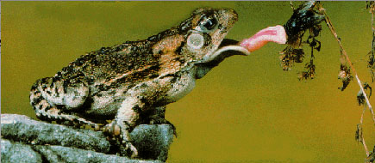
Examples
Mountain goats have padded hooves to grip the rocks on which they climb.
Frogs have long, sticky tongues to catch insects to eat, and are colored brown or green to match their environments so that predators do not notice them.

Slide 5
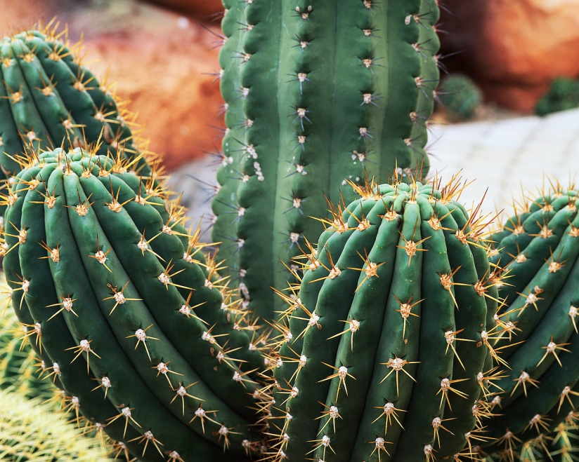
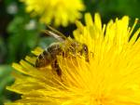
More Examples
Cacti are able to store water because they live in dry places, and they have spines to discourage animals from eating them.
The flowers of flowering plants are an adaptation for attracting bees and butterflies, which enable to plant to reproduce.

Slide 6
Objective
To show your understanding of adaptations and how they drive evolution.
What to do:
Randomly create an organism and its environment with a roll of the die.
Be creative – but try to stick to the rules of nature so that you can demonstrate that you understand what adaptations are and how they help an organism survive in its environment.
Adaptations must be realistic and exist in nature.
No bionic hearing or laser vision!

Slide 7
Part 1: ROLL
Roll a die for each category to determine the conditions of your environment.
Then, roll it to determine the qualities of your beast.
You MUST use these qualities; however, you may add more adaptations to ensure that your beast will survive with its adaptations within its environment.
Each time you roll the dice, think about how this roll affects your beast.
Create an adaptation for A-C that helps your beast survive in those environmental conditions and an adaptation for G that helps your beast survive against predators. .
For roll F, be sure to describe what your beast eats based on the mouthparts you were assigned.

Slide 8
Part 2:
Front of Paper:
The Drawing
Back of Paper:
The Essay
Your drawing must be colorful and include ALL of the following criteria:
Environment
Beast with adaptations
Prey
DO NOT WRITE THIS YET, WE WILL DO SOMETHING BEFORE THAT IS WRITTEN.
INSTEAD…ANSWER THE QUESTIONS IN YOUR PACKET ABOUT THE ACTIVITY

Slide 9
Part 3: Catastrophe!
Your beast has enjoyed a life of leisure in your current environment:
Playing with other beasts,
Frolicking in the lovely weather,
Eating lots of food, and
Evading predators in the area.
Unfortunately, times are changing, and your beast’s species may not survive!
Based on your first roll (A), determine the catastrophe that will now affect your beast’s environment.

Slide 10
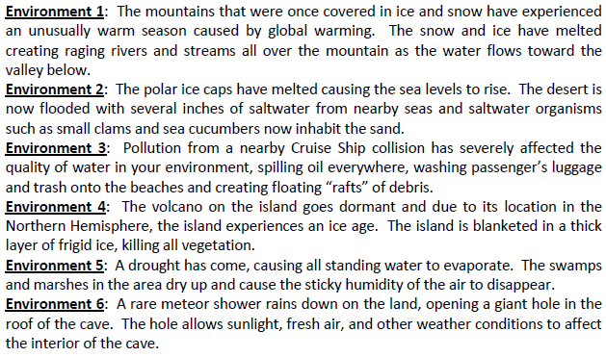
Catastrophes:

Slide 11
Your Task
Write two paragraphs with at least five sentences each:
Explain what has happened to your environment.
What has happened to the vegetation?
How about the predators and prey in the environment?
Is the climate the same? How has it changed?
Explain what has happened to your beast.
Would the current beast be well adapted for the environment?
Do you think the species would be able to survive another 3 generations?
Pretend that there was genetic variation in your beast species, what type of variation would be more likely to survive and reproduce in your environment?

