Slide 1
Warm Up: 4/18
What is an example of genetic variation (my example: the different phenotypes of fur color we see in dogs.)
What are 3 ways that new combinations of genes are created? (in other words, how is genetic variation increased).

Slide 2
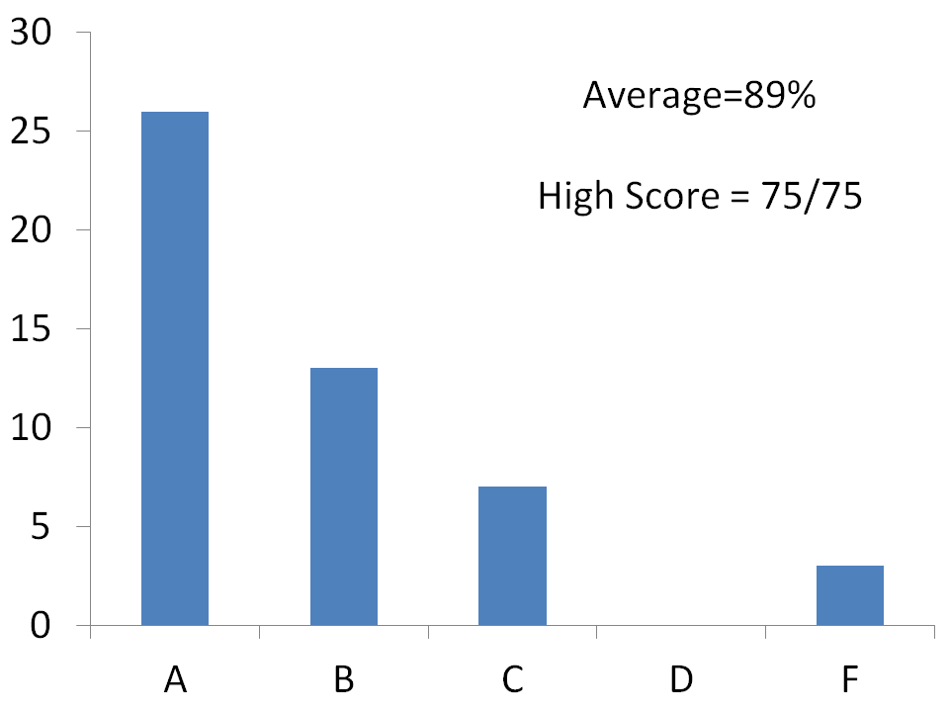

Slide 3
Lets look at variation in sunflower seeds and your hands….
With a partner you will count the number of stripes on 10 sunflower seeds. Record on a piece of paper
Record your groups stripe and hand width data on the board once tabulated.
Copy class table on your worksheet when done.
Then graph the Class Data…remember to use units and label your axis.
Answer Questions….

Slide 4
Class Graph
Use the class data on the board to complete graph #2 (cross out number 4 and put number 2)
Once you have graphed the class data then answer questions # 4 – 6.

Slide 5
Notes: Genetic Variation

Slide 6
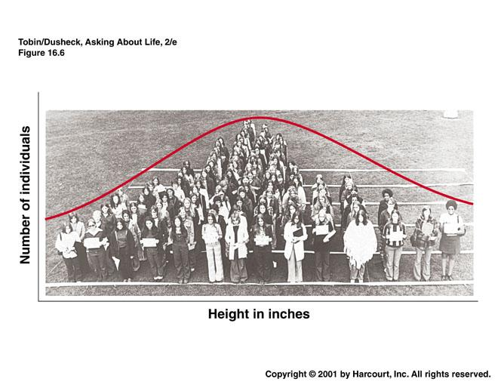

Slide 7
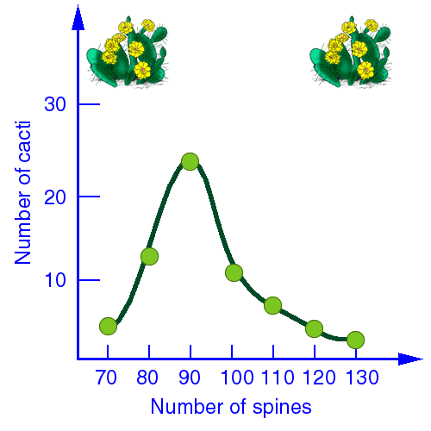
Bell Curve:
On a graph a frequency of a variable, a curve that first rises and then falls and thus forms a symmetric bell shaped curve.

Slide 8
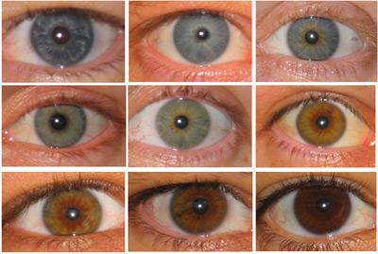
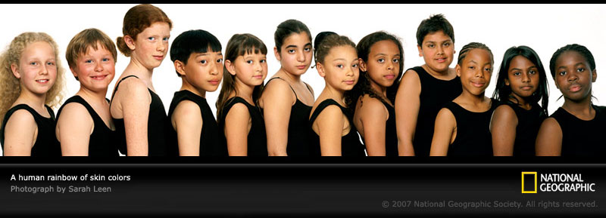
Population: Humans

Slide 9
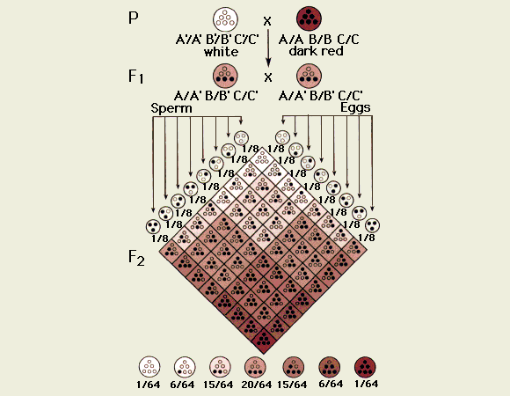
Punnett Square for Skin Color

Slide 10
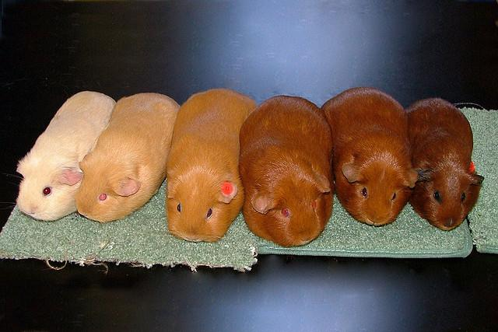
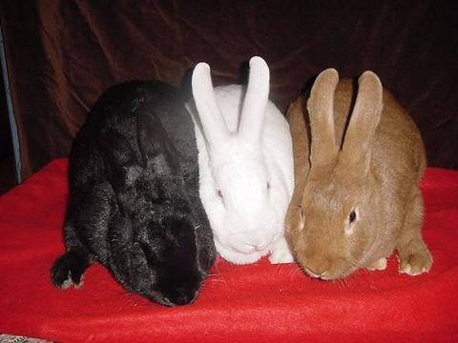
Populations: Guinea Pigs & Rabbits

Slide 11
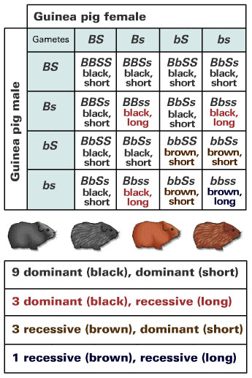

Slide 12
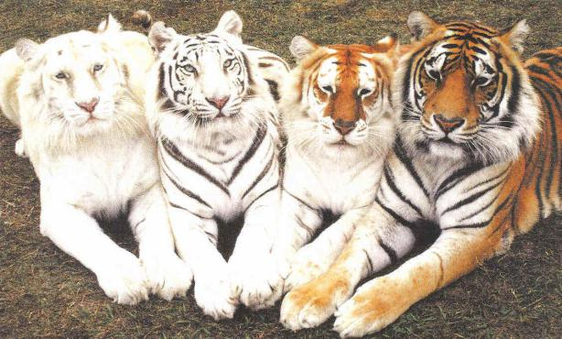
Population: Tigers

Slide 13
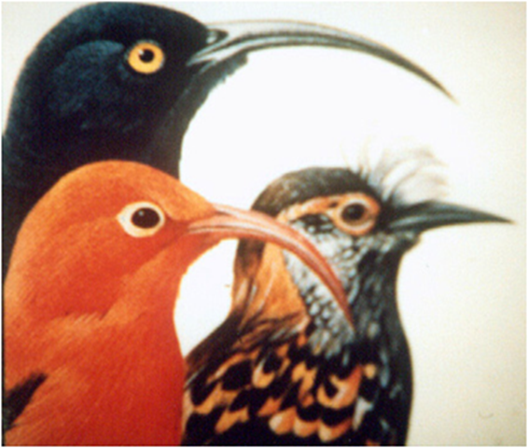
Population: Birds

Slide 14
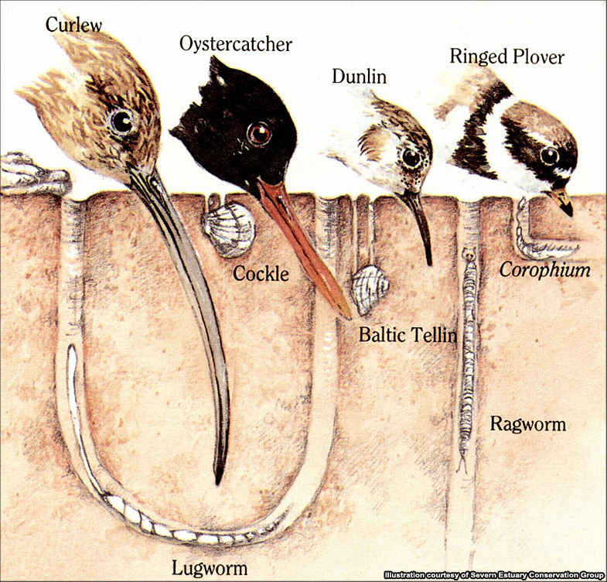

Slide 15
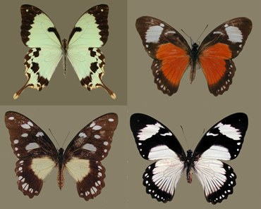
Population: Butterflies

Slide 16
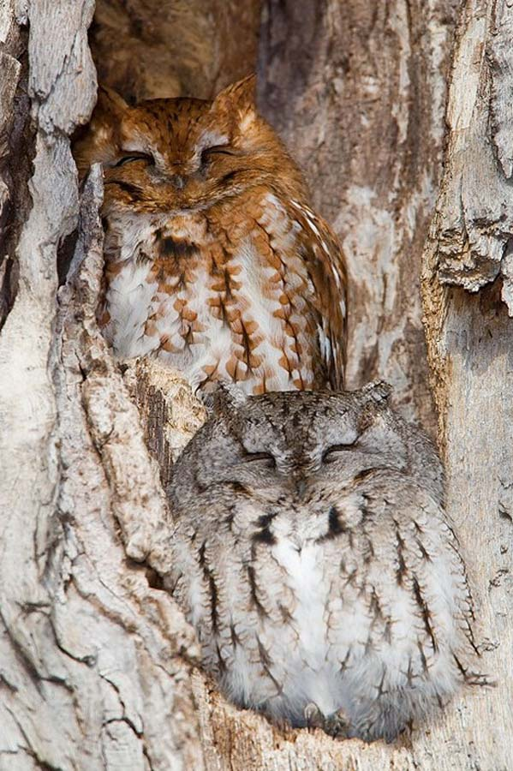
Population: Owls

Slide 17
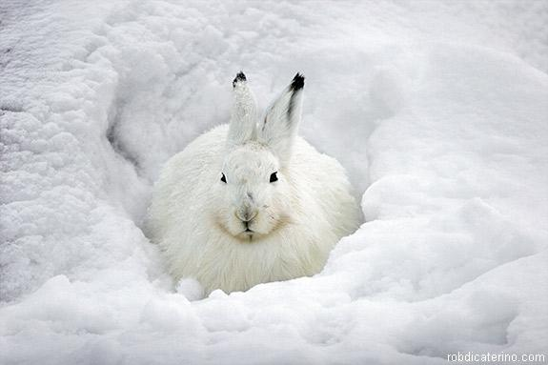
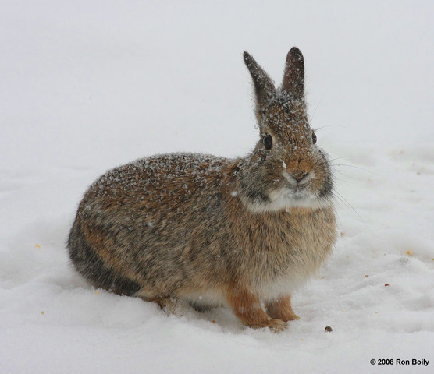

Slide 18
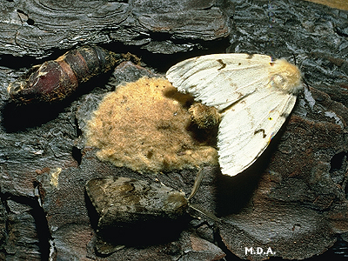

Slide 19
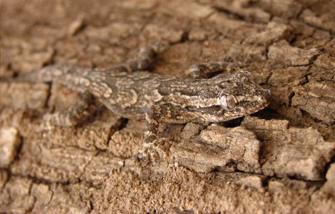

Slide 20
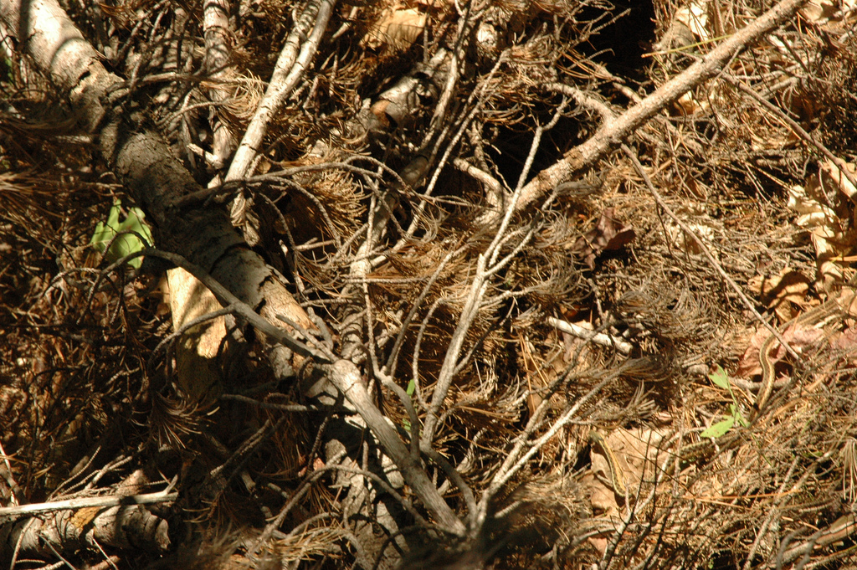

Slide 21
What causes this variation?
Environment
Heredity (The big one)……the different alleles that make up a organism

Slide 22
Sources of Variation in Genetics
Mutations: Random change in a gene that passed on to offspring (change in DNA code)

Slide 23
Sources of Variation in Genetics
1. Mutations: Random change in a gene that passed on to offspring (change in DNA code)
2. Recombination: Reshuffling of genes in the production of gametes (crossing over and independent assortment)

Slide 24
Sources of Variation in Genetics
1. Mutations: Random change in a gene that passed on to offspring (change in DNA code)
2. Recombination: Reshuffling of genes in the production of gametes (crossing over and independent assortment)
3. Random Pairing of Gametes: Occurs because each organism produces large numbers of gametes (sexual reproduction)

Slide 25
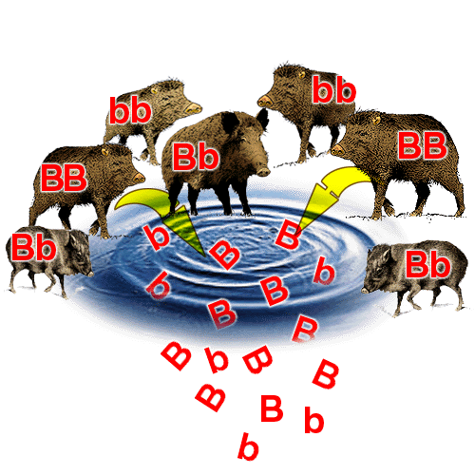
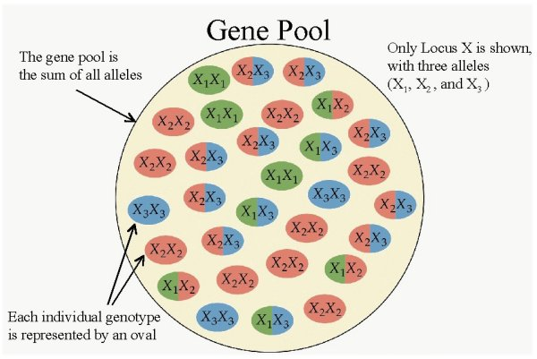
Notes: Genetic Variation
Gene Pool: Total genetic information available in a population.

Slide 26
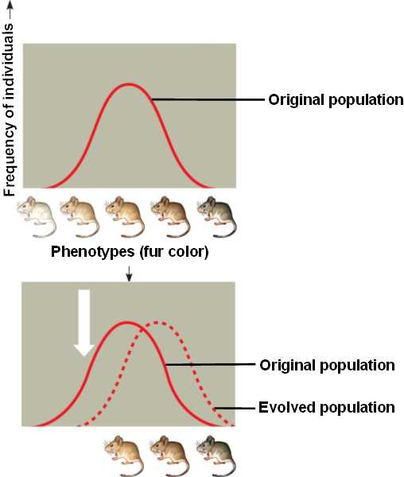

Slide 27
Evolution:
Change in a populations allele frequency over time
Or
Change in the gene pool

Slide 28
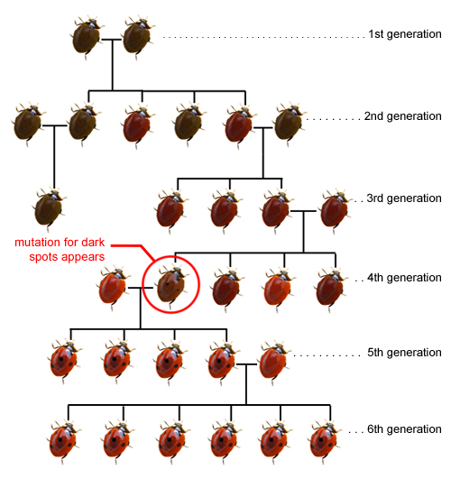
What is Evolution?
What genetic traits are tracked in this pedigree?
How has the population changed over 6 generations?

