Slide 1
Warm Up: 4/11/16
A blue flower and a red flower cross, you get purple flowers. Which type of inheritance pattern is this? What would the genotype of each parent be?
A man sues his wife on the grounds of infidelity. Both man and wife have normal vision, but their daughter has coloboma irisis, a fissure in the iris of the eye. This is known to be sex-linked recessive. If you were the man's lawyer, could you use this fact as evidence? If so, how?
Quiz Tomorrow and TEST on Thursday
Phyla project is due on June 2nd

Slide 2
Dihybrid Genetics

Slide 3
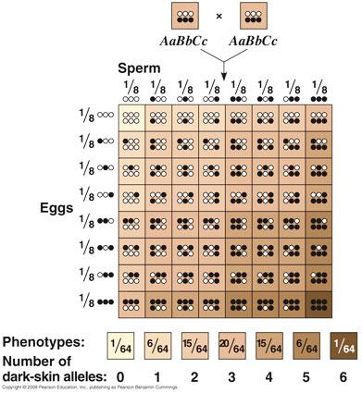
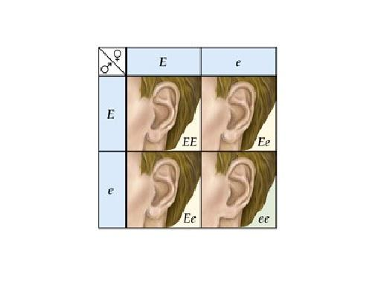
One Gene
for a trait
Multiple Genes
for a trait
Trait: Attache Earlobes Trait: Skin Color
Genes: 1 Genes: 3

Slide 4
Monohybrid Cross v. Dihybrid Cross
Mono = "one" Hybrid = "mix"
Monohybrid Cross - Tracking one trait at a time
Example: Pea color
2. Di = "two" Hybrid = "mix'
Dihybrid Cross - Tracking two traits at a time
Example: Pea color AND shape

Slide 5
Steps in Solving Dihybrid Problems
1. Write the genotypes of the parents
2. Determine all possible trait combinations for each parent.
3. Set up a punnett square with the number of combinations.
4. Analyze the percentages OR ratios of the genotypes.

Slide 6
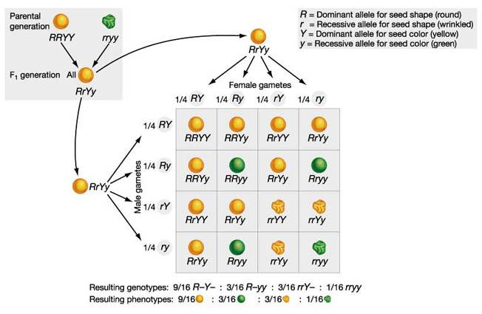

Slide 7
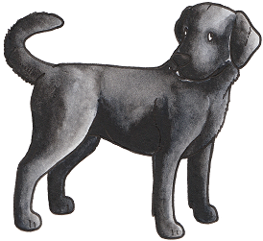
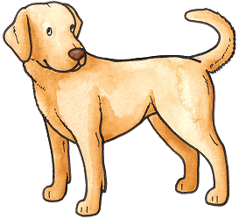
Parents
Fur Color: BB
Nose Color: DD
Fur Color: bb
Nose Color: dd
Assume complete dominance:
What are the genotypes and phenotypes of the parents?
What are the genotypes and phenotypes of the offspring?
What is the ratio of genotypic and phenotypic offspring?

Slide 8
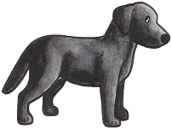
So we got…
Is this what you expected? Why?

Slide 9
Parents
Notice the change is Genotype:
Fur Color: Bb
Nose Color: Dd
Fur Color: bb
Nose Color: dd
Assume Complete Dominance:
What are the genotypes and phenotypes of the parents?
What are the genotypes and phenotypes of the offspring?
What is the ratio of genotypic and phenotypic offspring?

Slide 10
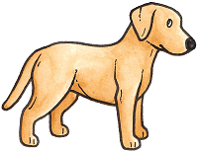
So we got…
Notice the nose color too!

