Slide 1
Warm Up: 3/8/16
What are the three parts of a nucleotide?
What is the function of DNA Polymerase?
Period 5 remember to get your packet stamp if you need it!

Slide 2
Reading Quiz #1 on 3/15
Genetic Variation Handout, posted on website as well.

Slide 3
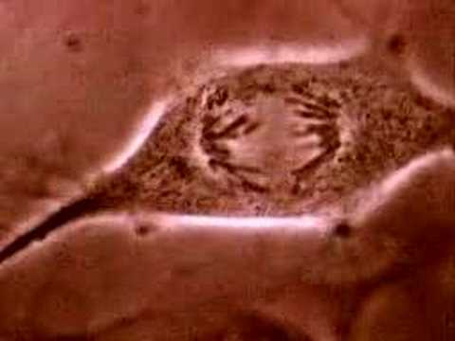

Slide 4
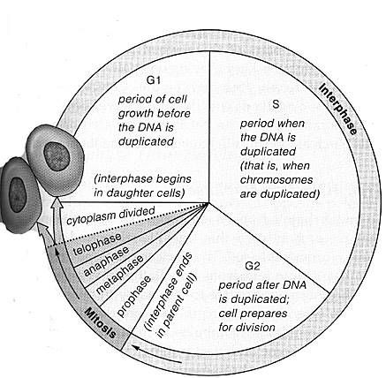
Cell Cycle

Slide 5
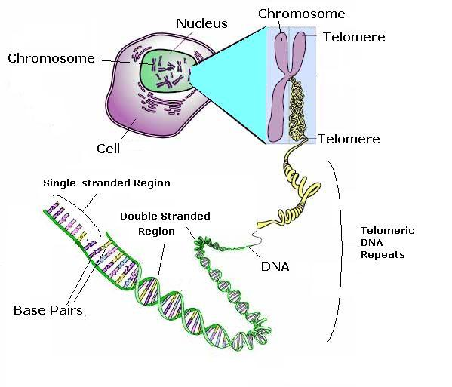
Chromosomes
Before Cell Division:
DNA is wound into chromosomes.

Slide 6
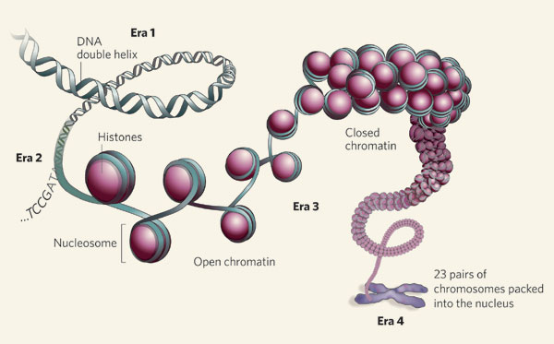
DNA is wound around a Histone

Slide 7
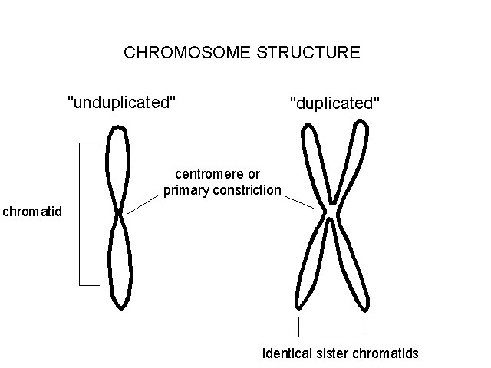
Chromosome Structure
Chromatid -
One set of DNA.
Sister Chromatids -
Two sets of the same DNA (after DNA replication)
Centromere -
center of the chromosome.

Slide 8
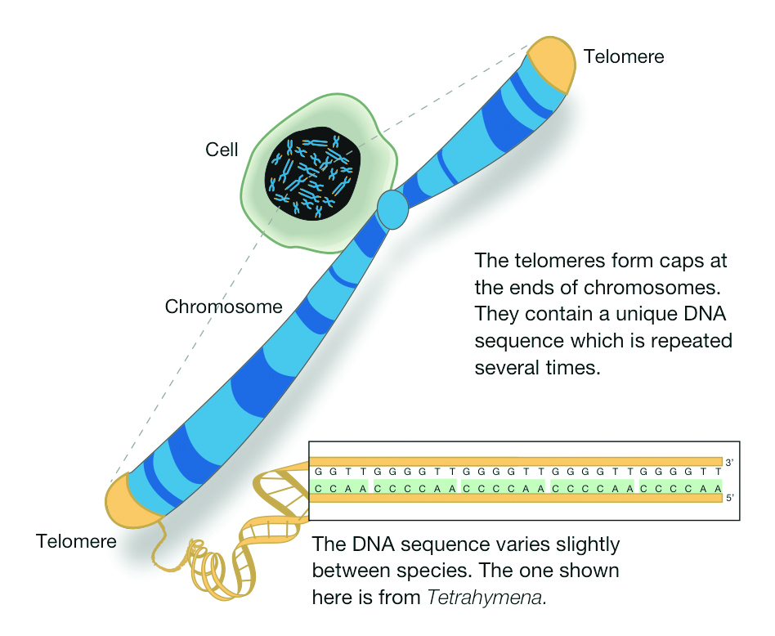
Telomeres
Caps at the end of chromosomes.
Contain no information that codes for a protein.
Get much shorter as you age….

Slide 9
Chromosome Terms
Materials: String, paper, pipe cleaners, glue, bead
Divide your paper into thirds.
Label the first column chromatid and define
Label the second column sister chromatid and define
Use the pipe cleaners (histones) string (DNA) and beads (centromere) to create the chromosome types
Label the centromere and telomere for each
Leave the last third of the paper blank, we will come back to this later in the unit.

Slide 10
Telomeres and Sugar!
Read through the article, highlight and take notes on each section in your reading outline section of your notebook.

Slide 11
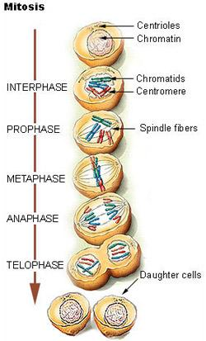
Mitosis
The process of cell division is called mitosis.
Phases of Mitosis
Interphase
Prophase
Metaphase
Anaphase
Telophase
Purpose: Growth and repair of cells

Slide 12
Cell Cycle

Slide 13
Get 2 or 3 markers, paper and scissors

