Slide 1
Warm Up 3/6/17* *Remember to use your warm up sheet
Will the water move into or out of the egg?
1. 2.
75% Water
75% Water
85% Water
75% Water

Slide 2
Egg demo
Next Prediction:
Placing an Egg in 100% water….Where will the water go?
How much will it weigh?

Slide 3
Cell Transport worksheet
Complete both the front and the back of the worksheet

Slide 4
Essential Question:
Given different levels of solutes predict if water will go into or out of a cell.

Slide 5
Direction of Osmosis
In regards to the solution
Hypotonic: Lower in concentration of solutes (higher in water)
Water goes into the cell

Slide 6
In regards to the solution
Hypertonic: Higher in concentration of solutes (Lower in water)

Slide 7
In regards to the solution
Isotonic: Same concentration of solutes (same in water)

Slide 8
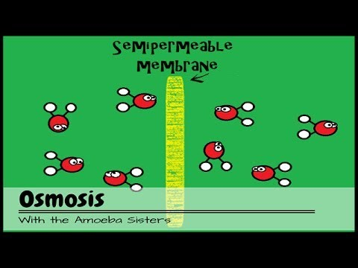
Osmosis and Diffusion Video

Slide 9
Osmosis Problem Practice

Slide 10
Get a white board!!

Slide 11
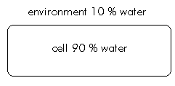
1.
Water leaves the cell and it shrivels or shrinks
Cell _______________________
Environment _____________________
hypotonic
hypertonic

Slide 12
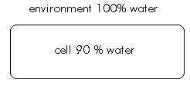
2.
Water enters the cell and it swells
Cell_________________________
Environment _____________________
hypertonic
hypotonic

Slide 13
3.
Water leaves the cell and it shrivels or shrinks
Cell_________________________
Environment _____________________
hypotonic
hypertonic

Slide 14
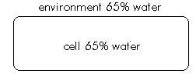
4.
Equal water entering and leaving cell so cell is in homeostasis
Cell_________________________
Environment _____________________
isotonic
isotonic

Slide 15
Cell membrane Lab
Pages 97-99
Follow instructions carefully for each activity.
Make sure to record observations and summarize each activity on page 99.

Slide 16
Exit Ticket: 3/6/17*
1. Compare and contrast passive and active transport (include concentration gradient and energy in your answer)
* Remember to TURN IN your warm up sheet!

