Slide 1
Agenda: 3/3
Grab your folder!
Ecology Matching Vocabulary
Ecosystem Inquiry Wrap Up
Ecological Niche Poster
Exit Ticket

Slide 2
3/3 Warm Up
Which resource below is a limiting factor?
Food
Shelter
Wifi
A&B only
B&C only
When is our next test?
Monday
Today
Friday
Thursday

Slide 3
On the handout match the vocabulary words with their definition
Get out:
All your note sheets!
Food Chain foldable (spiral )
Your Symbiosis Foldable

Slide 4
Observations
Complete Part 5: Analyzing Population Data in your Ecosystem Inquiry Packet
Graph grass, beans, crickets, and worms
Answer part 5 questions
Make sure to answer Part 2 questions B and C
The only portion not finished will be your Final Analysis

Slide 5
Inquiry Packet: Part 8
Write an analysis paragraph.
Include answers to the following question
Complete sentences only!

Slide 6
Analysis Questions
**Complete sentences only**
Describe the food web in your ecosystem?
What happened (observations) in your ecosystem?
What are the limiting factors?
Did your ecosystem reach carrying capacity?
What could you have done to improve your ecosystem?

Slide 7
What should be done:
Predator/Prey Graph and questions (with stamp)
Ecosystem Inquiry Packet
Vocabulary Matching

Slide 8
Ecological Niche
An ecological niche is the role and position a species has in its environment
(how it meets its needs for food and shelter, how it survives, and how it reproduces. )
A species' niche includes all of its interactions with the biotic and abiotic factors of its environment.

Slide 9
Help Wanted: Ecological Niche
Step 1: Pick a Niche (any organism)
Step 2: Create an advertisement that includes:
-how does it find food
-how does it find shelter
-how does it protect itself?
-work hours (when is it active?)
-Position in the food web
-How will it be paid? Be creative!
*note, do not include the name of your organism

Slide 10
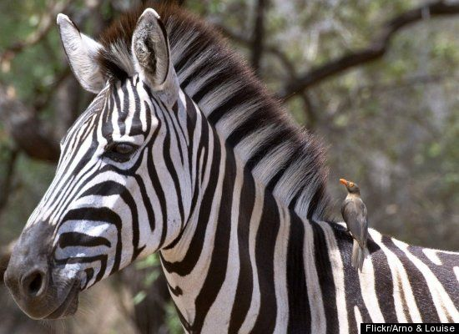
3/3 Exit Ticket
Zebras and Oxpeckers
Oxpeckers, feed off of lice and ticks found on the zebra's back. They are a welcomed guest because they scream when predators are near.
**Test next Thursday 3/9**

