Slide 1
Warm Up 3/31/16
A: Provide an example of a homozygous recessive genotype and a homozygous dominant genotype.
B: Provide an example of a heterozygous genotype.
C: Complete a Punnett Square between a homozygous recessive individual and a heterozygous individual.

Slide 2
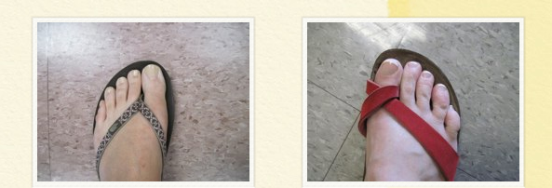
Penny Punnett
Predicted Ratios vs. Actual Ratios
Phenotype
Penny represents the possible alleles that you may give your offspring
T =Heads t=tails
Long Big Toe Short Big Toe
Recessive Dominant

Slide 3
Pedigree NOTES

Slide 4
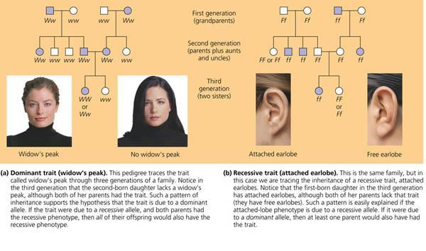
Pedigrees
Pedigree - a diagram showing patterns of inheritance over many generations.

Slide 5
Pedigree Symbols
Living Unaffected female: Clear circle
Living Unaffected male: Clear square

Slide 6
Pedigree Symbols

Slide 7
Pedigree Symbols
Carrier: Carries the trait for the condition but does not have the condition (heterozygous)

Slide 8
Pedigree Symbols

Slide 9
Pedigree Numbering

Slide 10
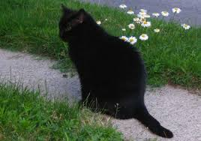
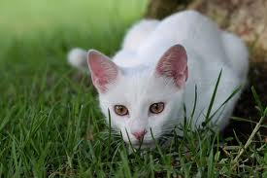
Simple Pedigree
1
2

Slide 11
Simple Pedigree
1
2

Slide 12
Pedigree Practice
Complete the worksheet in your Reading Outline Section.
Do not write on paper it is a class set

