Slide 1
Agenda 3/23
Warm-Up
Finish Lab
Soil Lab #4
Flashcards
Video
Exit ticket

Slide 2
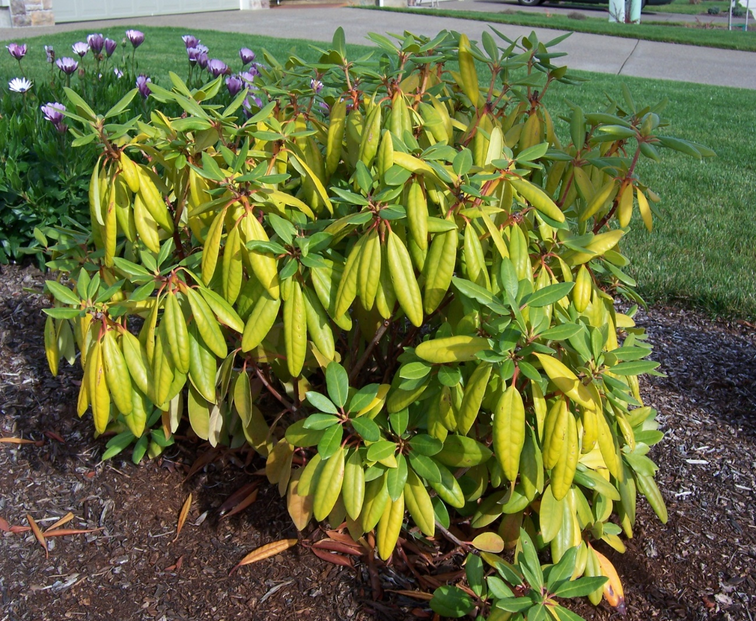
Warm Up 3/23
What is wrong with the plant on the right?
What does it need to become green?
Where would you add the needed nutrient?
In the air, soil, or water?

Slide 3
Nutrient Questions, you have 5 minutes
Soil Investigation #4

Slide 4
Soil Types and Plants
We will highlight the key components together

Slide 5
Plant and Soil nutrients
We will highlight the key components together
From your soil investigations you will copy down the key pieces of information.
For your prediction use Soil Type Information data table for evidence.
Each group member must finish page 1 before your table can plant your bean seeds.

Slide 6
Flash Cards, need all 7 words, the 2 new words are in gold
Soil Particles
Inorganic
Organic
Air Space
Stratification
Nutrients
Nutrient deficient

Slide 7
Memory
Take out your flash cards
Cut out Pictures
Math Pictures and words

Slide 8
Video: Dirt
Complete worksheet as we go.

Slide 9
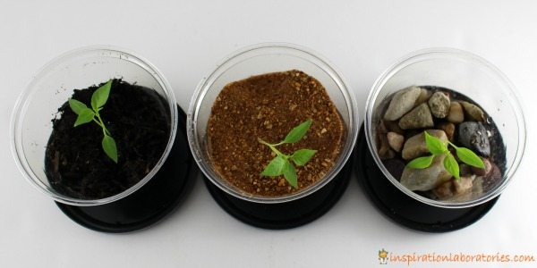
Exit Ticket
Which plant do you think will grow best?
1. 2. 3.

