Slide 1
Warm Up: 3/2/17* *Use your warm up sheet
What is the stimulus and response in the scenario below?
A dog is fed meat and he begins to salivate.

Slide 2
Stimulus & Response
Stimulus - an event in the external environment that elicits a response.
Read through the scenarios and identify:
1. The Stimulus
2. The Response
3. How this helps the organism survive through maintaining homeostasis.

Slide 3
Cell Membrane
EQ: How do substances get across the cell membrane?

Slide 4
Phobias!
Phobia = Fear
List your phobias:
1.
2.
3.

Slide 5
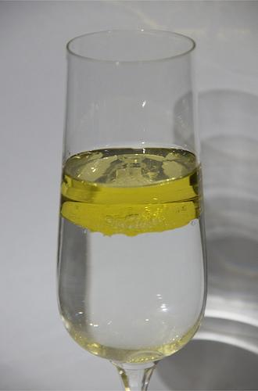
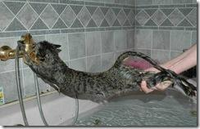
Hydrophobic!!
Hydro = "water" Phobic = "fear"
Examples of things that fear water.
Cats
Lipids

Slide 6
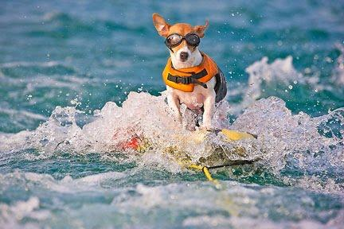
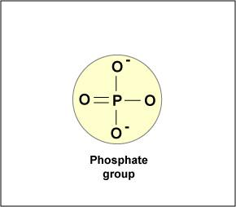
Hydrophilic!!
Hydro = "water" Philic = "loving"
Examples of things that love water.
Dogs
Phosphates

Slide 7
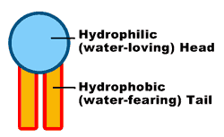
Phospholipid
Phospho = P Molecule
Lipid = Fat

Slide 8
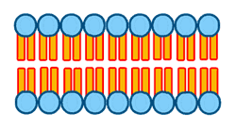
Bilayer
Bi = Two
Layer = Sheet

Slide 9
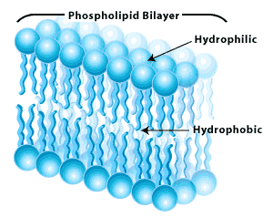
The Cell Membrane
Hydrophilic
Hydrophobic
Hydrophilic

Slide 10
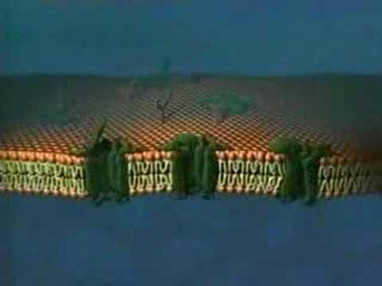
All the Parts of the Membrane

Slide 11
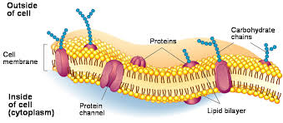
The Main functions of the cell membrane
Allows substances to move between the fluid inside and outside the cell.
Serves as a communicative device
Identifies the cell
Keeps the cell intact

Slide 12
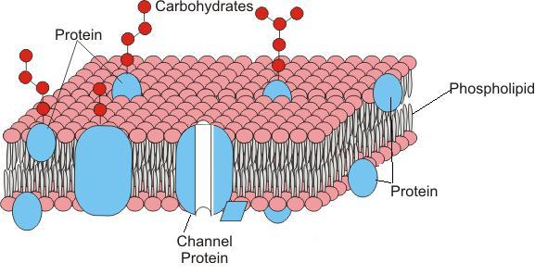
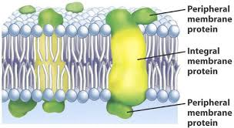

Slide 13
Complete Page 95 of Bluebook.

Slide 14
Getting through the Membrane

Slide 15
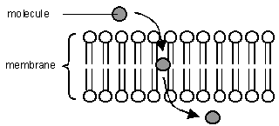

Slide 16
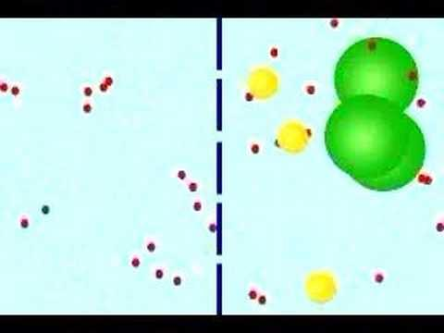
The Membrane is Selectively Permeable
Selective = Chooses Permeable = Passes through
The membrane chooses which molecules pass through

Slide 17
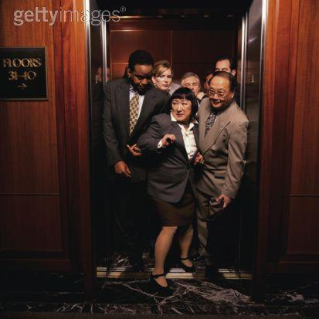
Concentration
Just like people, molecules don't like to be crowded.
Concentrated = Crowded

Slide 18
Concentration Gradient: measurement of how the concentration of something changes from one place to another.
A:
B:

Slide 19
Diffusion - Spreading Out
Diffusion - molecules naturally move from high concentrated areas to low concentrated areas.
1. 2. 3.

Slide 20
Equilibrium:
When molecules are evenly spread out
A:
B:

Slide 21
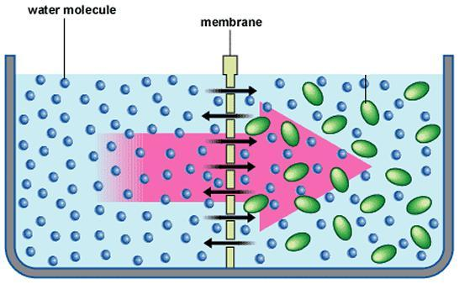
Osmosis
Water molecules also doesn't like to be crowded.
Osmosis - Movement of water from high concentration of water to a low concentration of water, across a cell membrane.

Slide 22
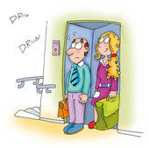
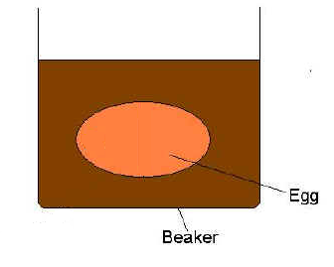
Osmosis Problems
1. Elevator = 80% capacity of people
2nd Floor = 5% capacity of people
2. Beaker = 60% water, 40% salt
Dialysis Tube = 20% water, 80% salt
3. Beaker = 10% water, 90% sugar
Egg = 60% water, 40% other molecules
4. Beaker = 100% water
Egg = 50% water, 50% sugar

Slide 23
Osmosis Problems
1. Elevator = 80% capacity of people
2nd Floor = 5% capacity of people
Will claustrophobic people move into or out of the elevator when it stops at the 2nd floor?
2. Beaker = 60% water, 40% salt
Dialysis Tube = 20% water, 80% salt
Will water move into the tube or out of the tube?
3. Beaker = 10% water, 90% sugar
Egg = 60% water, 40% other molecules
Will water move into the egg or out of the egg?
4. Beaker = 100% water
Egg = 50% water, 50% sugar
Will water move into the egg or out of the egg?

Slide 24
Demo
Egg in Vinegar!
Egg is approx. 90% water and 10% proteins
Corn syrup is about 90% sugar and 10% water
Predict: Where will the water go? (into or out of)
How much will the egg weigh? (in grams)

Slide 25
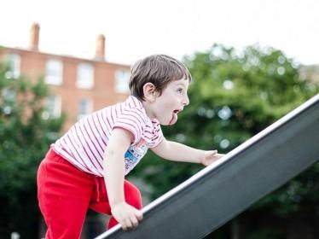
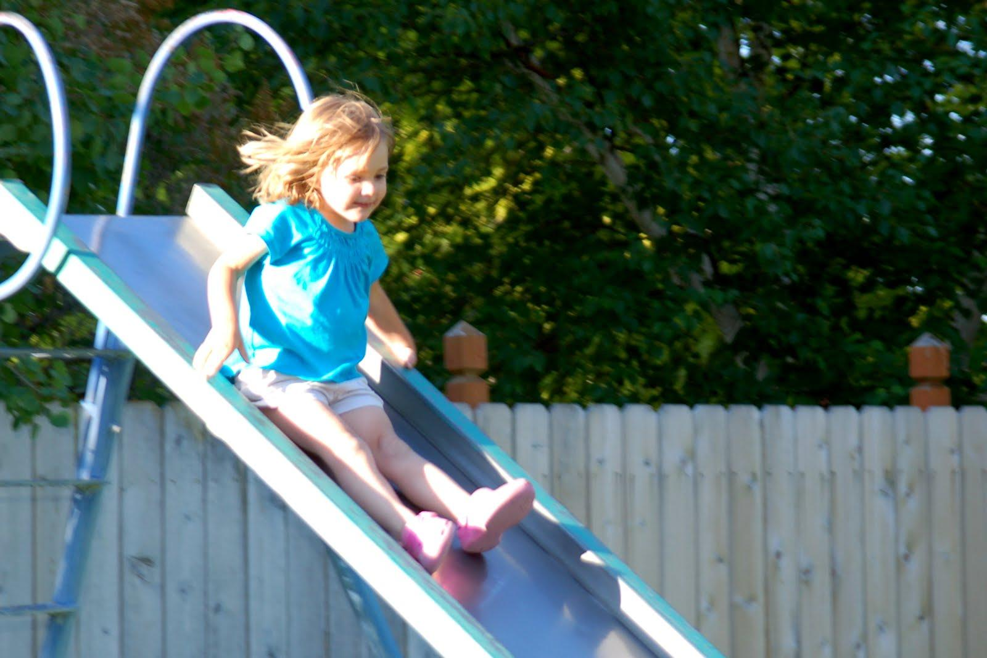
Set up the following table in your notes
 | Active Transport | Passive Transport
Direction of Movement
Energy
Examples
Molecules move from low to high concentration
Molecules move from high to low concentration
Energy required Molecules are helped across
No energy required Molecules naturally move on their own.

Slide 26
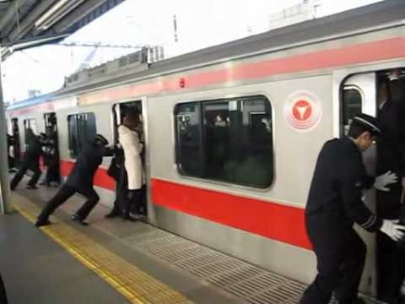
Active Transport - Molecules are forced into a crowded area

Slide 27
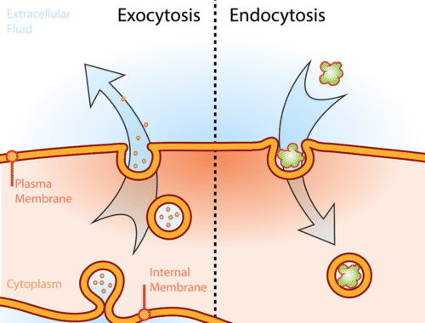
Examples of Active Transport
1. Protein Pumps - molecules are pumped across.
2. Endocytosis - ("Cell eating") The cell takes in lots molecules at one time.
3. Exocytosis - ("Cell dumping") The cell sends out lots molecules at one time.

Slide 28
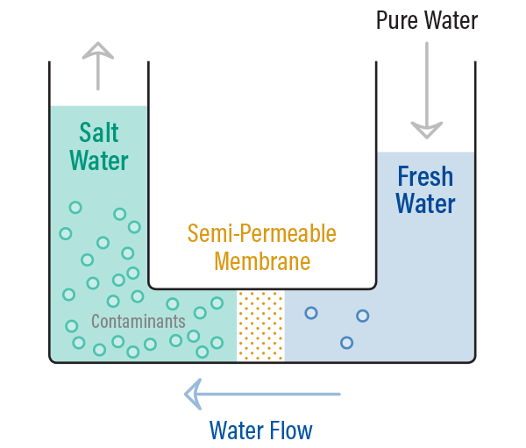
Types of Passive Transport
1. Diffusion - Small molecules go straight through.
2. Osmosis - Water molecules go through small pores.

Slide 29
Exit Ticket 3/1/17 What two molecules make up the phospholipid bilayer? What other molecules are found in a cell membrane? (Hint: Look at your notes)

