Slide 1
Agenda 3.16.2017
Finish Soil Reading #1
Stratification Frayer Model
Finish Soil Investigation #2
Air Space Notes
Soil Investigation #3

Slide 2
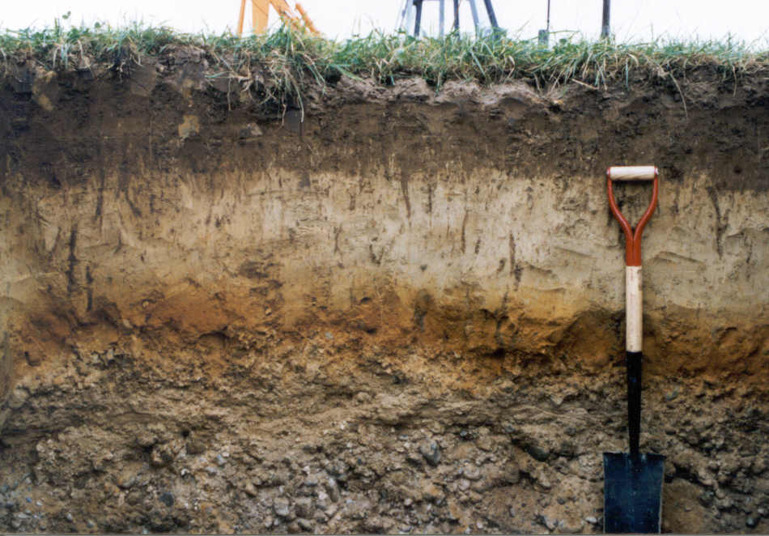
Warm UP: 3/16
Describe the picture to the right
List everything that you observe (see)

Slide 3
Quietly
Finish Soil Reading and Questions (10 minutes)

Slide 4
Soil Investigation #1 Recap
Which soil type had the most organic material?
Was plant or animal material more common?
For inorganic material, where small or large particles more common?

Slide 5
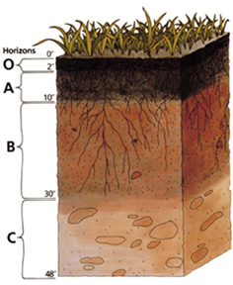
Frayer Model: Stratification
Stratification is layering…
How does stratification relate to soils so far?

Slide 6
Carefully grab your Soil Jar…do not shaker or move or stir!!!!
Fill out pages 2 and 3 of Investigation #2
Calculate the % of soil…there are calculators at the front of the room.
When done put your data on the board for the whole class to see

Slide 7
Essential Question
How does soil air space help organisms in the soil survive?

Slide 8
Air Space
Soils are not compacted together there is space in-between
Air space: space between soil particles, contains gasses

Slide 9
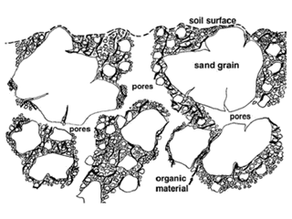
In the space there are gasses:
Oxygen
Carbon Dioxide
Nitrogen

Slide 10
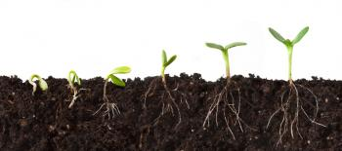
Why would it be important for plants to have air space in soil?
Plants need the air space for root growth.
Air in the soil helps to keep the plant roots alive.

Slide 11
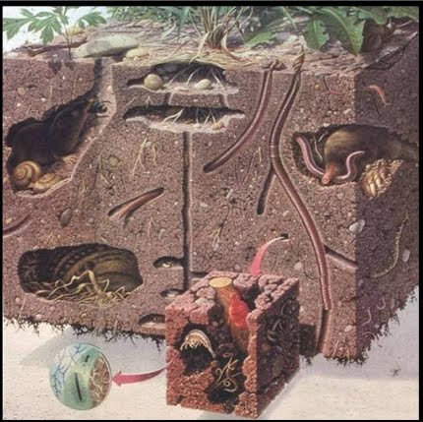
Why would air space be important for animals?
Provides a space for animals to live
Provides oxygen etc. for animals that live in the soil.

Slide 12
Soil Investigation #3

Slide 13
Flash Cards
Soil Particles
Inorganic
Organic
Air Space
Stratification

Slide 14
Exit Ticket: 3.16.2017
What is synonym for the word layer?
****Turn in when done!

Slide 15
Warm Up 3/21/17
What essential (necessary) things do humans need to survive?

