Slide 1
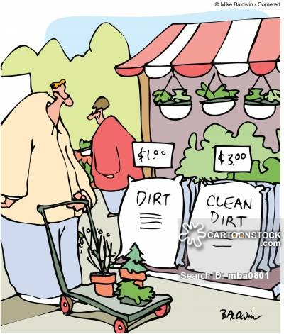
Agenda 3/14/17
Test pass back and corrections
Introduction to soil
Soil investigation 1 and start 2
Soil reading

Slide 2
Warm Up 3/14/17
What is soil made up of?

Slide 3
Test Pass Back

Slide 4
Test Corrections (Quietly!!)
# Wrong | Points Earned | Points Possible | Correct Answer | Why is it the Correct Answer

Slide 5
Essential Question:
What are the main parts of soil?

Slide 6
What do plants need to grow?
Soil
Air
Water

Slide 7
DIRT
Soil is not just…..

Slide 8
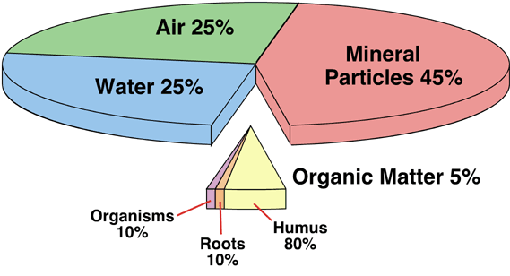
What makes up soil?
Air, water and minerals are inorganic

Slide 9
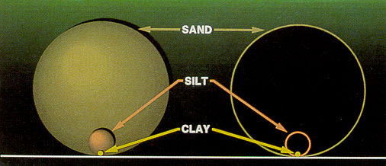
Soil Particles
Largest 1. Sand
Medium 2. Silt
Smallest 3. Clay

Slide 10
What are some important components of soil?
Inorganic Material (abiotic)
Small Particles
Large Particles
Organic Material (biotic)
Plant Material
Animal Material

Slide 11
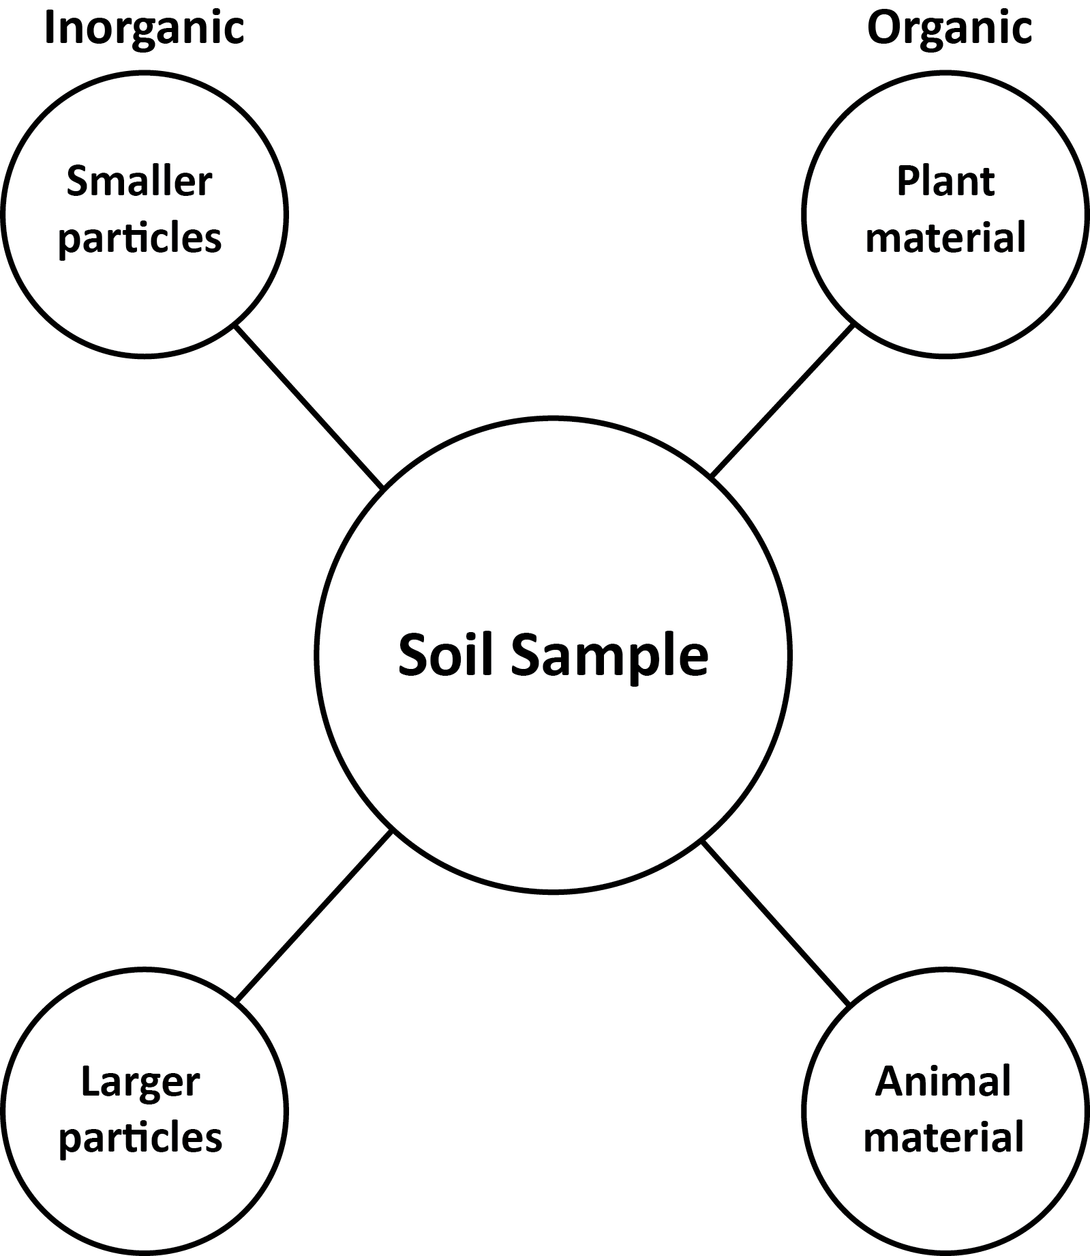
Sorting Soils
We will sort soil in two ways
1.Manually using the graphic organizer.
2. Chemically using water and ammonium.

Slide 12
Complete: Investigation #1 and Investigation #2 Day 1

Slide 13
Soil Reading
Questions are in order of the reading.
Read through and answer on your own paper.
Do not write on the reading.
You may write on the reading question sheet.

Slide 14
Exit Ticket: 3.14.2017
What is soil made up of?

Slide 15
Soil Investigation #1 Recap
Which soil type had the most organic material?
Was plant or animal material more common?
For inorganic material, where small or large particles more common?

Slide 16
Exit Ticket 3/14

Slide 17
Warm Up 3/14/17
What essential (necessary) things do humans need to survive?

Slide 18
Agenda 3/16
Finish Soil Investigation #2
Soil Investigation #3
Nutrient Notes

Slide 19
Warm UP: 3/16

