Slide 1
Warm Up: 3/14/16
What are the three main steps to Meiosis?
What type of cells does Meiosis make?

Slide 2
Makin Mosquitoes Activity
With your partner follow along….
Get a coloring tool (pen or pencil) that matches the colors of popsicle sticks in your bag

Slide 3
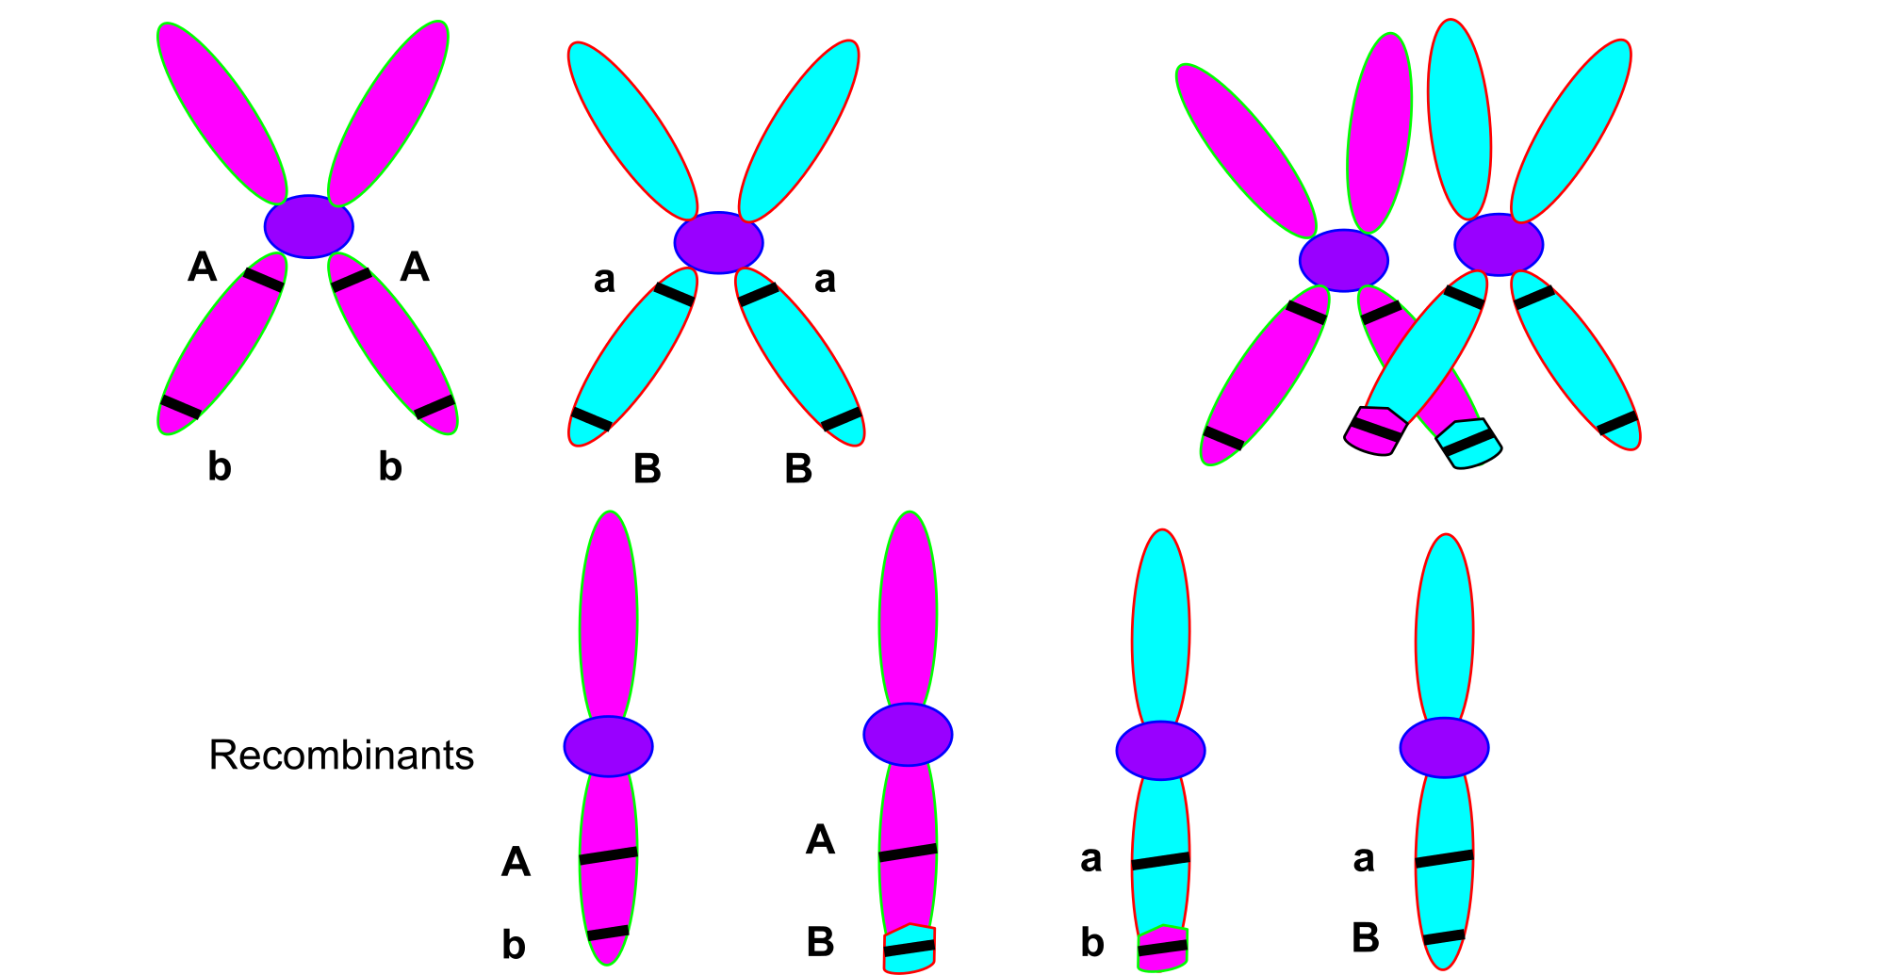
Meiosis Increases Genetic Variation
Crossing Over: The exchange of genetic material between homologous chromosomes that results in recombinant chromosomes.
:

Slide 4
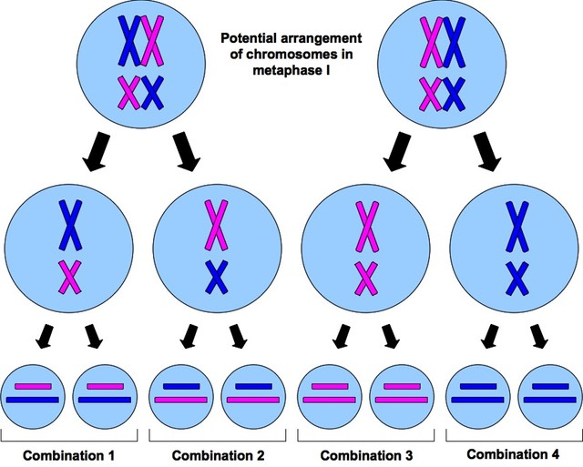
Meiosis Increases Genetic Variation
Independent Assortment: Non-homologous chromosomes align independently during metaphase I of meiosis

Slide 5
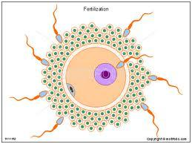
Random Fertilization Increases Genetic Variation
Random Fertilization: Any two parents can produce a zygote with over 64 trillion possible gene combinations

Slide 6
Meiosis I
Parent Cell
Interphase
Prophase I
Anaphase I
Metaphase I

Slide 7
Meiosis II

Slide 8
Meiosis

Slide 9
Meiosis

Slide 10
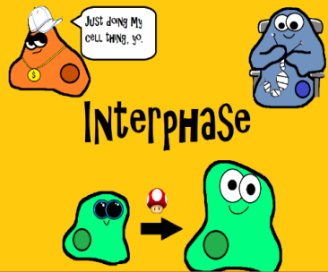
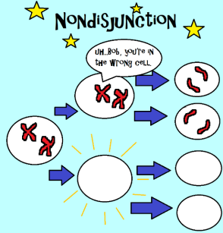
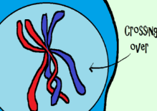
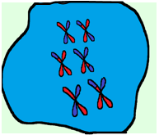
1. How many chromosomes are in a sperm or egg cell if, when they come together to form a fertilized zygote, there are 46 chromosomes? Write the correct number of chromosomes for the sperm and egg | 2. Interphase must occur once before meiosis can happen. (Same thing for mitosis). What would happen if interphase didn’t occur first? | 3. In the process of meiosis, chromosomes begin to match up in homologous pairs. How would you know if two chromosomes were homologous?
4. Crossing over is a very important event in Prophase I of meiosis! What happens during crossing over and what is the significance? | 5. Meiosis does PMAT twice! How would you know whether the cell below is in metaphase 1 or metaphase 2? | 6. Describe what occurs during nondisjunction and the effect on the resulting cells.

Slide 11
Blue Book Pages: 155 and 161- 163
Have 12 frames
Title frame, indicate what type of gamete you are making.
Interphase
Prophase I
Metaphase I
Anaphase I
Telophase I
Cytokinesis I
Prophase II
Metaphase II
Anaphase II
Telophase II
Cytokinesis II
Include:
--Subtitles indicating all above phases and main points for each phase.
--Subtitles for crossing over, genetic recombination AND independent assortment
-- Centrioles and spindle fibers and nuclear membrane through out.
--Show chromosomes number 1 and number 2 and make number 1 big and number 2 small
--Different colors for the mother's chromosomes and the father's chromosomes

