Slide 1
Warm Up 3/10
Define centromere
How many cells do you end with in mitosis?
What is a sister chromatid?
Get your packet out I will come around and stamp your homework!

Slide 2
Notes: Meiosis: Sex, & Eye Color

Slide 3
Homologous Chromosomes
1. Gene- A DNA sequence that codes for a protein and gives organisms their physical traits.
2. Allele- Genes that control different versions of the same trait.
3. Homologous Chromosomes – pairs of chromosomes that contain genes for the same trait arranged in the same order.

Slide 5
Homologous Chromosomes
Example: Eye Color
Mom gave you the allele for brown eyes
Dad gave you the allele for blue eyes
So….. now you have:
one allele for _________eyes and one allele for _________ eyes

Slide 6
Homologous Chromosomes
Example: Eye Color
Mom gave you the allele for brown eyes
Dad gave you the allele for blue eyes
So….. now you have:
one allele for Brown eyes and one allele for Blue eyes

Slide 7
Homologous Chromosomes
Dominant vs. Recessive:
Does this mean you will have one blue eye and one brown eye?
Brown is dominant so it wins. Congrats you have brown eyes.
BUT since you possess an allele for blue eyes, you can still pass on blue eyes to your children.

Slide 8
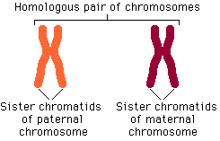
Homologous Chromosomes
Do not forget the centromere.
Glue and label!
Each pipe cleaner in an X should match.
BUT…each X should be a different color….

Slide 9
Meiosis
Meiosis - A type of cell division that leads to cells with half the amount of DNA.
Meiosis Produces: Gametes (Sex Cells: Eggs and Sperm)

Slide 10
Meiosis
Meiosis - A type of cell division that leads to cells with half the amount of DNA.
3 Main Steps to Meiosis
DNA Replication
Homologous Chromosomes Separate
Sister Chromatids Separate

Slide 11
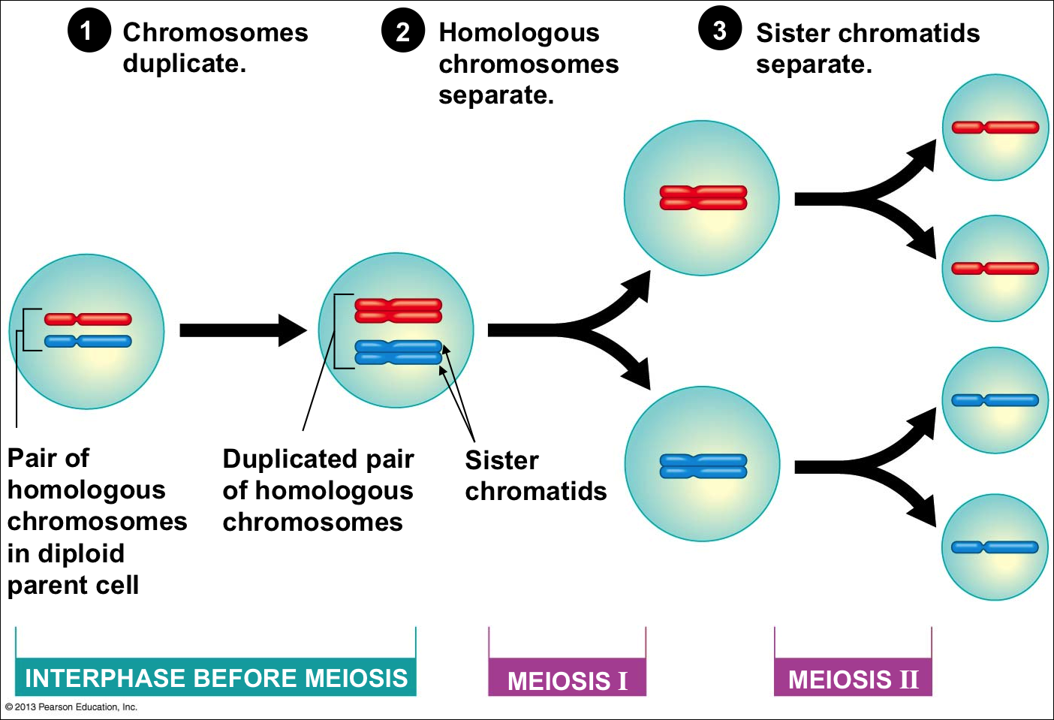

Slide 12
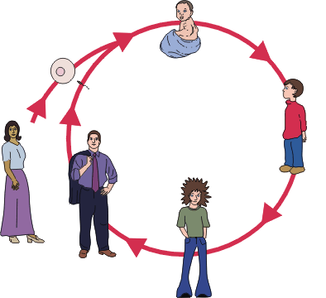
Mitosis (Growth)
Fertilization
23
46
23
Meiosis
Meiosis
46
Mitosis
Mitosis
46
46
46

Slide 13
Gamete Addition

Slide 14
Makin Eggs Through Meiosis!

Slide 15
Makin Mosquitoes Activity
With your partner follow along….
Get a coloring tool (pen or pencil) that matches the colors of popsicle sticks in your bag

Slide 16
Fruit Quiz!
There will be 5 questions

Slide 17
Which processes produces eggs and sperm?

Slide 18
2. Which processes produces toe cells?

Slide 19
3. What two cells are gametes?

Slide 20
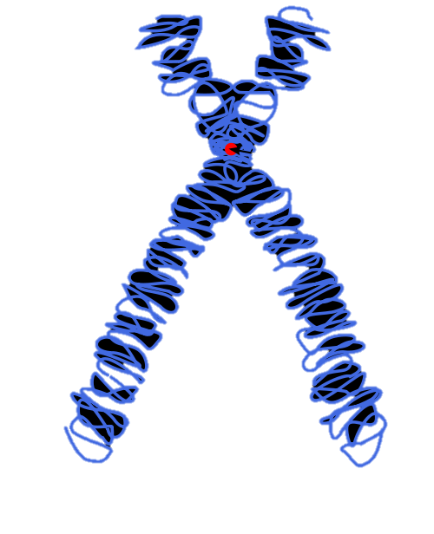
4. What is the structure represented by A in the picture below?
A:

Slide 21
5. What is the structure represented by B in the picture below?
B:

Slide 22
Which processes produces eggs and sperm?
Meiosis

Slide 23
2. Which processes produces toe cells?
Mitosis

Slide 24
3. What two cells are gametes?
Sperm and Egg

Slide 25
4. What is the structure represented by A in the picture below? Centromere
A:

Slide 26
5. What is the structure represented by B in the picture below? Telomeres
B:

