Slide 1
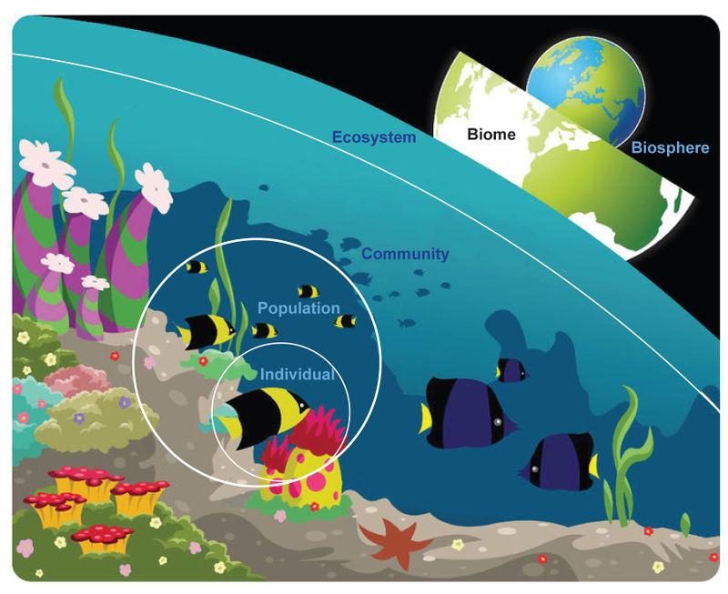
Agenda: 2/9/17
Warm-Up
Ecology Notes
Level of Organization Drawing
Setting up Ecosystems
Exit- Ticket

Slide 2
Warm Up: 2/9/17
Find two connections between abiotic and biotic factors that you wrote down yesterday from our school walk.
What is an ecosystem?
*remember to use the word wall and/or your notes

Slide 3
Concept Map Time
Follow Ms. Spencer’s instructions
When done, ask an adult for a stamp!

Slide 4
Ecology

Slide 5
Notes 1: What’s in an ecosystem?

Slide 6
What are the biological levels of organization and how are they related?

Slide 7
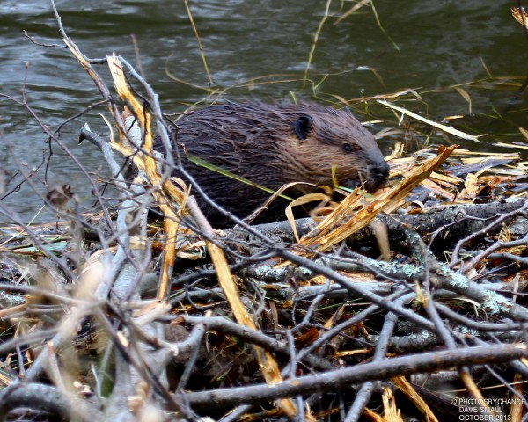
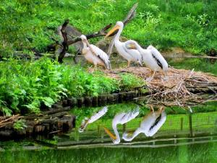
Ecology
Ecology - The study of interactions between organisms and their environment.

Slide 8
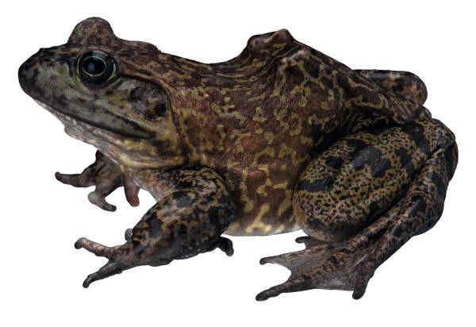
What’s in an Ecosystem?
Organism: a single living thing that obtains food, water, and shelter to live, grow, and reproduce in its habitat (environment).
Ex: A frog
Organism

Slide 9
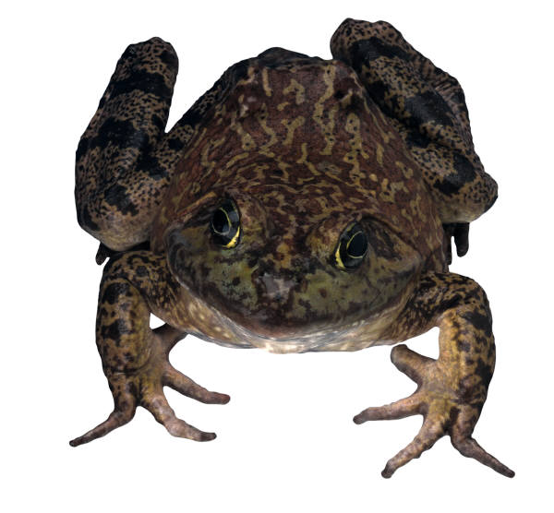
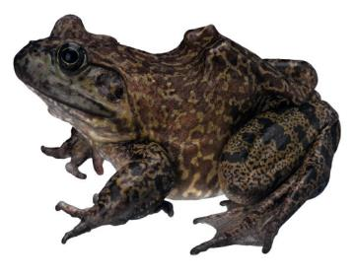
Population: A group of interbreeding organisms (species) living in the same area
Ex: All of the frogs living in a pond behind your neighborhood

Slide 10
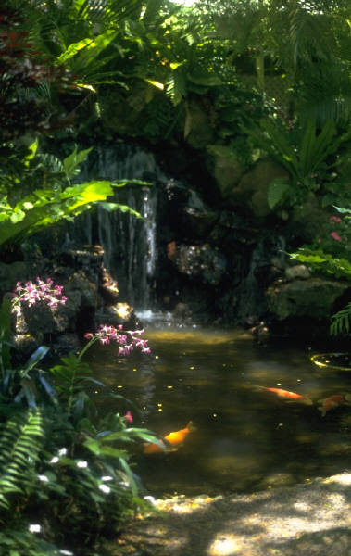
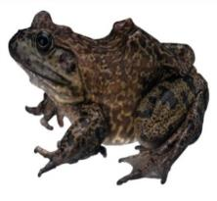
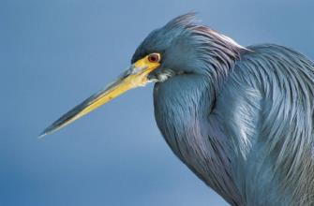
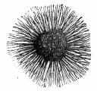
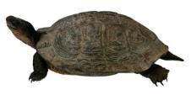
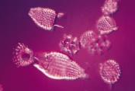
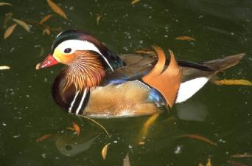
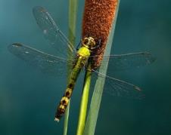
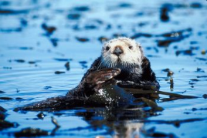
Community: all the populations in an ecosystem
Ex: All the frogs, insects, reptiles, birds, plants, mushrooms, bacteria, protists, mammals & fish living in the pond behind your neighborhood

Slide 11
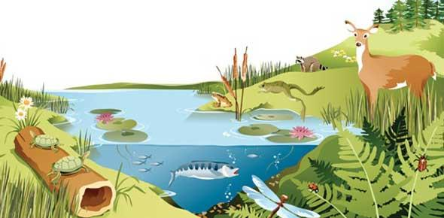
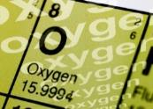
Ecosystem/Biome :Organisms interacting with each other and the environment.
Includes all the living (biotic) & nonliving (abiotic) features of an environment.
List some of the parts of the ecosystem below

Slide 12
What is part of the ecosystem?
Frogs
insects
birds
reptiles
plants
mushrooms
bacteria
mammals & fish
water, soil, air, clouds, sunlight
man-made materials in the pond behind your neighborhood

Slide 13
Biosphere: every place on Earth that can support life
Atmosphere
Lithosphere
Hydrosphere
Atmosphere = air
Hydrosphere = water
Lithosphere = land

Slide 14
Your own Ecosystem
Materials
-Pinch of grass seed
-3 mung-bean seeds
-3 earthworms
-3 crickets
Please Talk with an Adult to get your animals
Make sure to crush up the charcoal with mortar and pestle
Follow Instructions Carefully!!
MAKE sure to place 5 grass blades in the terrarium

Slide 15
Exit Ticket
Reference the word wall
1. List the levels of organization from the smallest to the largest.

