Slide 1
Warm up: 2/9/17 remember to use your warm up sheet
1. What are the four main biomolecules?
2. What is a monomer and what is a polymer.

Slide 2
Let’s learn more about carbohydrates
Read the handout: (you may write on it!)
Highlight key vocabulary words and circle any words you don't know the meaning to
Answer this question: What are the three types of carbohydrates? How are they different?

Slide 3
Now…
Review your list of circled words with your group...can you help each other figure out the meaning of these words.
Share your list of highlighted words with your group. Be ready to share with the class

Slide 4
New lab books
Make sure to write your name on the outside!!!

Slide 5
Biochemistry Detection lab
Read through page 83.
Highlight and underline important directions.

Slide 6
One page per lab partner:
What is the ONE test that you need to use the hot water bath for?
What color will a benedicts test change to? What is a benedicts test trying to detect?
What color will a Iodine test change to? What is a iodine test trying to detect?
What color will a Biuret test change to? What is a Biuret test trying to detect?

Slide 7
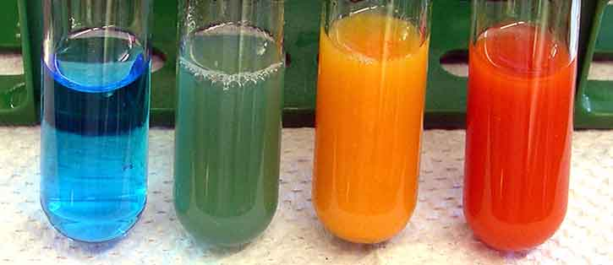
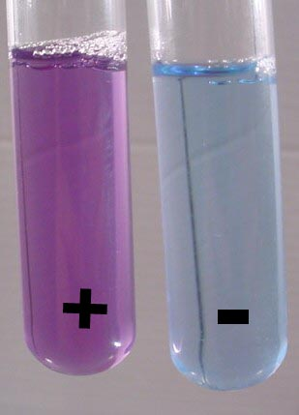
Iodine Test
Benedicts test
Iodine test
No
monosaccharides
Polysaccharides Present
monosaccharides Present
No polysaccharides
Biuret test (For Protein)

Slide 8
Review Macromolecules
Proteins → amino acids
Carbohydrates →sugars
(monosaccharides, polysaccharides, glucose)
Lipids → fatty acids and a glycerol
Nucleic acids → nucleotide

Slide 9
Essential question:
Describe how an enzyme works.

Slide 10
Proteins
Chains of amino acids
Many proteins are enzymes
Enzymes are proteins that catalyze chemical reactions
AA
AA
AA
AA
AA
AA

Slide 11
Enzymes as catalysts
Catalyst - Speeds up chemical reactions by decreasing the energy needed to start the reaction (activation energy)
Without a catalyst
Energy
With a catalyst
Time

Slide 12
Definitions
Substrate- monomers that bind to the active site of an enzyme
Active site- area on enzyme where substrate binds
Product- what the enzyme produces

Slide 13
Lock and Key Model Step 1:
Two substrates
Enzyme
Active site of the enzyme

Slide 14
The substrates fit like a key in a lock
Lock and Key Model Step 2:
Enzyme
The active site is like a lock

Slide 15
Lock and Key Model
Step 3:
Chemical reaction!!!
Enzyme

Slide 16
Step 4:
The substrates have reacted and changed into the product
Enzyme is unchanged
Active site

