Slide 1
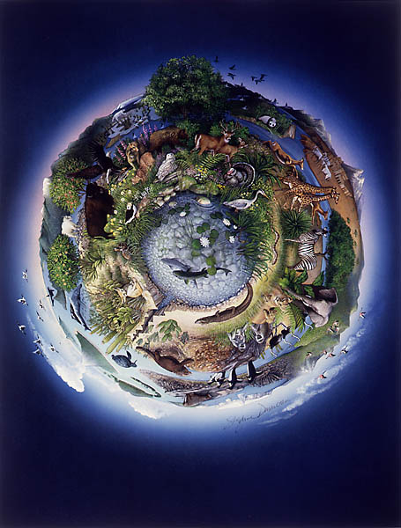
Agenda: 2/7/17
New Class Policies
Warm-up
Introduction to Ecology
Exit Ticket
**HW: Finish Concept Map**

Slide 2
New Seats

Slide 3
New Semester, New Policies
Classroom Folders & Notebooks
-Everything stays in folder bins
-Names on Folders
-To Do & Done labels
Cell Phones
-Phones should never be out
-If used inappropriately during class they will be placed in a bin at the front

Slide 4
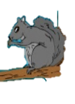
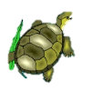
Warm Up: 2/7/17
Give two examples of non-living things from this picture.
Give two examples of living things from this picture.

Slide 5
Essential Question:
Compare and Contrast Biotic and Abiotic factors.
Compare

Slide 6
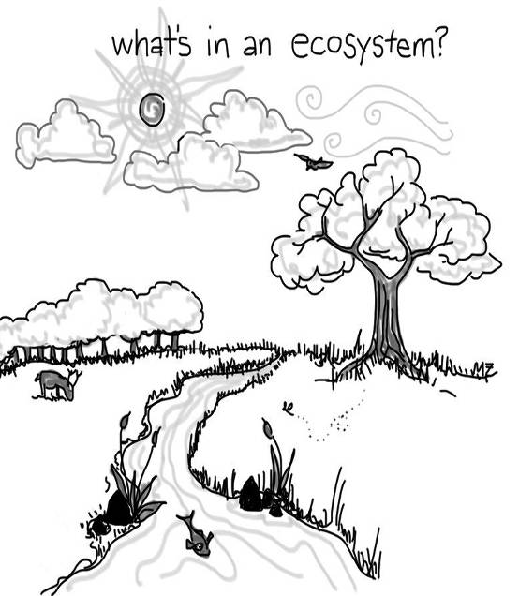
Ecology: the study of how living things interact with each other and their environment.

Slide 7
An ecosystem is made up of all of the living (BIOTIC) and non-living (ABIOTIC) factors.
In the picture, place a CIRCLE AROUND things that are LIVING and an “X” over things that are NON-LIVING.

Slide 8
In Your Packet
You have 10 minutes to walk around the school and take write down examples of biotic vs. abiotic factors…..

Slide 9
Next: We will make a concept map ☺

Slide 10
Exit Ticket 2/7/17
Reference the word wall:
Define biotic factor in your own words.

