Slide 1
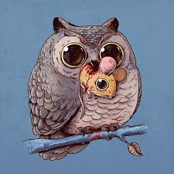
Agenda: 2.28
Warm-Up
Predator/Prey Game
Follow-up questions/graph
Exit Ticket
**Test next Thursday 3/9**

Slide 2
Warm-Up: 2.28/2017
1. What is a biotic factor?
  Explain in words & drawing
2. What is an abiotic factor?
  Explain in words & drawing

Slide 3
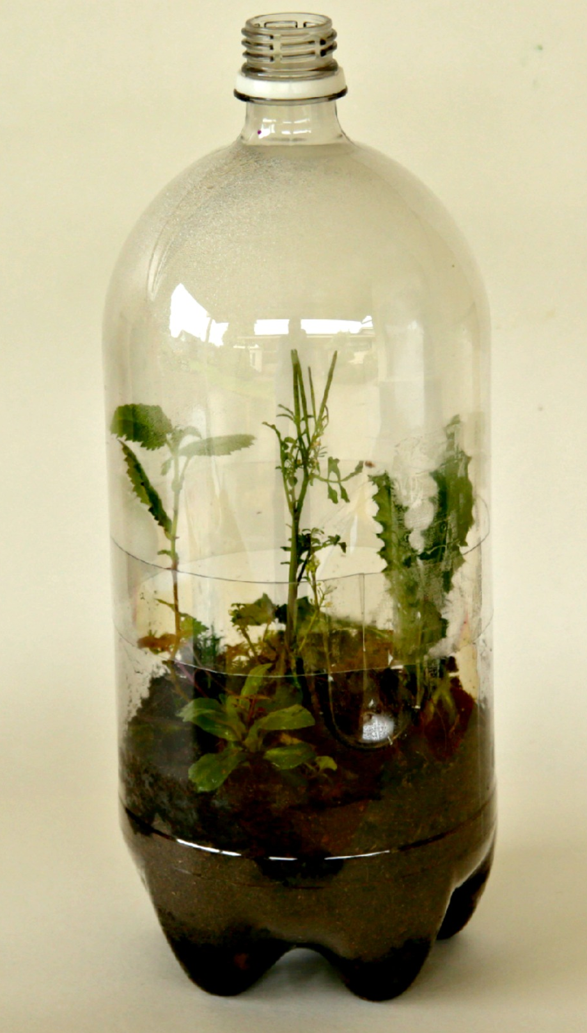
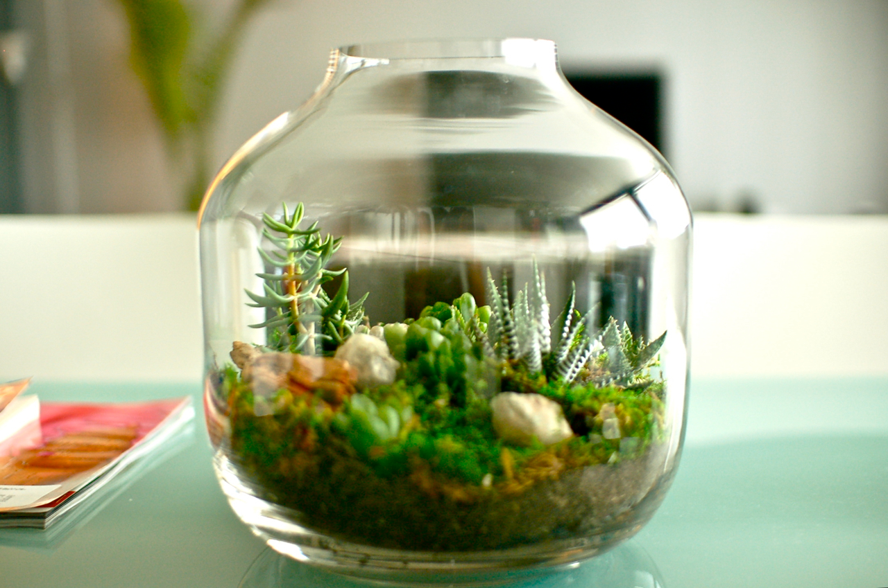
Observations
Terrarium Observations (in ecosystem inquiry packet).
  Write out numbers for temperature and organism observations
  Complete part 2 questions B and C (we skipped this before)

Slide 4
Get Out Ecology Packet

Slide 5
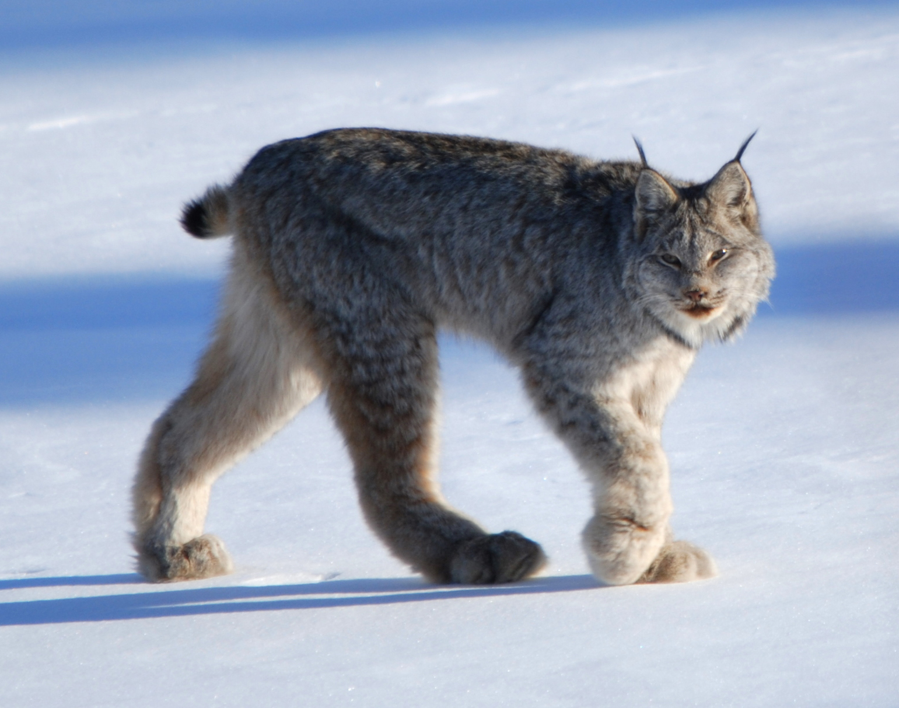
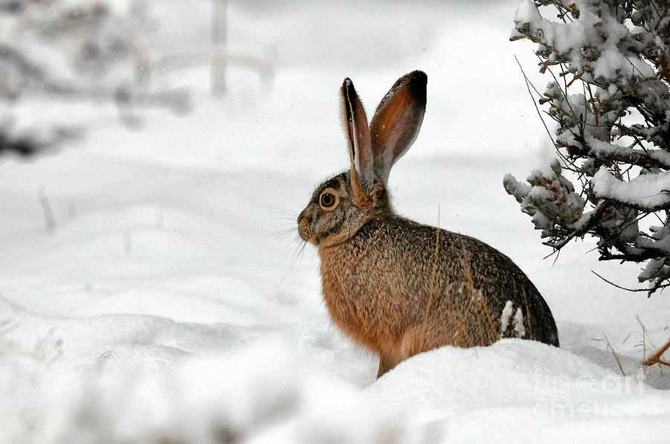
Predator Prey Game!
Lynx
Hare

Slide 6
Predator-Prey
1. Starting Round: Populate the habitat with three hares—spread them out within the square.
2. Toss the cardboard lynx into the square in an effort to capture (i.e., land on any portion of) as many hares as possible.
3. In order to survive and reproduce, the lynx must capture at least three hares. For each lynx that survived add one more lynx next round.
4. Count the number of hares remaining, for each hare one that survived it has one offspring. This is the total number of hares for the next round.
5. Start the next round using the numbers of lynx and hares from #3 and #4 above. The minimum number of hares is 3, the minimum number of lynx is 1.

Slide 7
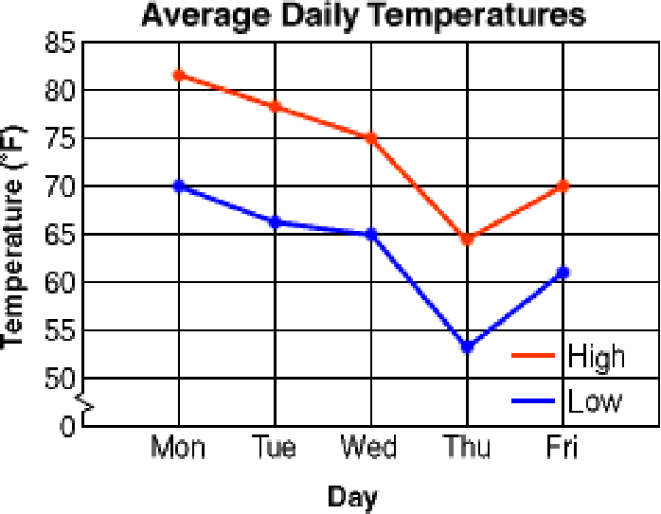
Graph
Create a line graph with TWO lines
Graph the “Number of Hares” vs “Generation” in one color.
Add “Number of Lynx” per “Generation” in another color.
Be sure to include all the parts of a good graph: Title, Labels, Key etc.

Slide 8
Post Game Questions
Answer questions # 1-6 in your packet
When done make sure to ask an adult for a stamp!

Slide 9
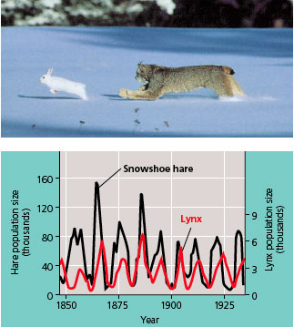

Slide 10
Johnathon’s blue world ocean symbiosis

Slide 11
Exit Ticket: 2.28.2017
1. Where do autotrophs get their energy from?
2. Draw a picture of an autotroph
**Test next Thursday 3/9**

Slide 12
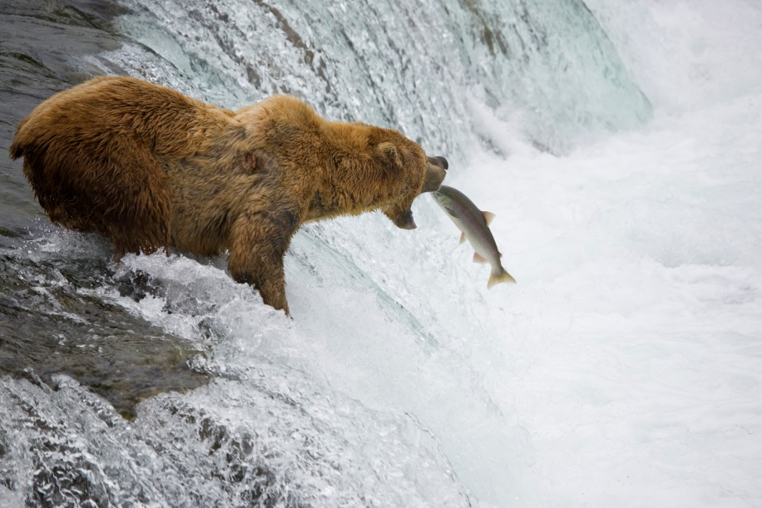
1. Grizzly Bear & Salmon
The Grizzly Bear braces itself as it waits for salmon to jump upstream to their breeding grounds.
The bears rely on the salmon for nutrition.
Predator/Prey
What symbiotic relationship is this?

Slide 13
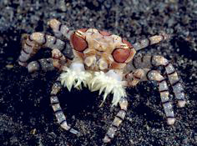
2. Boxer Crab & Anemones
This Boxer Crab carries a pair of stinging anemones in its claws, which it uses to defend itself from predators.
The anemones get to move around which increases their food supply.
Mutualism
What symbiotic relationship is this?

Slide 14
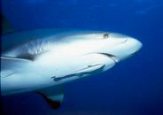
3. Shark & Remora
Commensalism
The remora attaches itself to the shark and saves energy since it doesn’t have to swim, and it gets to snack on the sharks kills.
The shark doesn’t get anything.
What symbiotic relationship is this?

Slide 15
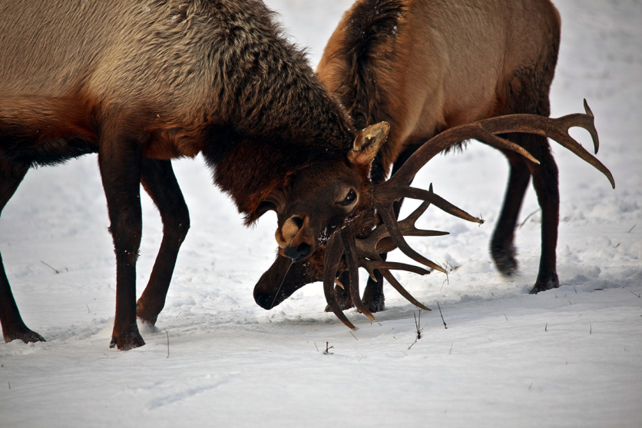
4. Elk
Competition
A battle or contest between individuals, groups, animals, etc. for territory, a niche, or a location of resources. It arises whenever two or more parties strive for a goal which cannot be shared.
What symbiotic relationship is this?

Slide 16
5. Emperor Shrimp & Sea Cucumber
This tiny emperor shrimp is riding along on the back of a sea cucumber (a long worm-like starfish relative) while it crawls along a sandy bottom. The shrimp gets to travel around under the protection of its much larger partner, and the sea cucumber doesn't seem to mind.
Commensalism
What symbiotic relationship is this?

