Slide 1
Warm Up: 2/28* *Set up your week 4 Warm up Sheet
What are the main functions of the stomach?
How are the liver and gallbladder related? (hint, what chemical do they have in common?)

Slide 2
Get out your video notes sheet
First and Last Name
Period_____
Guts with Michael Mosely:
Essential Question: Explain the route food takes through the digestive system. Identify chemicals that aid in digestions and their functions.

Slide 3
Write your summary of the video
When writing the summary:
1. Make sure to follow the path of food in your digestive system.
2. Include the key organs (all 5)
3. Include the key chemicals/processes in digestion (amylase, hydrochloric acid, gut bacteria)

Slide 4
Digestion Worksheet
Complete pages 91-93 in your blue book.
Use your notes sheet from last week and information from the video
Pharynx: Helps with swallowing food, transfers from the mouth to the esophagus
Appendix: help protect bacteria in the large intestine

Slide 5
Digestion Review
Table # 1: #’s 1-2 Table #6: #’s 13-15
Table # 2: #’s 3-4 Table #7: #’s 16-18
Table #3: #’s 5-6 Table #8: #’s 19-20
Table # 4: #’s 7-9 Table #9: #’s 21-22
Table # 5: #’s 10-12

Slide 6
Explain how your body maintains homeostasis
EQ:

Slide 7
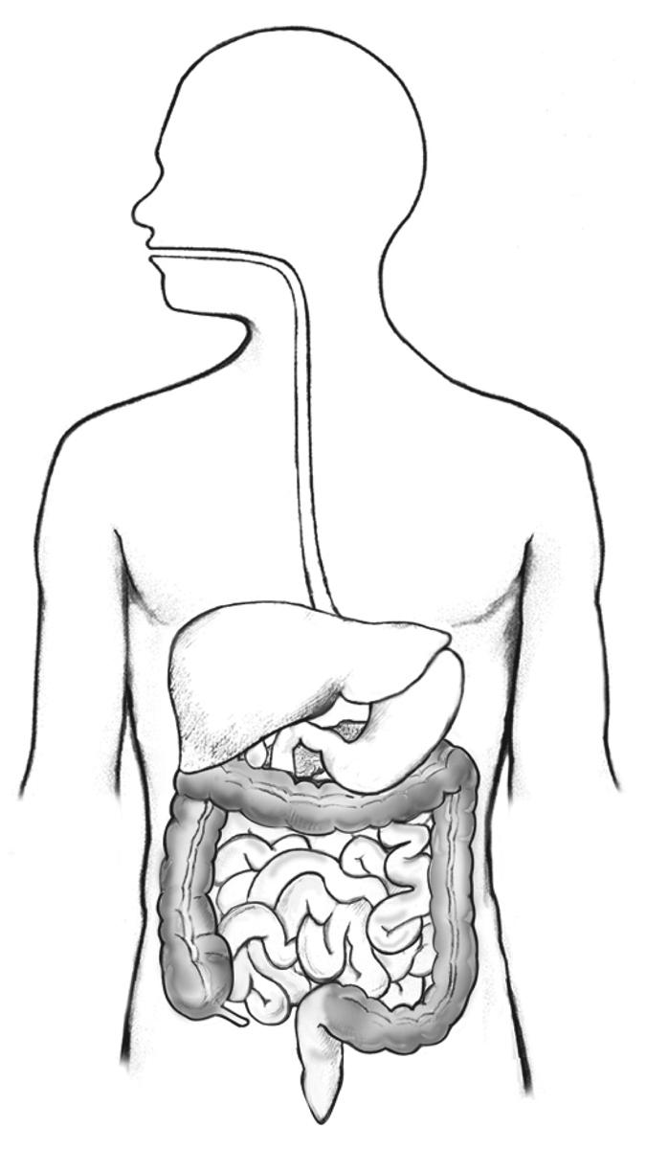
Re-cap: How does energy get from food to cells?

Slide 8
Re-cap: How does energy get from food to cells?
Digested into smaller parts
Absorbed into blood and taken to cells

Slide 9
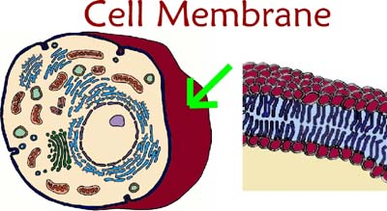
Getting Into the Cell
The Cell Membrane regulates what molecules go into and out of the cell.

Slide 10
Homeostasis
The ability to regulate the internal environment, despite changes in the external environment.

Slide 11
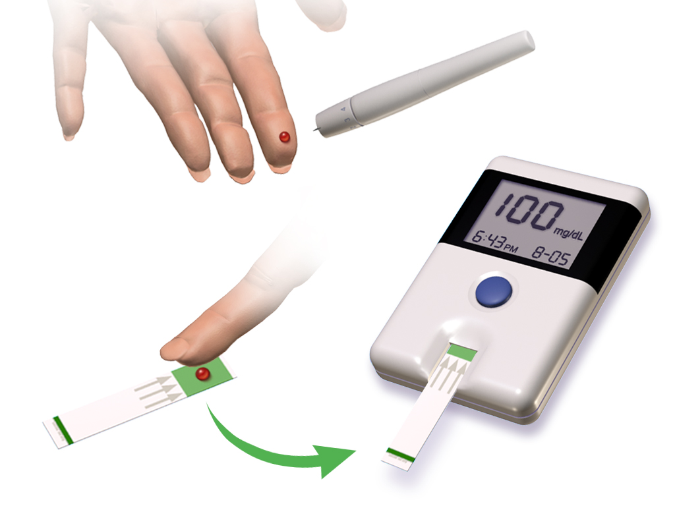
Set-Point
An organism's normal state.
Examples?

Slide 12
Stimulus & Response
Stimulus - an event in the external environment that elicits a response.
Read through the scenarios and identify:
1. The Stimulus
2. The Response
3. How this helps the organism survive through maintaining homeostasis.

Slide 13
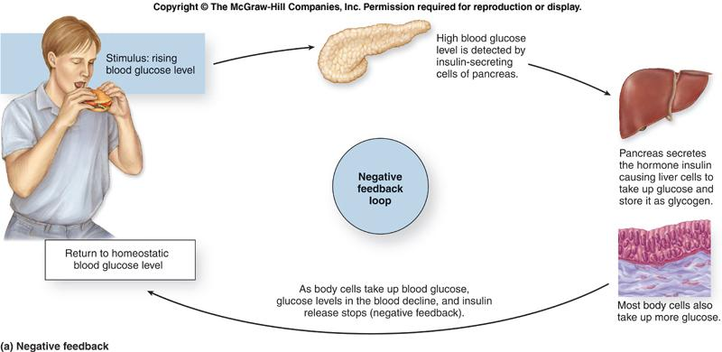
Example of Homeostasis

Slide 14
Exit Ticket 2/27
What is the difference between a stimulus and a response?
How do stimulus and response relate to homeostasis?

