Slide 1
Warm Up: 2/22/17 *Set up your warm up sheet
1. What is the difference between Mechanical and Chemical Digestion?

Slide 2
Finish your coloring
You have 10 minutes to finish your coloring…

Slide 3
Essential Question:
Compare and contrast organs and accessory organs of the digestive system.

Slide 4
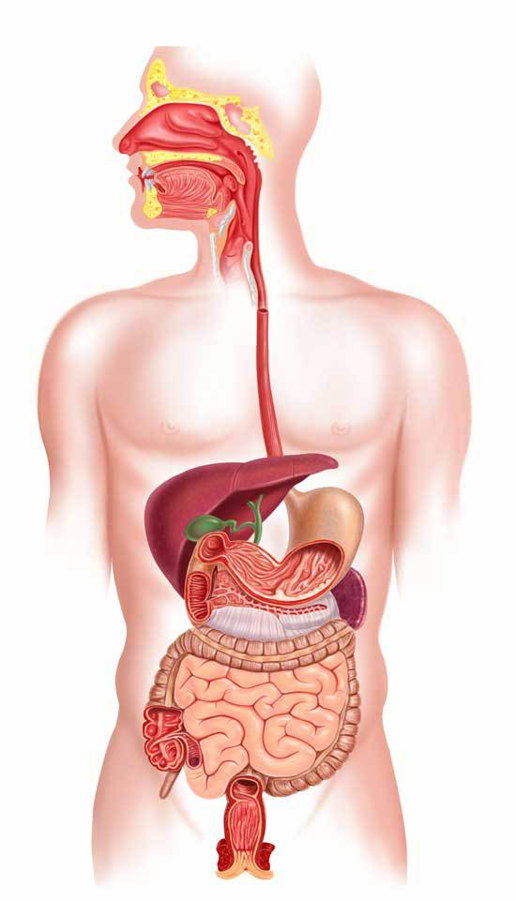
Digestive Organs:
Organs that food directly passes through.
1. Mouth
2. Esophagus
3. Stomach
4. Small Intestine
5. Large Intestine

Slide 5
Accessory Digestive Organs:
Salivary Glands
Organs help with digestion but food does not pass through.
Liver
Gall Bladder
Pancreas

Slide 6
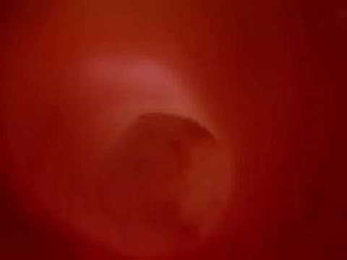
https://www.youtube.com/watch?v=Uzl6M1YlU3w
Journey of Food

Slide 7
You will create a poster based on one of the 9 organs/accessory organs that we have talked about.
You will use: 8.5 x 11 paper
Your classmates will get information from these in a poster walk, make sure to do a good job!

Slide 8
Exit Ticket 2/22: What is difference between an organ and an accessory organ?

