Slide 1
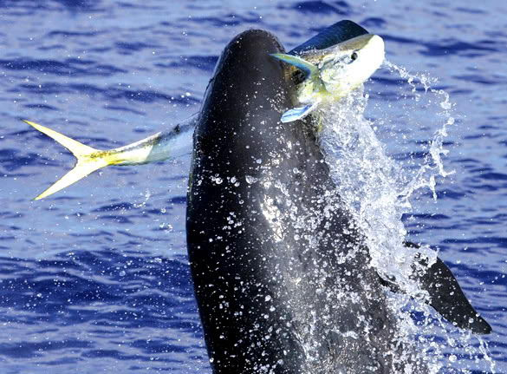
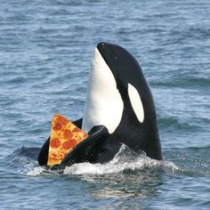
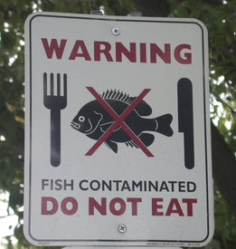
Agenda: 2.21.2017
Warm-Up
Notes: Nutrients vs. Toxins
Observations
Poster
Exit Ticket

Slide 2
Warm Up: 2/21/17
How much energy is transferred from one trophic level to another? (hint: it is a percentage)
What is the relationship between energy and biomass?

Slide 3
Nutrients vs. Toxins
Essential Question:
Describe the relationship between nutrients, toxins, and energy in an ecosystem.

Slide 4
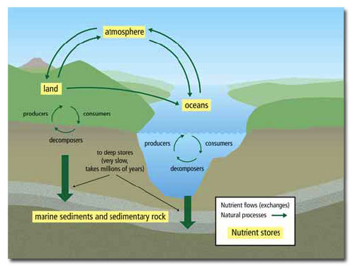
Nutrient Cycling
Nutrients get recycled.
Important Nutrients
Water
Oxygen
Carbon
Nitrogen

Slide 5
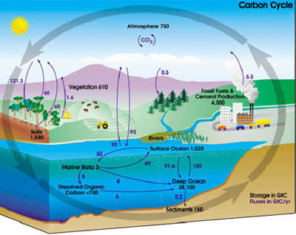

Slide 6
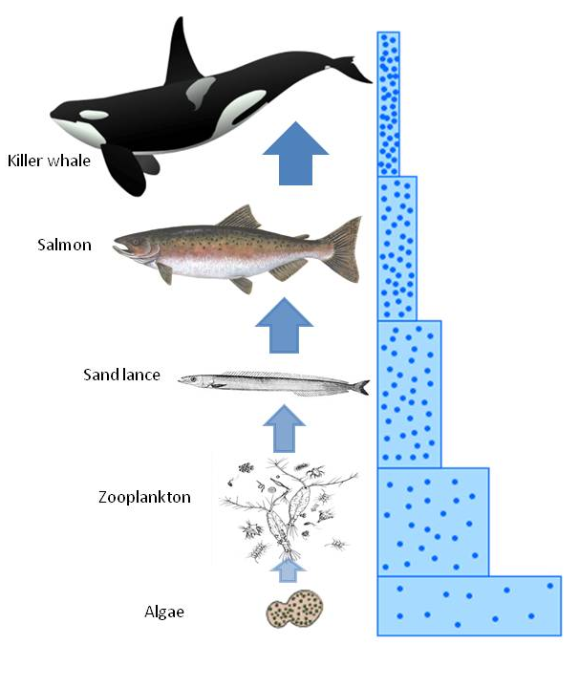
Toxins
Bioaccumulation -
An increase in toxins in the tissues of organisms with each increase in the trophic level.

Slide 7
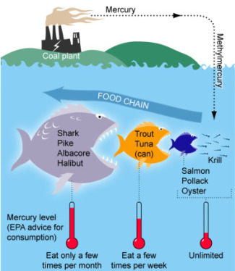
Tuna safety
Methylmercury exposure in the womb can affect a baby's growing brain and nervous system.
Women should watch their Tuna consumption.
http://www.ewg.org/tunacalculator

Slide 8
Summary
Energy FLOWS straight through the system
Nutrients CYCLE through the system
Toxins ACCUMULATE in the system

Slide 9
What you can work :
-Fish Observations
-Terrarium Observations
-Part 4 of Ecosystem Inquiry Packet
-Trophic Pyramid Questions in Ecology Packet
When done with Part 4 and it is checked off by an adult in the room start on your poster for the 2nd half of the paper
Food Web . | Energy and Nutrient Flow Create an energy pyramid and matter cycles chart using the organisms in your terrarium. Include the arrows with labels.

Slide 10
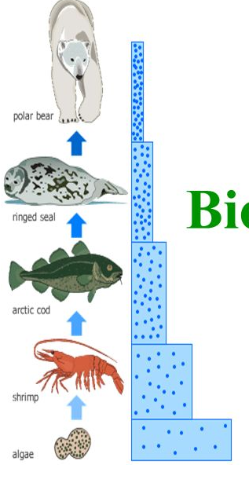
Exit Ticket: 2.21.2017
Look at the food chain
What animal has the highest amount of BIOACCUMULATION? Why?

