Slide 1
Agenda: 2.20.2017
Warm-up
Finish Notes
Ecosystem Inquiry Poster
Please get your folder out of the basket

Slide 2
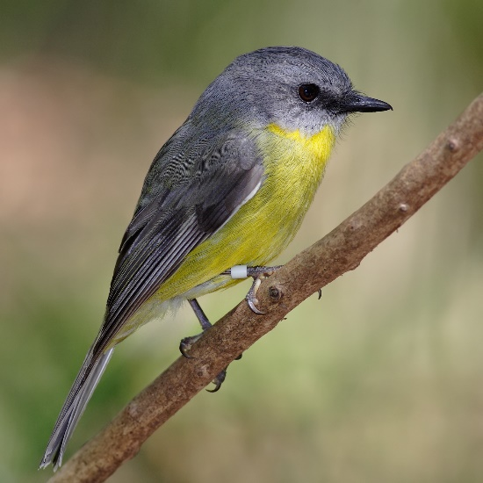
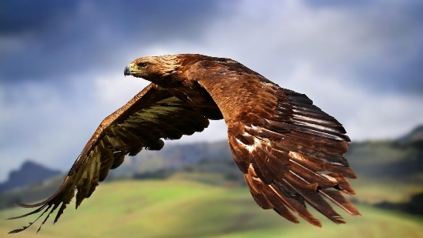
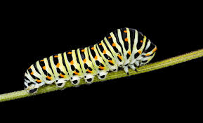
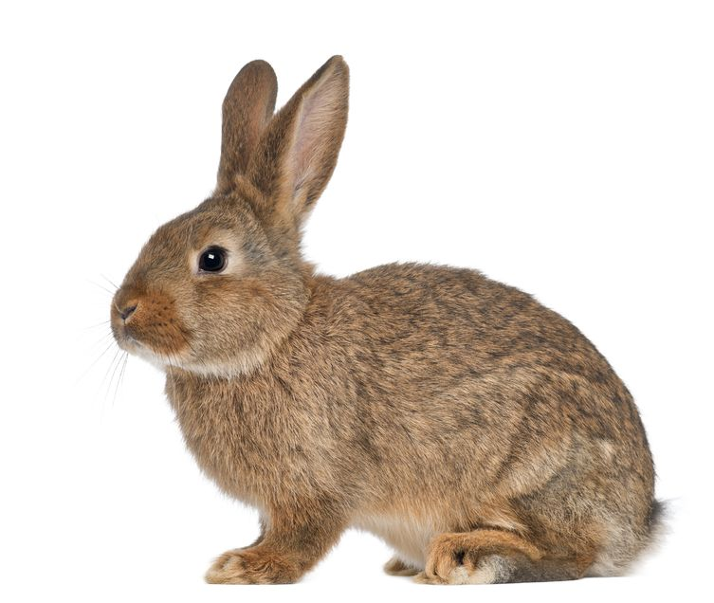
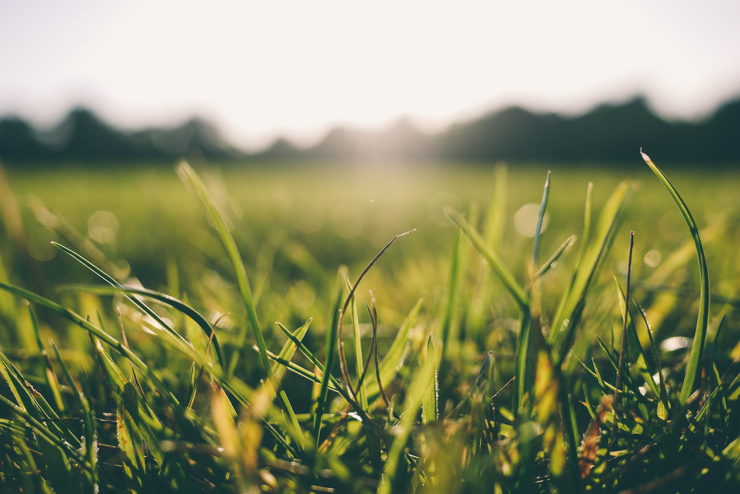
Warm Up 2.20.16 Place the following organisms into a food web. Make sure to include (P), (C1), (C2) etc and that your arrows face the right direction.
Song Bird
Hawk
Caterpillar
Rabbit
Grass

Slide 3
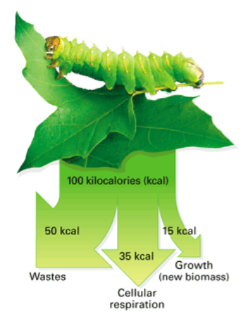
Energy Use
Grass has more energy than something that moves? Why?
Organisms do not store all energy. They burn energy through their own metabolism.

Slide 4
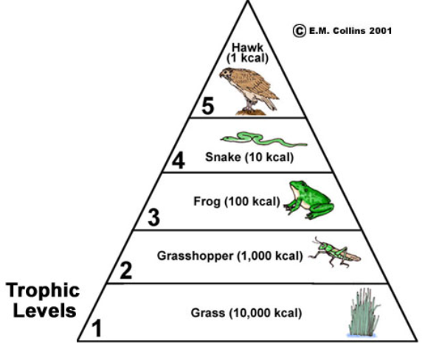
Trophic Levels
A step in the food chain, often shown in the form of a pyramid.
ENERGY
As you move up trophic levels, the energy decreases.

Slide 5
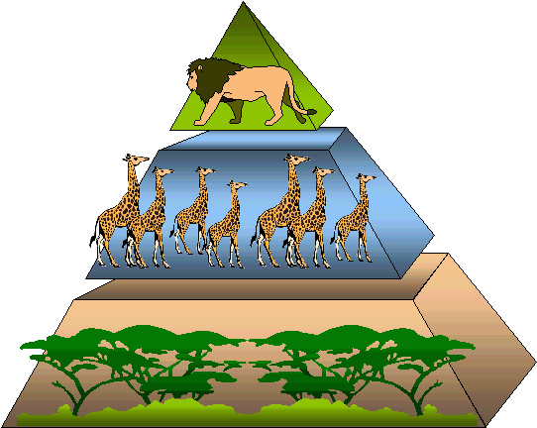
Energy & Biomass
Biomass - the amount of organisms in a population.
Because available energy decreases as you move up, the number of organisms also decreases.
Example:
There are more trees on a
savannah than there are lions

Slide 6
Energy Flows and Matter Cycles
Follow Instructions from Ms. Spencer
Get a red and yellow
pen or color pencil, scissors, glue stick or tape
Trophic Pyramid in Ecology Packet!!

Slide 7
Ecosystem Inquiry: Energy Flow Poster
Complete part 4, this is a draft for your larger poster.
Get part 4 checked by an adult in the room. Then start on the larger paper to complete your poster as set up below:
Food Web On this ½ of the paper create a food web for the organisms in your bottle ecosystem. Include the trophic level (P, C1 etc.) | Energy and Nutrient Flow Trophic Pyramid with your organisms. Make sure to include the arrows of different colors for energy and nutrients.

Slide 8
Exit Ticket 2.20.2017
Draw the food-chain from the warm-up as a trophic pyramid

