Slide 1
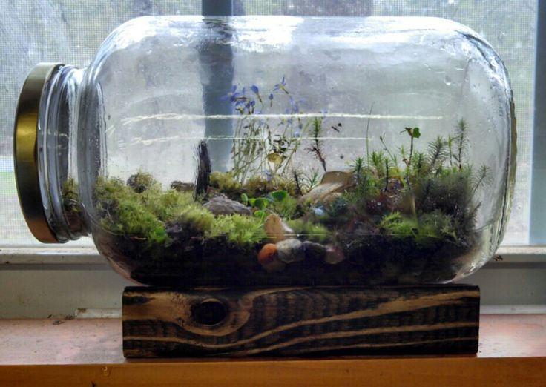
Agenda 2/10/17
Warm-UP
Terrarium Observations
Food Chain Foldable

Slide 2
2/10/17
Compare and contrast a community and a population. (Reference the word wall)
What does your bottle that you set up yesterday represent?

Slide 3
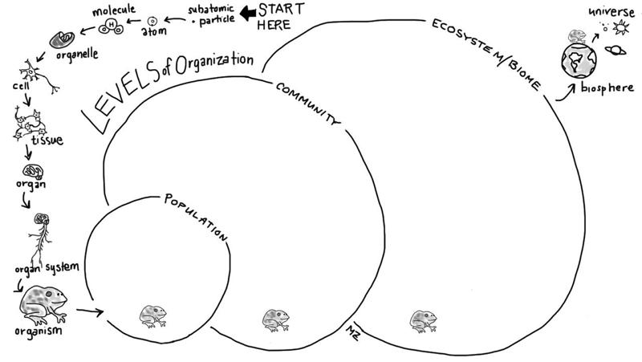
Now, use your frog to create each level.
Fill out the circles with pictures of other frogs that will join your frog in its population.
Include the frog and other animals/ plants/ fungi/ protists/ bacteria in the community,
All of the living & non-living things in the ecosystem.

Slide 4
Gently carry your terrarium back to your desk.
Record observations on the following:
Number of biotic factors that you see.
Record if there is condensation (Yes or No).
Record the temperature (DO NOT LET A CRICKET OUT)
3. Complete Part 1 of your Inquiry Packet (biotic and abiotic factors)
4. Complete Part 2 of your Inquiry Packet (Hypothesis)

Slide 5
In your Science Spiral
Write the definition and draw a picture under the flap

Slide 6
Exit Ticket: 2/10/17
What is the relationship between an Autotroph and a herbivore?

