Slide 1
Warm Up: 2/17/17
*Remember to use your warm up sheet.
Get out Page 81 for check off
Describe the difference between catabolic and anabolic enzymes.
What were your results for part 1 & 2 of your spit lab?

Slide 2
Spit Lab Parts 3 and 4
When you are waiting during part 4 work on the analysis questions for parts 1-3.

Slide 3
Page 81
Lets review the answers together

Slide 4
Study Guide Work Time
Independently and at your assigned seats

Slide 5
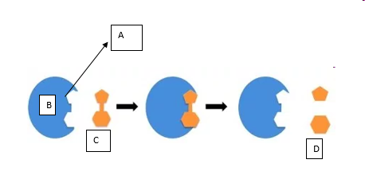
Exit ticket: Label the diagram using the following terms to select from
amylase enzyme
lipid nucleotide
substrate product
active site
temperature
Turn in your warm up sheet for the week when done!

