Slide 1
Agenda: 2.16.2017
Warm-up
Terrarium Observations
Finish Poster
Egg Observations
Open Oceans

Slide 2
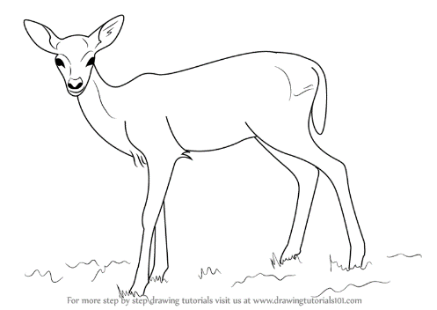
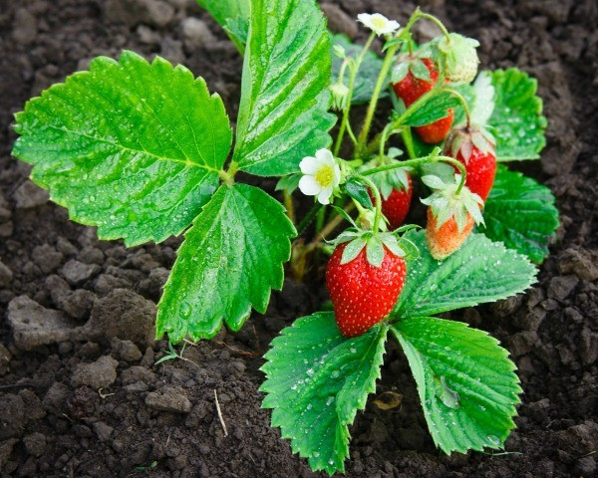
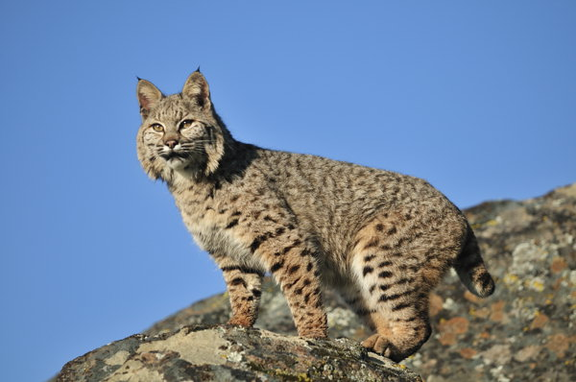
Warm Up 2/16
Draw your own food chain or food web!
Include: Sun
Deer
Strawberry Plant
Bobcat

Slide 3
What you can work on:
Make your 3rd observation in you ecosystem inquiry packet (do not forget to take the temperature!).
Eggs to Fry observations…
3. When done with your observations get out your food web poster from Tuesday. Remember this is based on the ecosystem in your bottle…it must be labeled, in color, with arrows following the energy flow

Slide 4
Ocean World

Slide 5
Exit Ticket
Ocean food web on board.

