Slide 1
Warm Up: 2/15/17
What does denature mean?
What are two things that can denature an enzyme?
*Remember to use your warm up sheet.

Slide 2
Essential Question:
Compare and contrast mechanical and chemical digestion.

Slide 3
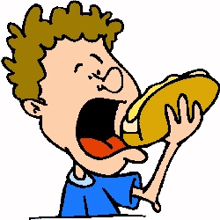
Digestion
Digestion is the breakdown of large molecules into smaller building blocks that can be used by the body.

Slide 4
Mechanical Digestion – Physical breakdown of food into smaller pieces
Chemical Digestion – the chemical breakdown of large molecules by enzymes.
Absorption –digested nutrients are taken up by cells of the digestive system

Slide 5
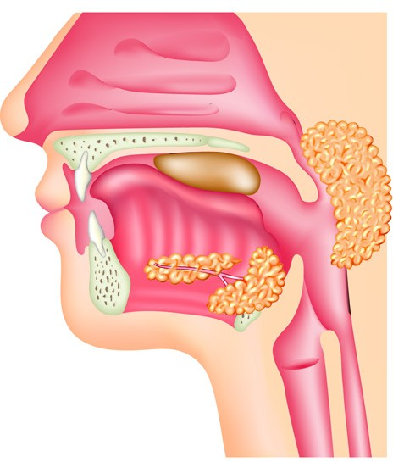
Mouth (M.D. and C.D)
Chewing breaks down food into smaller pieces =increased surface area=allows for easier chemical digestion
Saliva contains the enzyme amylase which breaks down starches into monosaccharides

Slide 6
Read Page 85
Highlight as you go, there will be prelab questions.
What does chemical digestion occur with?
What does mechanical digestion occur with?
Why is your food broken down into the smaller portions?
What are you testing in the lab today?

Slide 7
Read page 86 OUTLOUD
Complete Parts 1 and Part 2 only

Slide 8
Complete Part 1 and 2 of the lab.

Slide 9
Complete page 81 in your lab book
You will have a quiz on Monday 2.20.17 (Yes you have this class, it is an all day)
This will help you prepare.
You will get a study guide next time I see you

Slide 10
Explain how enzymes work. Make sure to use the following vocabulary: enzyme, active site, substrate, activation energy, product, monomer, and macromolecule.
2/15/17 Exit Ticket:

