Slide 1
Warm Up: 2/13/17* Set up your warm up sheet like the example on the board
Explain, in your own words, what is an enzyme?
How does the lock and key model explain how an enzyme works?

Slide 2
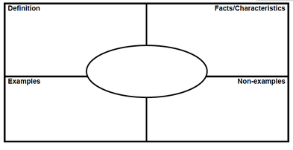
frayer Models

Slide 3
Words for you to use:
Monomer
Polymer

Slide 4
Essential Question
Compare and contrast the two different types of enzymes.

Slide 5
Types of Enzymes
Anabolic
Catabolic
Builds macromolecules
How does our body use these?
Break macromolecules apart into monomers
How does our body use these?

Slide 6
Partner A/B activity:
Use the cutouts to make:
Walk through and work together:
Catabolic lipid enzyme
Anabolic lipid enzyme
Partner A:
Catabolic protein enzyme
Anabolic carbohydrate enzyme
Partner B:
Anabolic protein enzyme
Catabolic carbohydrate enzyme
For each model: explain what is happening!

Slide 7
In Biology when a word ends in –ase it is more than likely it’s an enzyme.
Guess what polymers are broken down by these enzymes and what monomers are created?
Polymer Monomer
Protease ________ ___________
Sucrase ________ ___________
Lipase ________ ___________

Slide 8
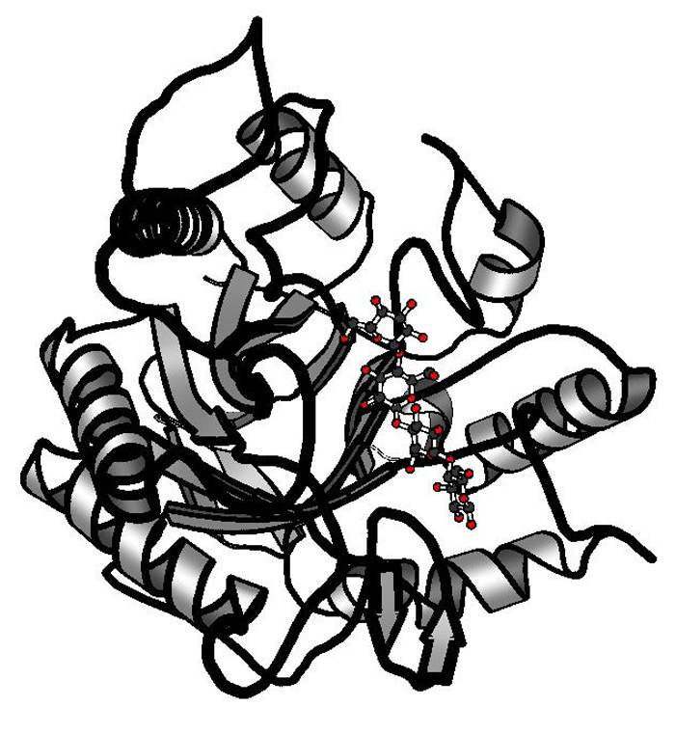
Enzymes are very complex structures whose shapes and functions can be affected by many factors

Slide 9
Review: What factors affect the rate of reaction?

Slide 10
What factors affect enzyme function?
pH
Temperature

Slide 11
Graphing enzyme activity
Optimum
Enzyme activity
Denaturation: enzyme is ruined
Increasing activity
20 30 40 50 60
Temperature (C)

Slide 12
The optimal temperature for this enzyme is __________
Optimum
Enzyme activity
Denaturation: enzyme is ruined
Increasing activity
20 30 40 50 60
Temperature (C)

Slide 13
While the video plays:
List 10 key vocab. terms or concepts.

Slide 15
Share your list with your group
Write a 3-4 sentence summary on the video using your vocab.

Slide 16
Lab part 2 page 84
Helpful Hint:
You need to conduct 3 tests for each sample!
For Example: If you are testing milk for example, you need to conduct 3 tests of milk, benedicts, biurets and iodine.

